Slide 1
Formal hearing training
Notes:
5 mins
Outcomes to be achieved:
learn more about the laws, policies and agreements that work around online formal hearings
learn more about how to represent individual members effectively
make some plans for when you return to work.
Introductions

Slide 2
What is a personal case?
A problem a member has at work, this could be almost any issue that affects them as an individual.
It could be:
With another member of staff
The working terms and conditions
The employer has a problem with them
Someone who is not employed by the same employer but they interact with (public, contractor, etc.)
Sometimes it involves formal procedures and
may have implications for other members.
Notes:
15 mins
Recap of part of Reps 2 as a reminder. Go through the slide and pick out some of the issues that were said on the introductions noting any experiences reps have had to date.
Outcome of session 1 - the session is designed to recap the role and bring out any areas of confusion or concern among delegates.

Slide 3
The member has rights in the workplace
Some of the legal rights are;
To be paid according to contract of employment
Not to be unfairly dismissed (after two years’ service)
Not to be penalised other than through correct use of disciplinary procedure.
Not to be unlawfully discriminated against.
Notes:
Go through the slide emphasise that a rep is there to help a member preserve these rights
The duty of care is in detail next page
Table on the page to give entitlements due to time in service and time limits if make an ET claim.
Reps can refer to and use the information for the future

Slide 4
Prospect’s role in a personal case
To advise and support all members with issues at work.
workplace and other legal assistance is offered at the union’s discretion and is decided on the facts and merits of each case.
We reserve the right not to provide assistance in relation to pre-existing issues. If a non-member asks you for help and you’re not sure how to respond, speak to your branch secretary or your full-time officer
This does not mean you have to agree with them but to see their rights are upheld and the member is treated fairly.
Lay reps (you) make the best-case handlers as they know the working landscape, have a (hopefully good) relationship with the management and invariably know the member.
Prospect tries to resolve all issues as swiftly as
possible and use the legal route if all fails.
Notes:
All employees have rights in the workplace and a member by paying their subs is entitled to assistance from the union to have these rights upheld.
This does not mean you have to agree with them but to see their rights are upheld and the member is treated fairly.
Go through the slide

Slide 5
Code of practice for Prospect reps
Responsibilities
Act honestly, responsibly and with integrity.
Communicate respectfully and honestly.
Treat others with fairness, dignity, and respect.
Encourage the open expression of views at meetings but accept collective responsibility for all decisions and policies once finalised.
Not behave in ways that may cause physical or mental harm or distress to another person, such as verbal abuse, physical abuse, assault, bullying, or discrimination or harassment.
Notes:
Prospect’s duty of care and the reps code of practice. A reminder for all reps of their representation on behalf of Prospect/Bectu. To behave in line with the trade union values.

Slide 6
Code of practice for Prospect reps
In representing Prospect, representatives must:
Only speak or act on behalf of Prospect when authorised to do so and clarify the capacity in which you are speaking.
Always be mindful of their responsibility to maintain and develop Prospect’s ethos and reputation.
Declare any interests that may conflict with their role in Prospect, for example in a professional or political capacity.
Respect confidentiality and ensure GDPR compliance in dealing with any documents, material, or devices containing confidential information.
Not bring Prospect into disrepute, including through the use of email, social and mainstream media and other internet sites.
Notes:
A continuation of the reps’ code of practice as agreed in November 21 by the NEC/Presidential team

Slide 7
Possible arguments in mitigation
A previous good employment record
Lack of information or training
Unclear or unwritten rules
Domestic pressures
Medical reasons
Poor or lack of investigation
Notes:
Key in a hearing – but not a line of defence
Procedures carried out properly as often can be the details that are lacking and will help add weight to your case.

Slide 8
Next steps
Advise the member of your view
What are the merits of the case
Assess the potential for success
How best to proceed
Manage expectation
Informal resolution
Identify appropriate channel contacts to discuss
Decide who will pursue it
Formal process
Identify what stage in the procedure the case is at
Prepare relevant documentation
Remember it is the members’ case not the reps
Notes:
Go through slide, second click adds what a rep is there for.
Important to carry out members wishes, rep is there to offer advice and support.

Slide 9
Hearings: Ground rules
Employer procedures should make the role of union rep clear
To be allowed to accompany the member
  To speak on behalf of the member
  To highlight missing or conflicting evidence
  To be able sum up the case
  Not to answer questions on behalf of the member
You may request an adjournment
  If the member is confused or distressed
  If you hear something that is new to you!
The Employment Relations Act refers to the right to accompany, not the right to represent
Notes:
Reminder of what a rep can do in a formal hearing…..

Slide 10

Activity B:
Pre-planning for hearing
We will break into groups of 2 or 3 and work out a strategy for the upcoming hearing meeting.
Using the planning sheet to get ready for the meeting.
Notes:
25 minutes for activity
Delegates to go over most valid points to be raised.
Break into groups of 2 (tutor may have to play a member if uneven number) and work out a strategy for the upcoming hearing meeting. One each can play the rep/ Alex(member)
Remind everyone that it is the member’s case, so those playing the member have the final say.
Using the planning sheet to get ready for the meeting.
Make sure they have worked out the following:
What is your plan for the hearing?
Who is saying what at the hearing?
What is your acceptable outcome?
How they are going to talk to each other at the online meeting

Slide 11
Feedback from Activity B
What is your plan for the hearing?
Who is saying what at the hearing?
What is your acceptable outcome?
How are the rep and the member going to speak to each other at the online meeting?
Notes:
15 mins for feedback.
Were procedures right? No, the following needs to be found out…..
None or poor investigation
No evidence presented about attendance, in the first sentence of the letter states members of management were abused? Witness statements?
It states in the procedure that an accompanying rep IS allowed to speak
Meeting time is inconvenient and the procedure allows it to be changed
Time between incident and process is very long
Are there any mitigating circumstances?
Yes, medical problems, sick noted, side effects of medication.
Home life disrupted and dependents to be looked after and every effort made by using neighbours to get into work.
Request for flexible working ignored
Behaviour and action of management;
Poor
Skeptical of stress/illness
Pre judged prior to meeting
Possibly bullying, (if a counter grievance is raised by the member, it stops the disciplinary process until the grievance is heard. )
Main learning outcomes; ensuring correct procedures but can’t rely on the employer.
The procedures were not followed by management and was so badly handled that it is unfair and should be thrown out.
Reference to Talon Engineering v Smith case (knobhead). The management may just go ‘so what’ and carry on with the disciplinary action anyway. Reps need to be reminded they still have to prepare the member and the caser as it will still go ahead.
Good case study for reps to be mindful of as it highlights the significance of procedure.

Slide 12
Hearings Online
Accessibility, it should not disadvantage the employee
How to communicate with member
Don’t lose control – be polite but interrupt if managers repeatedly ignoring hand up.
Recording
Privacy
Notes:
ACAS 4 slides 10 minutes to go over.
If processes can be delayed until face to face is possible then they should – but you may have to adapt to an online hearing. However if accessibility is an issue you have a good case to delay until a covid safe face to face is possible. This could be due to a disability or even if member has no access to appropriate equipment – not good for example, if they can only use a phone to access the meeting.
Think about how to manage a hearing like this via zoom. What to watch out for? How do they communicate with each other if they need an adjournment?
How do you pre-meet? How will you communicate if you want member to stop? Cant nudge/kick under the table. May need a WhatsApp group for private messaging between each other. Can they use a breakout room – is it secure?
How will you interrupt and take control of the meeting. Raising a hand – what if they ignore you. Are you all muted – can you interrupt.
Recording – is this agreed? If not, they should ask. Prospect position is that meeting should not be recorded. It is sometimes not to the benefit of members to record everything – a note taker can ignore clearly stressful scenarios.
Member needs to be alone – confidential meeting. Some members may be tempted to have a family member listen in or covertly record. This is fraught with problems and must be strongly discouraged.

Slide 13
The employer should:
explain the employee’s alleged misconduct or performance issue
explain that if the allegations are proven then this may result in a final written warning or even dismissal
go through the evidence
make sure someone takes notes
Notes:
If processes can be delayed until face to face is possible then they should – but you may have to adapt to an online hearing. However if accessibility is an issue you have a good case to delay until a covid safe face to face is possible. This could be due to a disability or even if member has no access to appropriate equipment – not good for example, if they can only use a phone to access the meeting.
Think about how to manage a hearing like this via zoom. What to watch out for? How do they communicate with each other if they need an adjournment?
How do you pre-meet? How will you communicate if you want member to stop? Cant nudge/kick under the table. May need a WhatsApp group for private messaging between each other. Can they use a breakout room – is it secure?
How will you interrupt and take control of the meeting. Raising a hand – what if they ignore you. Are you all muted – can you interrupt.
Recording – is this agreed? If not, they should ask. Prospect position is that meeting should not be recorded. It is sometimes not to the benefit of members to record everything – a note taker can ignore clearly stressful scenarios.
Member needs to be alone – confidential meeting. Some members may be tempted to have a family member listen in or covertly record. This is fraught with problems and must be strongly discouraged.

Slide 14
The employee should be given the chance to:
set out their case
answer any allegations
ask questions
show evidence
call relevant witnesses (with good notice)
respond to any information given by witnesses
choose if their companion can speak for them at the hearing
Notes:
If processes can be delayed until face to face is possible then they should – but you may have to adapt to an online hearing. However if accessibility is an issue you have a good case to delay until a covid safe face to face is possible. This could be due to a disability or even if member has no access to appropriate equipment – not good for example, if they can only use a phone to access the meeting.
Think about how to manage a hearing like this via zoom. What to watch out for? How do they communicate with each other if they need an adjournment?
How do you pre-meet? How will you communicate if you want member to stop? Can’t nudge/kick under the table. May need a WhatsApp group for private messaging between each other. Can they use a breakout room – is it secure?
How will you interrupt and take control of the meeting. Raising a hand – what if they ignore you. Are you all muted – can you interrupt.
Recording – is this agreed? If not, they should ask. Prospect position is that meeting should not be recorded. It is sometimes not to the benefit of members to record everything – a note taker can ignore clearly stressful scenarios.
Member needs to be alone – confidential meeting. Some members may be tempted to have a family member listen in or covertly record. This is fraught with problems and must be strongly discouraged.

Slide 15
The employee’s companion should be allowed to:
set out the employee’s case
respond for the employee to any comments or points made at the meeting
talk with the employee during the hearing
take notes
sum up the employee’s case at the end of the hearing
Notes:
If processes can be delayed until face to face is possible then they should – but you may have to adapt to an online hearing. However if accessibility is an issue you have a good case to delay until a covid safe face to face is possible. This could be due to a disability or even if member has no access to appropriate equipment – not good for example, if they can only use a phone to access the meeting.
Think about how to manage a hearing like this via zoom. What to watch out for? How do they communicate with each other if they need an adjournment?
How do you pre-meet? How will you communicate if you want member to stop? Can’t nudge/kick under the table. May need a WhatsApp group for private messaging between each other. Can they use a breakout room – is it secure?
How will you interrupt and take control of the meeting. Raising a hand – what if they ignore you. Are you all muted – can you interrupt.
Recording – is this agreed? If not, they should ask. Prospect position is that meeting should not be recorded. It is sometimes not to the benefit of members to record everything – a note taker can ignore clearly stressful scenarios.
Member needs to be alone – confidential meeting. Some members may be tempted to have a family member listen in or covertly record. This is fraught with problems and must be strongly discouraged.

Slide 16
Activity C:
The disciplinary hearing
We will practice accompanying the rep to an online hearing using role play. In pairs one will play the rep and the member. The management and HR will be played by the tutors. The hearing will be run twice in order for both groups to experience. We will then discuss as a group the outcome of the hearing and reflect on whether it could have gone better.
Notes:
10 mins
Activity C; Introduction into how this activity will work
For the purposes of the hearings, the tutors will play the role of the HR director and Alex’s manager, Ian Black. (use the script provided for ease.)
The hearing role plays should be run consecutively giving the other group a chance to observe and give feedback.
Tutor facilitated feedback
Tutor1 play role of Line Manager
Tutor2 to play role of HR director
30 minutes now allowed for the role play for both groups

Slide 17
Feedback from Activity C
Did the hearing go to plan?
What would you have done differently?
What is the outcome acceptable?
Notes:
10 minutes allowed for both sets of feedback from the hearing.
Were procedure right? No, the following needs to be found out…..
None or poor investigation
No evidence presented about attendance, in the first sentence of the letter states members of management were abused? Witness statements?
It states in the procedure that an accompanying rep IS allowed to speak
Meeting time is inconvenient and the procedure allows it to be changed
Time between incident and process is very long
Are there any mitigating circumstances?
Yes, medical problems, sick noted, side effects of medication.
Home life disrupted and dependents to be looked after and every effort made by using neighbours to get into work.
Request for flexible working ignored
Behaviour and action of management;
Poor
Skeptical of stress/illness
Pre judged prior to meeting
Possibly bullying, (if a counter grievance is raised by the member, it stops the disciplinary process until the grievance is heard. )
Main learning outcomes; ensuring correct procedures but can’t rely on the employer.
The procedures were not followed by management and was so badly handled that it is unfair and should be thrown out.
Reference to Talon Engineering v Smith case (knobhead). The management may just go ‘so what’ and carry on with the disciplinary action anyway. Reps need to be reminded they still have to prepare the member and the caser as it will still go ahead.
Good case study for reps to be mindful of as it highlights the significance of procedure.

Slide 18
Putting what you’ve learnt into practice
Spend a few minutes thinking about what you would like to do when you get back to your workplace and what you need to achieve this.
Task
Find out about your GDPR requirements and which resources you’ll have access to as a case handler.
Do you feel ready to take on your first case? Y / N If not, what else can we do to support you?
Ensure you’re familiar with the grievance/disciplinary procedures of your workplace. Do you have access to/know where to find your workplace policies? Y / N Are you able to be present in investigation meetings? Y / N
After attending this course, what will you stop doing?
After attending this course, what will you continue to do?
Based on your new knowledge, what will you start to do?
Notes:
10 mins to sum up and go through last two slides and any questions
Action plan – reps to fill out to ensure they know/have access everything they need to get started. What else would help?

Slide 19
And finally
I hope this training as been useful for you?
Don’t forget the following:
You will always be nervous when you start to represent members with their personal issues, just do your best
If you are not sure ask a more experienced rep or a full-time officer that is what they are there for
Your role as the rep is to ensure fairness is upheld in the workplace and policies are adhered to.
If you reach an agreement with a manager in a meeting
back it up in writing. An example of the wording would be:
  Thank you for meeting me today
  and just to clarify the following course
  of action was agreed.
Notes:
Go over learning outcomes form the day before – all covered?
Useful links going forward and the appendix pages
Mention about further training on offer (employment law if people wish)
Take a case asap to keep the skills up to date and don’t fall into bad habits (or what other case handlers do)
Have confidence in your own abilities and don’t forget the support is there.

Slide 20
Questions?

Slide 21
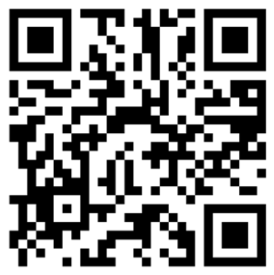
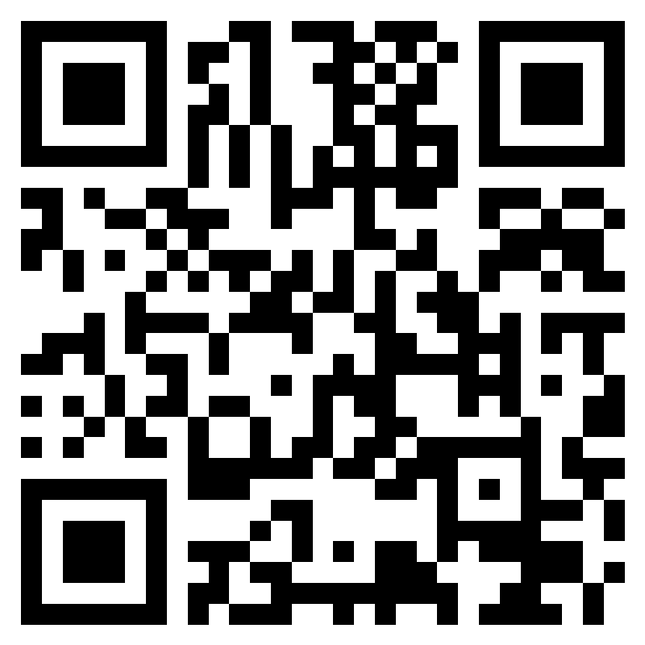
Evaluation & EDI
https://forms.office.com/e/5FCnzqRaMj
https://forms.office.com/e/
ZQmRFJYa6i?origin=lprLink
Notes:
On teams where no polls are set up – use these links/QR codes for the evaluations & EDI
If reps click on the link and then they’ll get the option to open the link and this will take them through to the form.

