Slide 1
Bargaining for a mentally healthy workplace
Class one

Slide 2
Course aims and learning outcomes
Knowledge of mental health and stress and how it is linked to wider social determinants of health
Knowledge of the law – the Equality Act and health and safety law -- and understanding of how it can support colleagues with mental health conditions
Understanding of best practice approaches to holistic mental health and wellbeing workplace programmes, focusing on workplace policies and organisational stress risk assessments,
Knowledge and confidence in raising awareness of mental health in the workplace and taking a collective bargaining approach to
improving employer practices

Slide 3
Course structure
Class one
Introduction to the course
What is mental health? What is stress?
Rates of work-related stress, depression and anxiety
The Health and Safety at Work Act, the Management Standards and stress risk assessment
Class two
The Management Standards and stress risk assessment, continued
The Equality Act
Reasonable adjustments
Mental health policies
Organising for mental health

Slide 4
A few ground rules
We will be talking about very delicate situations, which may bring out strong views in people, so we need to be:
tolerant
accepting
give everyone time to express their view by not butting in or talking over each other
listening is the first step to understanding

Slide 5
Activity: introductions
Task
Work with another person to find out some basic information about their workplace and union experience:
name
job and employer
role in the union
why they’ve come on the course
any mental health activities/achievements at
work so far
what they want to get out of the course.

Slide 6

What is mental health?
“A state of well-being in which every individual realises his or her own
potential, can cope with the normal stresses of life, can work productively and fruitfully, and is able to make a contribution to her or his community.”

Slide 7



What is stress?
Pressure

Slide 8
“Mental injury”
Should stress be conceptualised differently?
A physical injury is damage or harm to the body caused by external force
Stress can therefore be thought of as a mental injury – damage or harm caused by an external force
Removes any notion of individual susceptibility, which has no basis in research

Slide 9
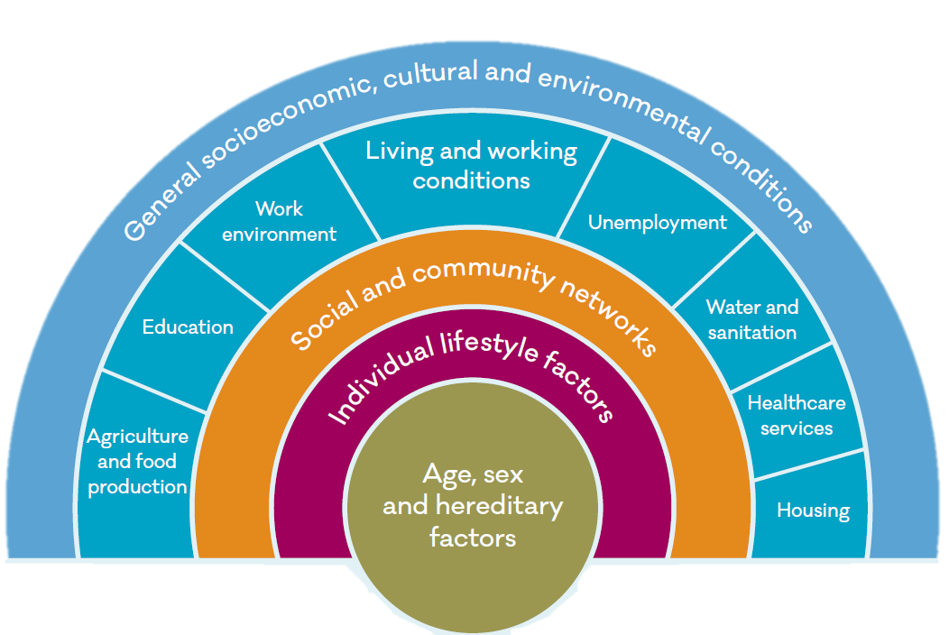
Determinants of mental health
Source: Dahlgren, G. and Whitehead, M. (1993) Tackling inequalities in health: what can we learn from what has been tried?

Slide 10
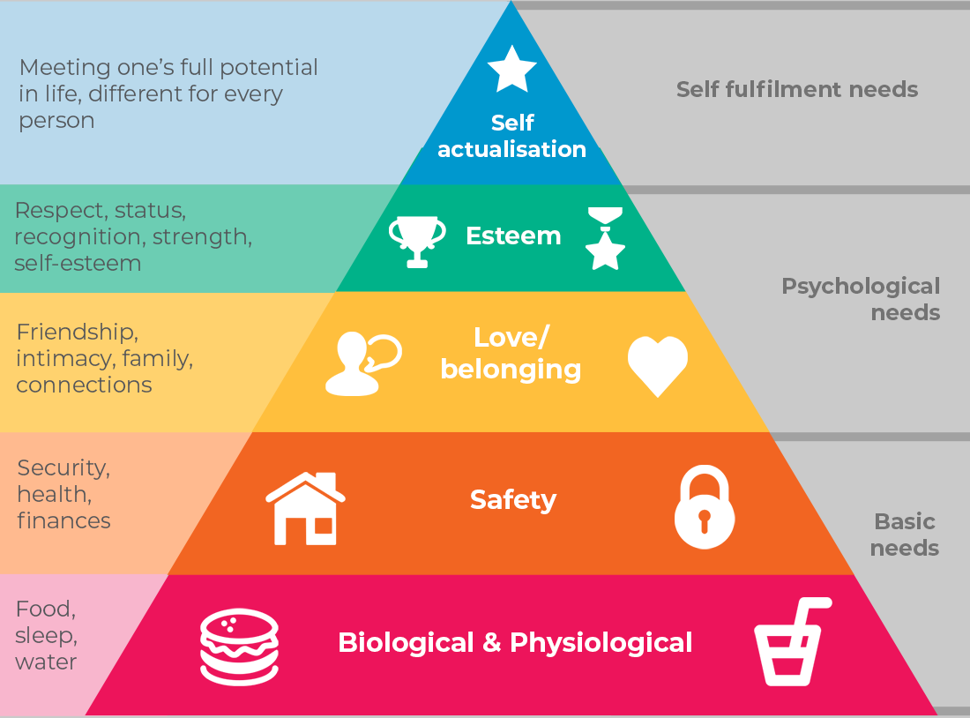
Hierarchy of needs

Slide 11
Rates of work-related stress, depression or anxiety

Slide 12
Stress-related sickness
absence

Slide 13
Activity: mental health conditions
As a group:
identify the different types of mental health conditions you are aware of
Consider what the impact of having these conditions could be in the workplace. What issues may arise for the members affected?
The tutor will lead a discussion around the topic.

Slide 14



The law
Two main laws must shape an employer’s response to stress/mental health at work:
Health and Safety at Work etc Act 1974 (and subordinate regulations)
Equality Act 2010

Slide 15
Health and Safety at Work Act
Main general duties:
“It shall be the duty of every employer to ensure, so far as is reasonably practicable, the health, safety and welfare at work of all his employees”.
“It shall be the duty of every employer to conduct his undertaking in such a way as to ensure, so far as is reasonably practicable, that persons not in his employment … are not exposed to risks to their health
or safety.”
Main general duties:
“It shall be the duty of every employer to ensure, so far as is reasonably practicable, the health, safety and welfare at work of all his employees”.
“It shall be the duty of every employer to conduct his undertaking in such a way as to ensure, so far as is reasonably practicable, that persons not in his employment … are not exposed to risks to their health
or safety.”

Slide 16

Reasonably practicable
Duty is only discharged if the risk is insignificant compared with the sacrifice
Individual employers’ ability to afford a control measure is not a legitimate factor in assessment of sacrifice
Money,
time or trouble
Risk

Slide 17
Activity: what is reasonably practicable?
In pairs:
Read the scenario
Evaluate:
  Has the employer done all that is reasonably practicable to protect staff?
  Could the employer introduce better measures in the circumstances?
  How could you use the principle of reducing risk to the lowest level reasonably practicable to argue for better protections?
Choose a spokesperson to report back to the group

Slide 18

Risk assessment
Employers have a duty to protect employees from stress by doing a risk assessment
The Management of Health and Safety at Work Regulations require employers to assess risks employees are exposed to, with aim of removing or minimising them

Slide 19
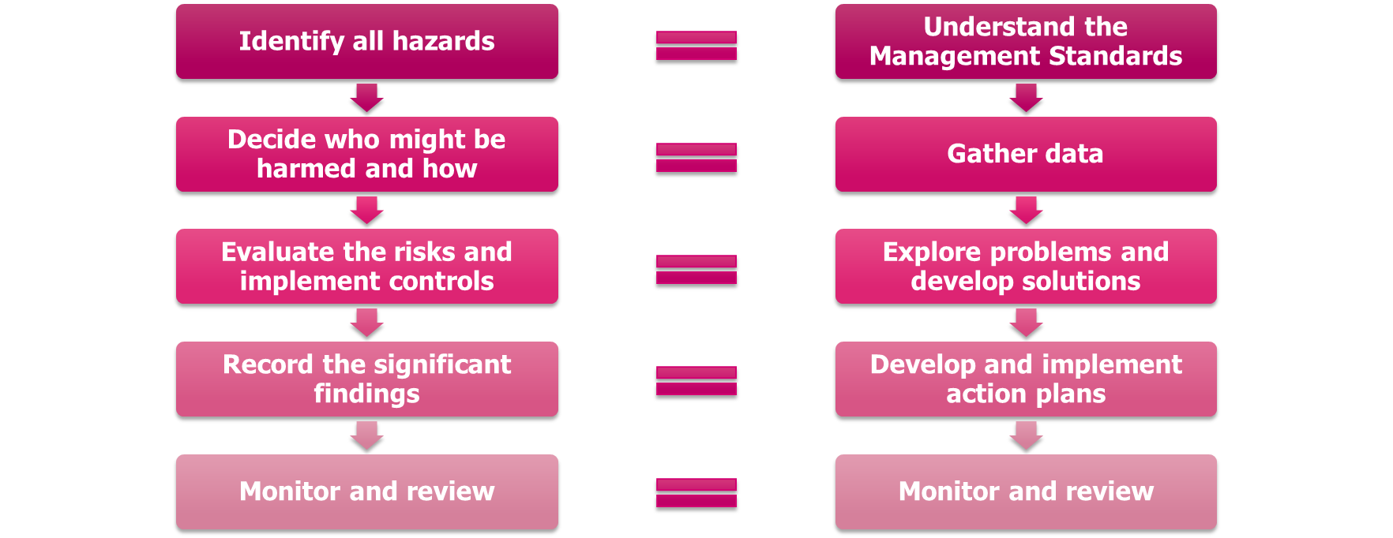
Five steps to risk assessment

Slide 20
The Management Standards
Demands – workload, work patterns and work environment
Control – how much say a person has in the way they do their work
Support – encouragement, sponsorship and resources provided by employer, line manager and colleagues
Relationships – positive working to avoid conflict and dealing with unacceptable behaviour
Role – whether people understand their role and do not
have conflicting roles
Change – how organisational change (large
or small) is managed and communicated
Understand the Management Standards
Gather data
Explore problems and develop solutions
Develop and implement action plans
Monitor and review

Slide 21

Demands standard
“Employees indicate they are able to cope with the demands of their jobs”

Slide 22

Control standard
“Employees indicate they are able to have a say about the way they do their work”

Slide 23

Support standard
“Employees indicate they receive adequate information and support from their colleagues and superiors”

Slide 24

Relationships standard
“Employees indicate they are not subjected to unacceptable behaviours, eg bullying”

Slide 25

Role standard
“Employees indicate that they understand their role and responsibilities”

Slide 26

Change standard
“Employees indicate that the organisation engages them frequently when undergoing an organisational change”

Slide 27
What data can we gather?
Sickness absence data – how much is stress-related?
Employee wellbeing survey – full data set
Productivity data – lower in one part of the organisation?
Staff turnover – higher in one part of the business?
Accidents – do investigations cite fatigue, stress, distraction as contributing factors?
Occupational health or employee assistance programme data – how many referrals?
The HSE Management Standards “indictor tool”
Understand the Management Standards
Gather data
Explore problems and develop solutions
Develop and implement action plans
Monitor and review

Slide 28
Explore problems and develop solutions – focus groups
Look at the methods used to explore data and develop solutions:
Who participated – was it representative?
What data was used/discussed?
Is the record accurate and does it reflect the issues discussed?
Have locally relevant, reasonably practicable solutions been generated?
Were all employees informed about developing solutions and given the chance to contribute to discussions/identify problems and solutions?
Are most of the interventions preventative and linked to the issues identified in step two?
Understand the Management Standards
Gather data
Explore problems and develop solutions
Develop and implement action plans
Monitor and review

Slide 29
Develop and implement
action plans
What to look for and encourage
Are there formal “signed off” action plans generated by workers and management together, agreed/signed off at board level and agreed by the union?
Are actions:
  aimed at different levels of the organisation
  (strategic, macro or micro) relevant to the issues identified?
  SMART? It is important for organisations to identify what success looks like.
  adequately resourced?
Have the action plans have been communicated to all relevant staff?
Understand the Management Standards
Gather data
Explore problems and develop solutions
Develop and implement action plans
Monitor and review

Slide 30
Monitor and review
What to look for and encourage
Evidence of carrying out agreed actions in line with timescales in the plans.
Recording progress against action plans and looking at the effectiveness of solutions, modifying as necessary.
Have assessed if any further data is needed and have plans in place to monitor any data collected.
Plans are in place to review the risk assessment and update it when necessary.
Understand the Management Standards
Gather data
Explore problems and develop solutions
Develop and implement action plans
Monitor and review

Slide 31
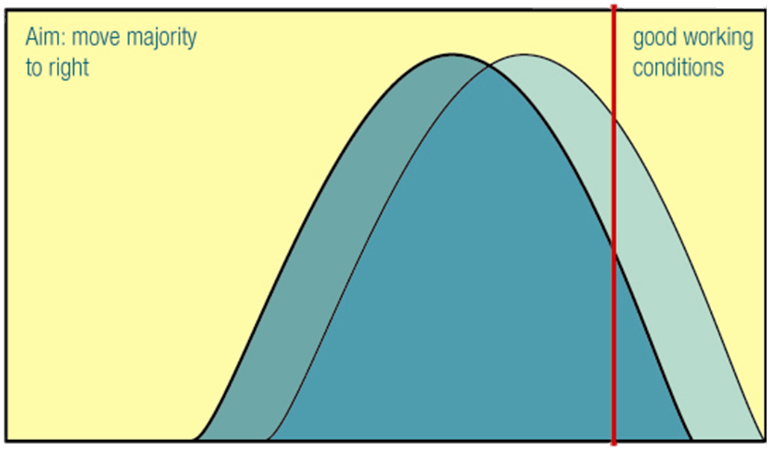
The aim…
Employees
Stress risk

Slide 32
Activity: homeworker stressors
Task
As a class, discuss the stressors which home workers may experience.
The tutor will then lead a discussion about how these relate the to the Management Standards.

Slide 33
Homework: organisational stress risk assessment
Task – part one
Read through the case study
Using the Management Standards, identify four stressors faced by the group of workers
Using information contained on pages 14 to 15 of the course workbook, identify possible measures to reduce the risk posed by each of the stressors
Make clear but brief notes on your findings in an electronic document
Part two
Obtain a copy of your employer’s mental health policy
and read it

Slide 34
Bargaining for a mentally healthy workplace
Class two

Slide 35
Today’s class
Discussion of homework
The Management Standards and stress risk assessment, continued
The Equality Act
Reasonable adjustments
Mental health policies
Organising for mental health

Slide 36
Activity: organisational stress risk assessment, part two
In your groups, work through all group members’ responses to the homework activity – aim to get through as many as possible in the allotted time.
Reflect and evaluate how you would negotiate with the employer for these measures to be implemented. For example, among other things consider:
How will the employer respond to the proposals?
How easy will they be to implement?
Who on the employer side will need to implement them?
How will you raise the issue with the employer – with an individual or in a committee?
Does your branch need to take a view on the measures? Are there any policy implications?
Who will need to get involved from your branch?
Nominate a spokesperson to report back to the group

Slide 37
A holistic approach to
mental health at work
Primary | Secondary | Tertiary
Modifies or eliminates stressors, targeting problem at source. Deals with aspects of work design, the organisation and management. | Intervention that tends to help individuals manage stress without trying to eliminate or modify stressors. | Intervention that helps individuals who are experiencing on-going mental health problems emanating from the organisation, their job or outside factors.
Reduce or eliminate causative risk factors (risk reduction). | Early identification and treatment. Coping techniques. | Stop the condition from getting worse and help people return to health.
Risk assessment, provision of appropriate resources, tackling bullying, reducing workload etc | Training, provision of information, mental health first aiders | Provision of counselling, employee assistance programme, reasonable adjustments

Slide 38
Equality Act
The Equality Act legally protects people with certain characteristics from discrimination in the workplace and in wider society – this includes disability
For many, mental health problems will be a disability under the Act. A person is considered disabled if:
Have a physical or mental impairment, including the effects or symptoms of any illness and the side effects of medication
The impairment is long-term – it has lasted or is likely to last for at least 12 months.
The impairment has a substantial adverse effect on their ability to carry out normal day-to-day activities

Slide 39
Reasonable adjustments
Employers must make reasonable adjustments to ensure workers with disabilities, or physical or mental health conditions, are not substantially disadvantaged when doing their jobs
Any adjustment must remedy the disadvantage the person faces
An individual does not have to be diagnosed – the duty applies when the employer is aware or should reasonably be aware that an employee has an impairment

Slide 40
What is reasonable?
What’s “reasonable” will depend on each situation. The employer needs to consider carefully if the adjustment:
will remove or reduce the disadvantage for the person with the disability
is practical to make
is affordable by the employer
could harm the health and safety of others
The employer must make the changes if they're reasonable – a failure to make reasonable adjustments is unlawful
discrimination

Slide 41
What sources of information for reasonable adjustments?
the individual
the individual’s GP, e.g. through the Fit for Work Statement (‘Fit Note’)
any specialist mental health support the individual may be receiving, e.g. a community psychiatric nurse (CPN) or consultant psychiatrist
occupational health services
union reps, who may have examples from other members or workplaces.

Slide 42
Activity: Workplace policies and practices
Task
In pairs, compare and discuss your employers’ policies. Discuss and answer the following questions:
Does the policy cover all areas you believe are necessary? What areas should it cover?
ls this policy a reflection of what actually happens, in practice, in the workplace? Identify any improvements needed.
If your employer does not have a mental health policy, are there any plans to develop such a policy?
What other workplace policies/procedures cover mental health?
Which policy, if either, is the strongest and why?
Report back
Prepare a report for the group. Elect a spokesperson to share your report.
Tutor to lead a discussion around what topics a mental health policy
should contain

Slide 43
What should a mental health policy contain?
The employer’s commitment to promoting and protecting employee’s mental health
A definition of mental health
A commitment to, and methods for, promoting awareness of mental health and tackling stigma
Roles and responsibilities of the people in the organisation, including:
  line managers
  human resources
  occupational health
  employees
  union reps
  The practical arrangements in place to achieve the statement of intent, including:
  the presence and maintenance of a stress risk assessment and action plan;
  reasonable adjustments for current workers and during recruitment and selection; and
  methods for monitoring employee mental health at an organisational level.
A list of key internal and external sources of information, support and advice
A commitment to provide training
Methods used to monitor effectiveness of the policy, and a commitment to keep the policy under review
Information regarding recruitment and selection
Links to related policies, such as health and safety, sickness absence and drugs and alcohol

Slide 44
Activity: Raising the profile of mental health in the workplace
Task
In small groups, develop a plan to raise the profile of mental health and raise awareness at work.
You may wish to consider ways in which you can progress mental health with your employer, identify negotiating and campaigning opportunities, different methods for raising awareness in the workplace, policy development etc. Consider who you will work with and how you will involve your members, other reps and your branch.
Identify the benefits of having a workplace which has a positive approach to mental health and wellbeing, for colleagues, the employer and the union.
Report back
Elect a spokesperson, to share your plan with the rest of the group.

Slide 45
Thank you

