Slide 1
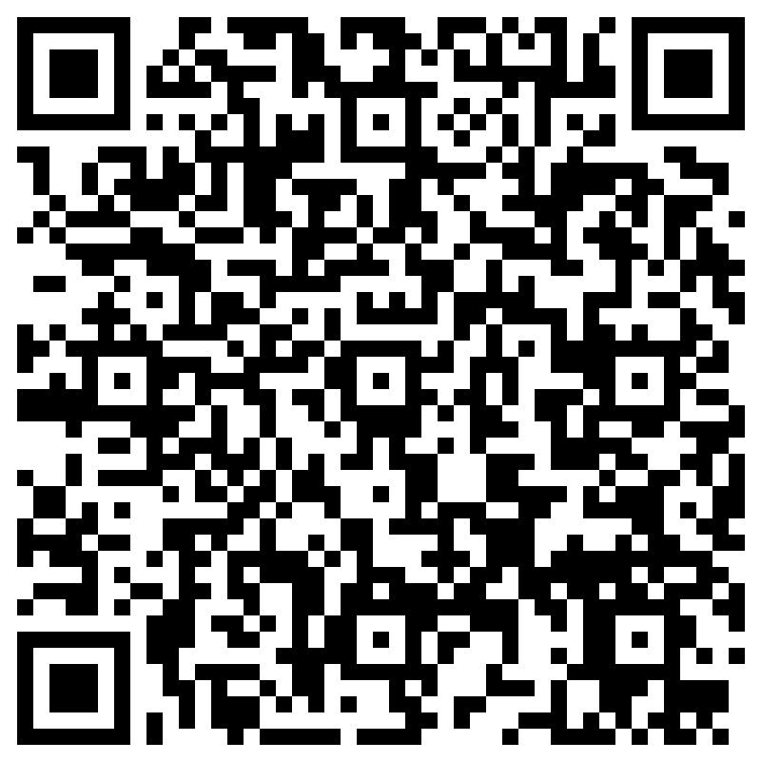
Evaluation
Evaluation form 2026
Notes:
On teams where no polls are set up – use these links/QR codes for the evaluations & EDI
If reps click on the link and then they’ll get the option to open the link and this will take them through to the form.

