Slide 1


Slide 2
Effective campaigning for union reps
Notes:
At the start of the course before starting on the presentation proper:
If this is an online course, highlight the parts of Zoom/MS Teams they need e.g. raise hand, chat etc. Explain that you will be using break out room (if you are) and that they don’t need to do anything as you control it. Worth pointing out that if they get kicked out they simply need to join via the original link.
introduce the course aims (Workbook Page 2).
Highlight that this course will give them the framework to hang any campaign on, now or in the future, and is the basis for further work.
Make sure the group are clear that this course will give them an action plan that they will need to work on further.
Be clear that while FTOs/organisers can support them, the campaign issues are theirs and they need to own them and lead on them.
Remind them there is the accompanying workbook that has additional information and can be used as ap planning doc. Highlight that there is an alternative planning doc/campaign tracker in the appendix.
Activity A - in the workbook is the introductions activity. If this is a branch training session and attendees already know each other it is still useful to get them each to tell you what they want to get out of the course. In Zoom you can utilise the whiteboard or chat in either Zoom or Teams.

Slide 3

Learning outcomes
Understand what campaigning is
Recognise a good campaign
Develop a structure for your campaigning
Know how to evaluate the progress of a campaign
Fear
Anger
Despondency
Hope
Apathy
Action
Notes:
Highlight the learning outcomes – workbook pg 2
Explain the images briefly, these both illustrate what campaigning is aiming to do within a planned structure.
Highlight that they will need to think digitally as well a physically.

Slide 4
What is campaigning?
Campaigning is about achieving change.
It might be about persuading people to take a particular course of action in relation to a particular issue.
Campaigning means having a clear aim, knowing what you want to achieve and
what is required to bring that change about.
It is more than organising individual
events or publicity stunts.
Notes:
Go through these ideas and emphasise:
Even resisting change is asking someone (the tartget) to do things differently. With information campaigns you might be asking people to think differently
Campaigns don’t just happen they need planning, monitoring and frequent evaluation.
Events and stunts are a tactic, we will talk about these later, people often jump straight to these rather than plan a campaign.

Slide 5
Thinking about campaigning?
Activity B
What campaigns have you noticed recently and why?
Who is a great campaigner?
What goes into a successful campaign?
What successful campaigns have you been a part of?
Notes:
(NB. Activity A will have been introductions – see handbook)
10 mins
Do as a group activity and talk about current noticeable campaigns. It might be useful to use a flipchart or the whiteboard in Zoom/Teams
Ask what made those campaigns particularly noticeable
What is it about good campaigners that make them good?
Why have some newsworthy campaigns failed or been limited?
Some examples for possible discussion
Brexit
BLM
Free School Meals
Justice for Hillsborough
Climate Strikes
LGBT in the Military Campaign
Just stop oil
David Attenborough
Greta Thunburg
Marcus Rashford
Dame Kelly Holmes

Slide 6
What you need to be clear about:
What you want done
Why it needs to be done
Who you want to do it
What message you want to get across
How you are going to get that
message across
Notes:
Go through the slide. It is important here to be clear that this is their campaign and while organisers will support as much as is needed it is for them as reps to lead.

Slide 7
Campaigns require:
Planning
Organisation
Effective communication
Resources
Evaluation
Notes:
Campaigns don’t just happen they require planning and resourcing to be successful and they may span a considerable timescale or be broken down into linked time frames. They will need evaluating and re-thinking along the way. This is why it is important to have goals, a strategic plan and a timeline.

Slide 8
Planning Stage

Slide 9
Building blocks of strategic campaign planning
Evaluate
Redevelop
Identify
issue
Analyse strengths and weaknesses
Build a campaign team
Determine goals
Create a core message
Research
Identify targets and allies
Develop campaign strategy
Develop tactics
Create a timeline
Notes:
Any campaign can be built using these building blocks. They do not necessarily always go in the same order and some parts of the campaign will be happening in parallel. For example, goals and targets may happen alongside the identification of the issue and then a campaign team built around that. The point is if the campaign team think about and utilise all these building blocks it will greatly aid the success of the campaign. It is also useful for those new to campaigning and/or new to planning their own campaigns as it provides a structure to help them.
You could use current campaigns such as those mentioned before to highlight this.

Slide 10
Identify
issue
A strong campaigning issue will...
...be widely felt
...be deeply felt
...have a good chance of success
...be easily understood
...involve the workforce – both members
and non-members
...be worth the effort involved
...support union values and be consistent
with union priorities
Notes:
Go through this with the group and ask them to start to think about good issues. Give some examples of local campaigns if you can or go back to some of the national/global campaigns discussed at the beginning.
Get them to think about how they know the answers to these and if they don’t, how will they find out?

Slide 11
How can we make an issue more...
  Widely felt?
  Communicate and educate
  Deeply felt?
  Appeal to justice and fairness
  Potentially winnable?
  Break it down into smaller, more
  winnable steps
Notes:
Some issues will be important to campaign on but not generally widely and/or deeply felt yet! Outline the ideas in the slide and ask the group to think of some ways they could amplify their campaign idea – they can take this through to activity 3 which is next. Visibility might also be key here so they should also discuss that.

Slide 12
Why do we need goals?
Determine goals
Keep our campaign focused
Help us know when we have won
Keep campaign grounded
in workplace or union issues
Notes:
Groups wishing to campaign often have really good tactical ideas but forget what the aim of the campaign is. Having a clear goal shapes the campaign and helps with developing a campaign strategy. Eg. A goal of "gaining a 15% pay increase" is very specific and easily lost (what if the pay settlement is 14%?) whereas as goal of "achieve a significant pay rise in line with inflation" gives some room for manoeuvre when it comes to claiming a win and associated branch communications.

Slide 13
Creating campaign goals
Determine goals
Workplace issue: Terms & conditions under attack
Campaign goal: Maintain terms & conditions
Union issue: Not enough reps
Campaign goal: Recruit, train and support five new reps
Set smaller, winnable goals
Keep sight of the larger goals
Notes:
Highlight that large goals especially over a protracted timescale can be broken down into more manageable, smaller goals.
Worth highlighting the difference between workplace and union issues.

Slide 14
Activity C
Part A:
Pick a campaign issue and test it in light
of the last slide
Part B:
Analyse the strengths and weaknesses
of the campaign issue. What are arguments for and against?
Part C:
Set a Goal
Notes:
Activity C (15 minutes in groups. 10-15 mins feedback)
If this is a small group do this as a tutor lead exercise (on the main screen for online). For larger groups split into groups of 3-4 using breakout rooms if tutoring online. If working in groups ask each group to nominate a spokesperson to share their issue and ideas when the group comes back together.
Direct them to make notes in the work book for future reference.
Ask them to decide on their campaigning issue and test it against the list on the previous slide (this is replicated in the workbook for them to refer to). Does the issue pass the test? If not can it be amplified?
Highlighting weaknesses and arguments against at an early stage will help with formulating arguments brought by opponents later.
For group work get them to feedback when they return to the main group.

Slide 15
Campaign team
Build a
campaign
team
Who?
Will need to meet regularly
Not necessarily the branch committee
What skills are needed?
Can provide leadership and access different areas
When?
The earlier in the campaign the better
How?
Map
Identify potential activists
Communication strategy
Notes:
This part of the training will likely need more thought and will form part of their action plan for future meetings so at this stage go through the slide and emphisise the following:
Good way to involve new members and encourage new activists
Identifies natural leaders
Need to be clear about a network of activity.
Need a clear communications strategy both between team members and for communicating the campaign more widely.

Slide 16
Activity D
Think about who would like to be involved in the campaign team:
Are there activists/members who might want to
be more involved in the union but don’t know how?
Do you need any particular skills that members have (e.g. social media skills, publishing skills)?
Who is going to approach these people?
Notes:
Start with what skills you need
Think about what areas you need to access and where you need leadership
Include potential activists you want to bring into the branch structure.
This activity could be done as a list of things to think about at the next campaign meeting.
It is possible to skip this activity and give it to the group for “homework” i.e. the next campaign meeting.

Slide 17
Campaign message
Create a core
message
This is the public expression of the campaign
It describes the campaign clearly and briefly, to the public as well as workers
It is different from a slogan which is
a short catchy phrase
Notes:
You might really need to reinforce the difference between a message and a slogan! While the slogan is the fun part it needs to have a clear link to the message and part of their initial campaign should focus around linking the meaasge and slogan in people’s minds. Having a graphic that links both to the slogan and the message might be useful too. Black Lives Matter is a really good example. The slogan instantly tells you what the campaign is about and is now tightly linked with the message about what the campaign is about and what change is being called for. The graphic links to both and has historical resonance as well.

Slide 18
Why have a campaign message?
Create a core
message
To inspire members and non-members
To define the central issues
To send a message to the employer
To win community and public support
Notes:
Talk through

Slide 19
Developing a core message
Create a core
message
Things to consider:
Facts don’t always work
Values and emotions often engage people
You need to anticipate opponent's arguments
Don’t go to the opposing side in your message/slogan
Notes:
Facts don’t always work doesn’t mean we are asking them to lie! It means that facts and figures don’t engage people as much as emotions do. What Marcus Rashford did with free school meals and child poverty is a good example of this. His campaign is driven by his own experiences and people’s reactions to children going hungry not by figures on child poverty. It has engaged people who are not directly affected which is clever.
Anticipating opponents arguments allows you to have a ready answer
It is sometimes difficult not to go over to the opponent’s arguments particularly when you are opposing change but by doing this you are focusing on what the opponent wants to do rather than what you want to do. An example is the slogan “Stop the Cuts” – anyone who didn’t know anything about public sector cuts will immediately ask “what cuts?” “Why are they being made?” which focuses their mind on what you opponents are doing and why. A slogan like “Fund the public sector” will better allow you to talk about your arguments. It’s a subtle thing but useful to try and do.

Slide 20
Activity E
Discuss what your core message is going to be.
Think of a slogan.
How are these going to engage people?
Notes:
(10 mins plus 15 mins feedback)
If group working send them back to their original groups to work on a message and slogan for the issue they tested earlier. Remind them that although the slogan is the fun part they need to think of their campaign message too and make sure that the two link together. They also need to think about how they are going to communicate the two and link them in people’s minds.
The test of a good campaign message
It fits the situation.
It appeals to the broader community.
It unites the workers.
It is not a slogan
Come back to the main group and discuss ideas if working in groups.

Slide 21
Targets and allies
Identify
targets and
allies
Target
Who can affect the change you are seeking or solve the problem?
Secondary target
Who might have an influence?
Allies
Who can help? Who has a common interest? Who can you trust with your plans?
Notes:
The target is “simple” – it is the person or small group of people who can affect the change you want. Obviously it’s sometimes not that simple but presenting it as such will get the groups to really think about who is involved in decision making and who they need to influence. This may require some research! Some of the people they think of as targets might turn out to be secondary targets.
In a similar way the lines between secondary targets and allies might be blurred – the defining difference is that allies are those who can be trusted with part or all of your plans. For example, you would share the date of a twitter storm or flash mob with allies but not with secondary targets.

Slide 22
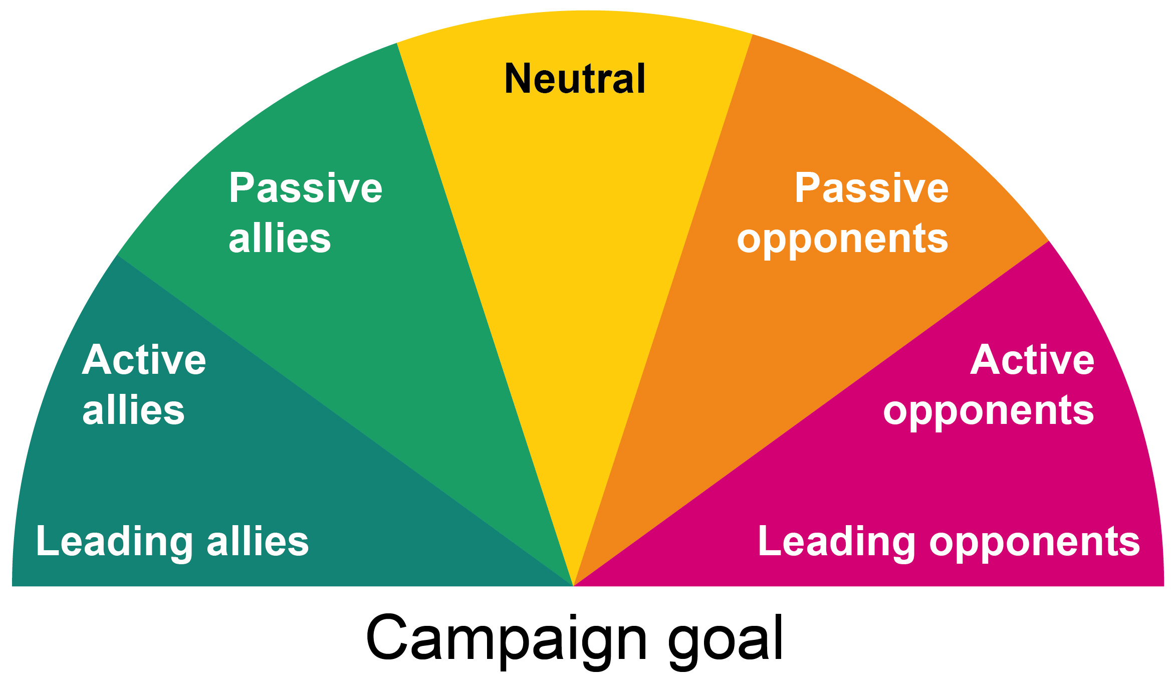
Spectrum of allies
Identify
targets and
allies
Notes:
This is an illustration of where different people will be in relation to your campaign. The idea is to move people from right to left at least one box. It is also an opportunity to discuss who you focus the campaign on outside of the target(s). Leading opponents and active opponents are unlikely to come right over to your side but they may become passive if your arguments are compelling enough. What you will want to aim at is activating passive allies and possibly turning passive opponents into passive allies or at least making them neutral.
The Brexit campaign is a good working example of this theory.

Slide 23
Activity F
Identify your target. Who is the one person
(or small group of people) who can make the change happen?
Identify any secondary targets who might have an influence on the target
Identify any allies (e.g. other unions, public)
Notes:
(10 mins plus 1mins feedback)
Quick exercise to get them thinking about this. Send to original groups if doing this as groupwork. Use breakout rooms again if working online.
Feed back quick answers back in the main group and then highlight any issues it threw up.
This will also highlight any reasearch they need to do if they don’t know.

Slide 24
Strategies and tactics
Develop campaign strategy
Develop tactics
Strategy
The overall plan for how to win a campaign; where you are trying to get to
Tactic
How you are going to get there; how
you are going to accomplish your goal
Notes:
This is quite difficult to explain but needs to be made clear. People tend to think tactically and group members previous experience with campaigning may be only by being involved with individual tactics but the aim of this course is for them to take the lead (with support if necessary) so they need to think strategically first and then fit the tactics into that strategy. Also tactics are more fun!
There are some ideas of tactics in the workbook to get them started if they need help.

Slide 25
Identifying the strategy
Develop
campaign
strategy
The overall plan for how to win
a campaign
Good strategies are based on
good information
The vulnerabilities of the targets
drive the strategy
Notes:
Example:
Free school meals campaign. Strategy is one of engaging people not directly affected to put pressure on the government to change their stance. Weight of public opinion will alter government policy. Government is vulnerable to public opinion. Tactics include twitter campaign, petitions etc.

Slide 26
Tactics
Develop tactics
Tactics vary in intensity:
Low – not much effort or involvement
Wearing a badge or sticker; Zoom stickers; backgrounds
Medium – more involvement
Signing a petition; writing a letter/email; leaflet drop
(real or electronic)
High – definite involvement
Twitter storm; protest; industrial action
The aim is to increase the level of intensity
as the campaign grows, and also to move
people up the scale of intensity.
Notes:
Need to fit into a timeline
At this time we need to think of digital alternatives as well as workplace ones. These will also prove useful once members are back in workplaces.

Slide 27
Taking things forward
Evaluate
Think about:
How you are going to communicate
with both campaign team and members
How often the campaign team are
going to meet
How often you are going to
evaluate activity
Notes:
Reminders of action points and to build evaluations into their timeline

Slide 28
Activity G
Create a timeline
.
Bring it all together and prepare a 5-minute presentation on your campaign. As part of this:
Discuss some of the tactics you might use to put pressure on the target. Remember to start low and work up.
Create a draft timeline.
What resources are you going to need?
How are the tactics going to bring members
and non-members on board
Notes:
(10 minutes plus lunchtime)
Make it clear this is laying the groundwork for future meetings.
The timeline will be a living thing that will change as early tactics are evaluated.
It is sometimes useful to think about your most intensive tactic and work backwards.
The timeline will also include campaign team meetings, evaluation points, communications events.
Resources are people as well as materials.

Slide 29
Lunch Break
Plus preparation time
(90 Mins)
Notes:
90 minute break for lunch but this will include time to work individually or in a group on their presentation.

Slide 30
Presentations
5 minutes plus 5 minutes for feedback/questions

Slide 31
Delivery Stage

Slide 32
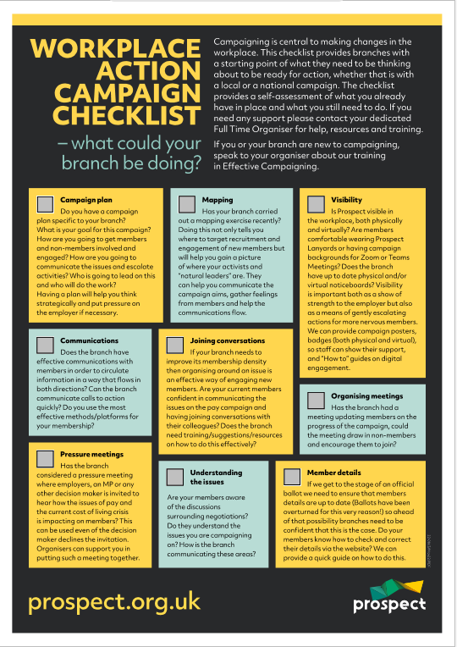
Are you ready…?
Do you have a campaign plan?
Have you done a recent mapping exercise?
Is your campaign and your branch visible both physically and digitally?
Do you have good branch communications?
Are your members confident in “talking union”?
Have you arranged organising meetings with members?
Have you thought about pressure meetings?
Do members understand the campaign and the issues?
Are members details up to date?
Notes:
Once their plan is in place branches should use the campaign checklist to check they are ready and build additional features into their timeline e.g a mapping exercise. They could also build in training for reps where needed before embarking on the campaign.

Slide 33
Charting - Factors to consider
How engaged are your members?
Are non-members engaging and how are you progressing them?
How many members are engaging with communications?
How many members come to meetings?
If you asked members to do something – how many respond?
Notes:
As the planned c campaign swings into action branches need to know how strong the engagement is and monitor how the campaign is progressing this can be done through measuring support using structure tests and charting. Take the group through what this looks like and how they can do this in a real life campaign.
E.G UKAEA petition – 1000 signatures in a branch that had 500 members – were the other 500 followed up to progress them into membership?

Slide 34
Structure tests
Measure actions that involve your branch
Measuring engagement gives you evidence and confidence as a campaign builds
Process necessitates two way communications
Builds solidarity amongst members
Engagement is essential before starting any action.
Notes:
Each tactic will in effect be a structure test and should be evaluated after each one, therefore data has to be collected and processed. This will be easier for ,say, a petition where you can see who has signed and compare to a member list to spot non-members but will also mean that you need to remember to have a sign in list at meetings or note who wears a lanyard. Use this slide to explain this and why it is important. This will become clearer in the next activity.

Slide 35
Activity H
Look at the two charts on the next two slides and be ready to discuss
What can we tell about the campaigns from these charts?
What would your next steps be now you have this information?
Notes:
Group activity – use flip chart or whiteboard/Jamboard if online.

Slide 36
Building a campaign
Name | Lanyards | Meet1 | Survey | Meet2 | Petition
John | O | O | O | O | O
Sue | O |  | O |  | O
Sahid | O | O | O |  | O
Elspeth | O | O | O | O | O
Andy | O |  | O | O | O
Ash |  | O | O | O | O
Notes:
This is an example of some data that shows a campaign that is going well. Members are participating in the actions and engagement is remaining steady.
Examples of questions that this data raises are:
a) why does Sue not attend meetings (ask her) do the branch need to vary meeting times?
b) Why doesn’t Ash wear a lanyard – does visibility need to be done differently in Ash's department (H&S issue) or is there a reason he doesn’t want to be visible at a TU member (fear of bullying)?
This data might highlight other issues as well as relate to the campaign.

Slide 37
Building to a campaign
Name | Lanyards | Meet1 | Survey | Meet2 | Petition
Elli | O | O |  |  | O
Mary | O
Hafsa | O |  | O
Sade | O | O
Zoe | O
Obi | O | O | O | O | O
Notes:
Points to discuss
The campaign is stalling
Do you need to revisit whether this is a good issue?
What are the barriers for members?
What are the positives?
What about Obi?

Slide 38
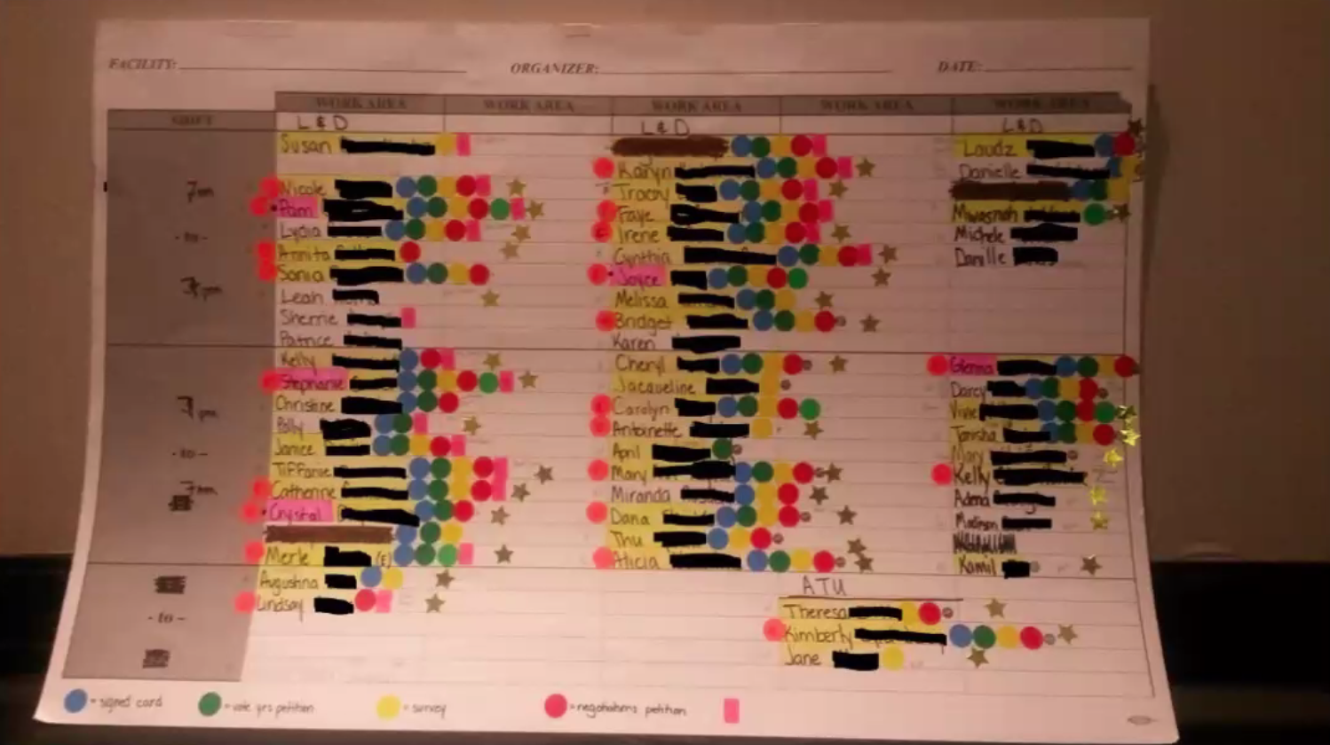
Image: www.janemcalevey.com
Notes:
Here is a real life example where a branch have kept a chart of engagement that everyone adds information to each time they meet. This can be a valuable way to share the workload and the charts can be stored securely. This could also be done as a shared XL document (protected to only allow certain people to edit)

Slide 39
GDPR and Data
Mapping/Charting etc a legitimate union activity.
The right to organise cannot be taken away by GDPR legislation.
Protect data, keep secure, limit audience, password protect.
Distribute activity and data – like a distributed network, more secure less chance of any GDPR issues.
Notes:
Here I am talking about individuals talking to colleagues in their team rather than one individual holding all of the data for the branch.
Hold lists of members and non-members seperately.
Paper lists the same as electronic lists
Individuals have a right to know what you have written – they are not likely to know the lists exists so access requests are unlikely to be an issue, but you should consider possibility. If you have rated people 1-5 be prepared to defend this, so think about what it means when you write it down.

Slide 40
Sliding scale
Not supportive … > neutral (or supportive)
Non-members …> members
Members … > to engaged members
Engaged members … > active members
Active members … > reps
Reps … > branch officials
Branch officials .. > national officials
Notes:
Remember that this is what you are aiming for.

Slide 41
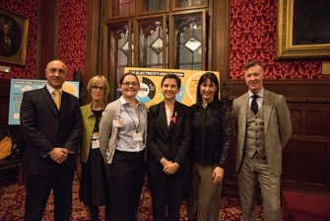
Top tips for campaigns
Make it local
Stay focused on a simple message
Marshall your evidence
Suggest opportunities for raising
the issue
Anticipate counter-arguments
Offer public praise when ‘targets’
do the right thing
Notes:
Quick tips

Slide 42
Remember!
Campaigning relies on the strength of
the branch so recruiting new members
and using campaigning as a vehicle to
do this is important too.
Include opportunities for non-members
to join in your planning
Advertise wins!
Don’t forget member-recruit-member
Notes:
Grow the union through campaigning
Make what you are doing is visible
Advertise wins!! Or even advancements.

Slide 43


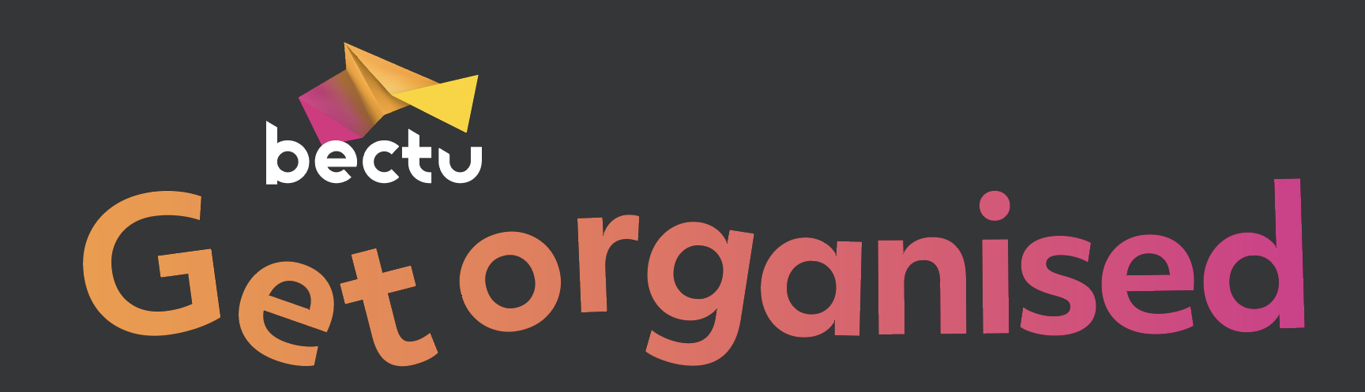
Questions?
!

