Slide 1
Bargaining for a sustainable workplace
Day two

Slide 2
Unit 5
Building your Branch

Slide 3
Bringing about change through policy review…
Travel & subsistence | Home-working | Relocation strategies
IT & data infrastructure | Supply chains | Skills development
Company cars | Cycle-to-work | Corporate sponsorship
Notes:
Policy review is a great place to start mainstreaming sustainability in union negotiations. This is absolutely critical to balancing the tensions and exploiting the synergies between environmental issues and other bargaining points. For example:
TENSION – A public sector organisation is under pressure to cut their carbon footprint. They put a blanket ban on the use of internal flights, except for a small quota reserved for senior managers. The union branch points out that this contravenes the equalities policy, by limiting the ability of some disabled workers and carers to travel for professional activities.
SYNERGY – A major private sector employer presents a location strategy that requires regionally dispersed workers to consolidate into a handful of big offices. The union branch surveys members on current and predicted commute distance/mode, to demonstrate the additional GHG emissions likely to result from the employer’s decision. They use the employer’s published environmental sustainability policy as leverage for a more flexible approach to remote working.
Ask participants to suggest environmental dimensions to other policies in the workbook there is room to write under each policy.
Note we are looking for examples of good policy and implementation relating to sustainability. If workplaces have well-used car-share schemes, or branches have negotiated incentives to use the Eurostar instead of flying, we want to hear about it!

Slide 4
Building a Stronger Union
Membership density
Engaged members
Visible Profile
Constructive Dialogue
Representative membership
Representatives
Notes:
Outcome to be achieved: key to active branch. - reminder from Reps 1
Density – proportion of members to help campaign./add their voice
Engaged members – keeping information relevant and specific, timely and useful.
Visible profile – is the union visible in the workplace, if you started a job tomorrow, would you know how to join the union?
Constructive dialogue – do you listen to members? Do you have opportunities to discuss issues? Is it worthwhile conversation?
Representative membership – Does every member in your branch have a say – or a rep to speak on their behalf. If you have a large percentage of under 35’s – do you/have you elected a young members rep? To ensure the proportion of the memberships’ voice is heard.
Representatives – Key role in the communications between the employer and the members and the union and it’s members. Supporting/advisory roles.

Slide 5
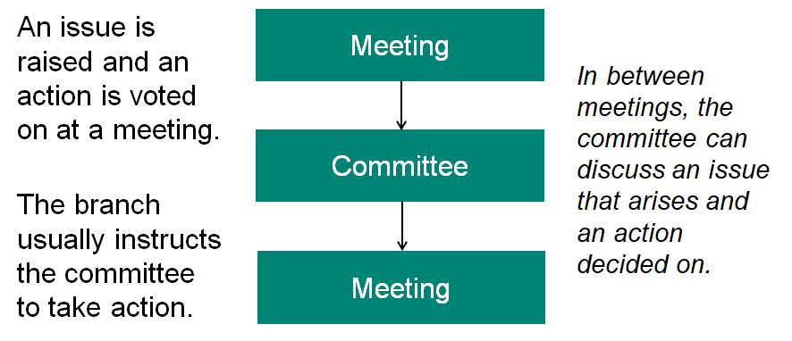
Bringing about change through union democracy:
Motions
Notes:
Reminder from Reps 1 that union democracy is set up to affect change whether that is at branch, sector or national level. If they want to steer the direction of the union at whatever level then the motion to AGM/Conference is the way to do that. This is the point to remind them of how to write a motion and there is an example in the workbook on page 46

Slide 6
Unit 6
Effective campaigning for union reps
Notes:
Highlight that this session will give them the framework to hang any campaign on, now or in the future, and is the basis for further work, especially if you are going this as a “101” or in half a day.
Make sure the group are clear that this course will give them an action plan that they will need to work on further.
Be clear that while FTOs/organisers can support the campaign issues are theirs and they need to own them and lead on them.
Remind them there is the accompanying workbook that has additional information.

Slide 7

Learning outcomes recap
Find out how to identify collective issues and build them into campaigns.
Learn how your campaign can influence policy – in the workplace and in the wider union.
Fear
Anger
Despondency
Hope
Apathy
Action
Notes:
Highlight the learning outcomes
Explain the images briefly, these both illustrate what campaigning is aiming to do within a planned structure.
Highlight that while we are in various incarnations of lockdown they will need to think digitally in some cases.

Slide 8
What is campaigning?
Campaigning is about achieving change.
It might be about persuading people to take a particular course of action in relation to a particular issue.
Campaigning means having a clear aim, knowing what you want to achieve and
what is required to bring that change about.
It is more than organising individual
events or publicity stunts.
Notes:
Go through these ideas and emphasise:
Even resisting change is asking someone (the target) to do things differently. With information campaigns you might be asking people to think differently
Campaigns don’t just happen they need planning, monitoring and frequent evaluation.
Events and stunts are a tactic, we will talk about these later, people often jump straight to these rather than plan a campaign.

Slide 9
Thinking about campaigning?
Activity
What campaigns have you noticed recently and why?
Who is a great campaigner?
What goes into a successful campaign?
What successful campaigns have you been a part of?
Notes:
Page 32 Do as a group activity and talk about current noticeable campaigns. It might be useful to use the whiteboard in Zoom (not possible in MS Teams yet)
Ask what made those campaigns particularly noticeable
What is it about good campaigners that make them good?
Why have some newsworthy campaigns failed or been limited?
Some examples for possible discussion
Brexit
BLM
Free School Meals
Justice for Hillsborough
Climate Strikes
David Attenborough
Greta Thunburg
Marcus Rashford

Slide 10
What you need to be clear about:
What you want done
Why it needs to be done
Who you want to do it
What message you want to get across
How you are going to get that
message across
Notes:
Go through the slide. It is important here to be clear that this is their campaign and while organisers will support as much as is needed it is for them as reps to lead.

Slide 11
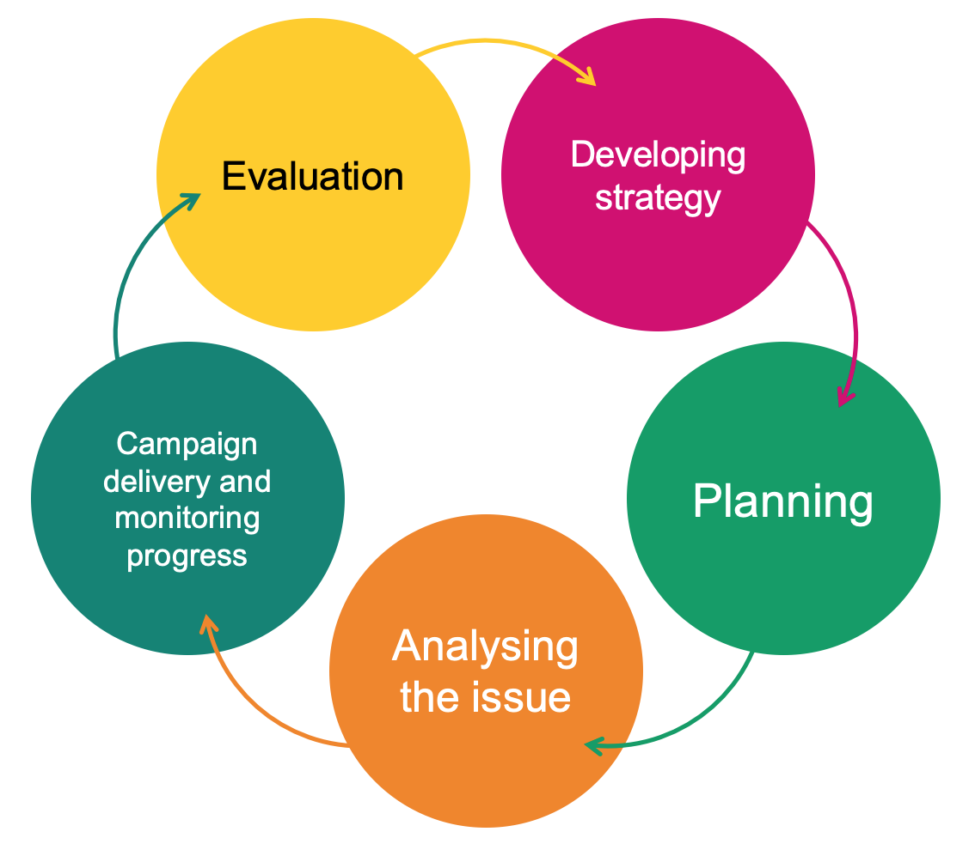
Campaigns require:
Planning
Organisation
Effective communication
Resources
Evaluation
Notes:
Campaigns don’t just happen they require planning and resourcing to be successful and they may span a considerable timescale or be broken down into linked time frames. They will need evaluating and re-thinking along the way. This is why it is important to have goals, a strategic plan and a timeline.

Slide 12
Identify
issue
A strong campaigning issue will...
...be widely felt
...be deeply felt
...have a good chance of success
...be easily understood
...involve the workforce – both members
and non-members
...be worth the effort involved
...support union values and be consistent
with union priorities
Notes:
P25 Go through this with the group and ask them to start to think about good issues. Give some examples of local campaigns if you can or go back to some of the national/global campaigns discussed at the beginning.

Slide 13
Activity
Identify
issue
Analyse strengths and weaknesses
Part B:
From the homework, discuss the ideas of each reps’ campaign issue and test it considering the criteria in page 34 of your workbooks.
Part C:
Analyse the strengths and weaknesses
of the campaign issue
What are arguments for and against?
Devise a 5-minute strategy of how you might engage members and raise awareness of your campaign.
Notes:
Activity (10 minutes in groups. 10-15 mins feedback)
If this is a small group do this as a tutor lead exercise (on the main screen for online). For larger groups split into groups of 3-4 using breakout rooms if tutoring online. If working in groups ask each group to nominate a spokesperson to share their issue and ideas when the group comes back together.
Tutor to show the next few slides to help…
Direct them to make notes in the work book for future reference.
Ask them to share the campaign issue they thought of for homwork and test it against the list on the previous slide (this is replicated in the workbook for them to refer to). Does the issue pass the test? If not can it be amplified?
Highlighting weaknesses and arguments against at an early stage will help with formulating arguments brought by opponents later. Pick one issues out of all those shared to progress for the rest of the training.
For group work get them to feedback when they return to the main group.

Slide 14
Campaign team
Build a campaign team
Who?
Will need to meet regularly
Not necessarily the branch committee
What skills are needed?
Can provide leadership and access different areas
When?
The earlier in the campaign the better
How?
Map
Identify potential activists
Communication strategy
Notes:
This work will form part of their action plan for future campaign meetings so go through the slide and emphasise the following:
Good way to involve new members and encourage new activists
Identifies natural leaders
Need to be clear about a network of activity.
Need a clear communications strategy both between team members and for communicating the campaign more widely.

Slide 15
Build a campaign team
Think about who would like to be involved in the campaign team:
Are there activists/members who might want to
be more involved in the union but don’t know how?
Do you need any particular skills that members have (e.g. social media skills, publishing skills)?
Who is going to approach these people?
Notes:
Start with what skills you need
Think about what areas you need to access and where you need leadership
Include potential activists you want to bring into the branch structure.
Again this will be “homework” for future campaign meetings.

Slide 16
Creating campaign goals
Determine goals
Why is it important to have goals?
Workplace issue: Terms & conditions under attack
Campaign goal: Maintain terms & conditions
Union issue: Not enough reps
Campaign goal: Recruit, train and support five new reps
Set smaller, winnable goals
Keep sight of the larger goals
Notes:
Highlight that large goals especially over a protracted timescale can be broken down into more manageable, smaller goals.
Worth highlighting the difference between workplace and union issues.
Keep our campaign focused
Help us know when we have won
Keep campaign grounded
in workplace or union issues

Slide 17
Campaign message
Core message
Facts don’t always work
Values and emptions engage people
Anticipate the opponent’s argument
Try not to just oppose the other’s message
Notes:
Facts don’t always work
This doesn’t mean you should lie! It just means that facts and figures will not necessarily motivate and engage people when it comes to supporting your campaign.
Values and emotions often engage people
The values held by people and their emotional response to an issue is what will get people involved. It feeds into the widely felt, deeply felt aspect of deciding on a campaign issue. It is often surprising what will get people agitated and motivated to take action.
You need to anticipate opponent's arguments
Be ready to have your message challenged and be ready with your counter arguments. This may be where facts and figures will be useful.
Try not to go to the opposing side in your message/slogan
There is a temptation, particularly when your campaign is resisting a change, to use the opposing side’s message. Examples of this are things like “Stop the Cuts”. This focusses attention on what your opponent is doing and their arguments rather than on your message. A better slogan in this case would be something like “Keep the NHS funded” – this focuses on your message and your agenda.

Slide 18
Tests for a good campaign message
Core message
It fits the situation
It is clear and uncomplicated
It unites the workforce
It could appeal to the broader community
It is not a slogan.
Notes:
Go through slide

Slide 19
Who are you targeting?
Identify targets and allies
The person, or small group of people, who can affect the change you are seeking or solve the issue you are addressing.
It is important to identify the target of the campaign early on.
Campaigns can lose focus if this person is not identified.
Secondary target
These are people who might have an influence on the target, who might help you to change the target’s mind or influence the target’s thinking.
Notes:
Go through slide

Slide 20
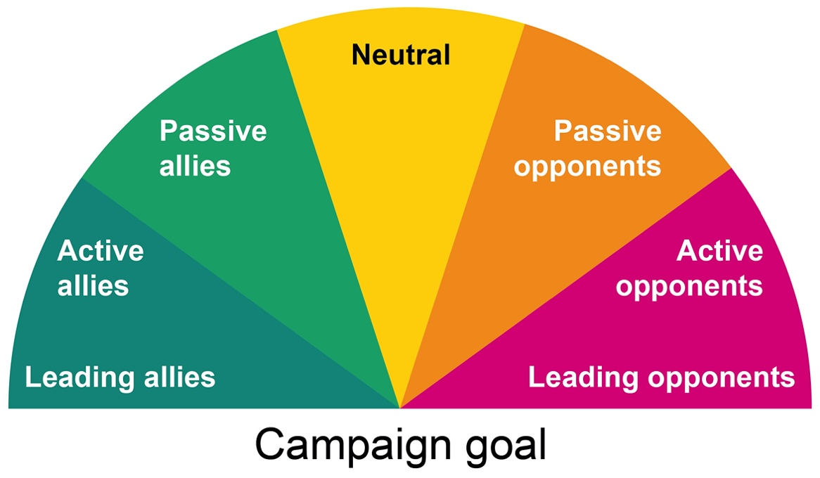
Who is with you and who is against you?
Identify targets and allies
Notes:
Go through slide try and give a relevant ally

Slide 21
Activity D: Identify targets and allies
Identify targets and allies
Identify your target. Who is the one person (or group of people) who can make the change happen?
Identify any secondary targets who might have an influence on the target.
Identify any allies, eg other unions, general public etc.
Notes:
Do as either a big group or split into small groups

Slide 22
Taking things forward
Create a timeline
Evaluate
Think about:
How you are going to communicate
with both campaign team and members
How often the campaign team are
going to meet
How often you are going to
evaluate activity
Notes:
Reminders of action points

Slide 23
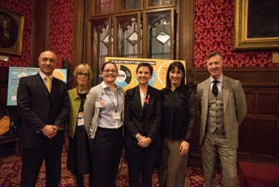
Top tips for campaigns
Develop a strategy
Develop tactics
Make it local
Stay focused on a simple message
Marshall your evidence
Suggest opportunities for raising
the issue
Anticipate counter-arguments
Offer public praise when ‘targets’
do the right thing
Notes:
Quick tips

Slide 24
Remember!
Campaigning relies on the strength of
the branch so recruiting new members
and using campaigning as a vehicle to
do this is important too.
Include opportunities for non-members
to join in your planning
Advertise wins!
Don’t forget member-recruit-member
Notes:
Grow the union through campaigning
Make what you are doing is visible
Advertise wins!! Or even advancements.

Slide 25
Case studies on website
https://prospect.org.uk/news/climate-emergency-webinar-the-reps-making-a-difference-in-their-workplace/
“Starting with education, with so much stuff to read and worry about, our roles as environmental reps include providing useful and relevant information that can actually be acted upon,”
Adrian Bond, Department for International Trade, environment rep and chair of the DIT’s Green Network speaking about taking and approach through education, collaboration and communication.
I wanted to ‘clean up’ the industry and so I stood for election as the first sustainability rep in my branch. I began reaching out to other like-minded branches and individuals and created and elected a sustainability subcommittee. We created five key goals that we wanted to achieve.
Laurence Johnson, a freelancer, in Bectu’s London Production Division explained that a a single $70m film in the course of its production would create as much carbon as 630 UK homes in a year.
Notes:
Inspiration from other reps

Slide 26
Case Studies
Low carbon heating system
LED Lighting and controls upgrade
Electric vehicle charge points
Recycling of PPE
Goodlives Timebank
Move to Bio Diesel
Notes:
Add any raised by members and other case studies

Slide 27
Need some inspiration...?
Examples of what some environmental reps have achieved.
A cycle to work scheme
If your company travel, do they have a travel policy – can you help form the policy to include recommendations around distance, mode and frequency.
A commitment from the company to look at suppliers and sources used. E.g. one company who historically banked with Barclay, were encouraged by their environmental rep to be reviewed given their investment in fossil fuel extraction.
Move company completely to a 'net zero policy' and what implications/resources this would have including where staff are hired, travel practices, procurement policies.
Office now stocks oat milk as an option (which is a much lower impact environmentally, than cow milk.)

Slide 28
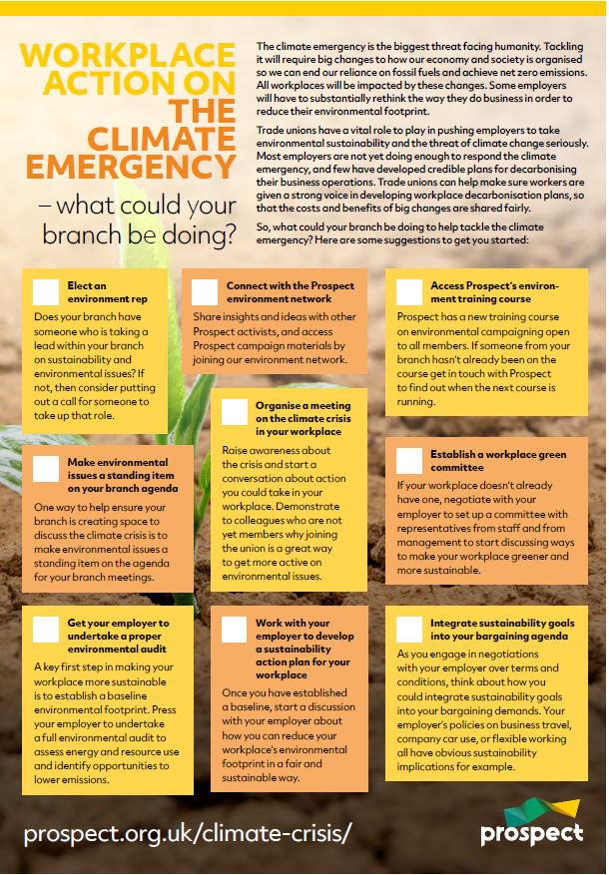
Green Checklist
Start point – Prospect Checklist
  Elect an environment rep
  Standing item on branch agenda
  Environmental audit
  Prospect environmental network
  Climate crisis meeting
  Develop a sustainability action plan
  Training
  Workplace green committee
  Integrate sustainability into bargaining agenda
Notes:
Focus on the checklist as a starting point for self assessment and action planning within their branch. Good way to focus on what they already do and what they need to develop.

Slide 29
Networks to get involved with;
Prospect dedicated Environmental ebranch
EarthWatch.org
https://carbonliteracy.com/toolkits/
https://green-alliance.org.uk/project/circular-economy/policysources
Courses | Greener Jobs Alliance

Slide 30
Strategies within workplaces
Financial
Circular economy
Re-new
Re-cycle
Re-use

Slide 31
Pensions
Environmental options look for ESG in schemes
Find out what funds your pension is investing in
See if there is an option to change funds to ones that protect the environment, such as renewable energy.
Notes:
Environmental, Social and Governance
Do you know what your pension is investing in?
While you want your pension fund to make a return – so you have an income when you stop working – they can make a return doing good rather than harm.
Most funds invest in the biggest companies, this means your money is going into the likes of tobacco firms and oil and gas companies. See if your pension can switch funds to one that invests in ESG companies.

Slide 32
Actions for a sustainable workplace
Make a pledge for individual action.
Negotiate with your employer for action.
Campaign for local action
Ask Prospect Union to take some action.
Campaign for national action.
Notes:
Just a reminder that action can be taken at all levels. We have focussed on workplace/individual but worth mentioning broader opportunities for influencing.
Individual actions are important, and we won’t be able to make positive change without this. By working together union members can support and encourage each other to make positive changes.
Use your collective strength and your negotiating power to ask for positive changes in your workplace. The environmental group and climate slack group can help you by sharing examples of best practice in other workplaces.
Prospect is led by its members and your members can engage in the democratic process of Prospect to ask for changes to be made union wide.
The expertise of Prospect members means they can be a valuable voice to lobby for change at national and governmental level.

Slide 33



Resources
https://prospect.org.uk/climate-emergency/

Slide 34
Review
Have difficult conversations with confidence.
Look at what are the barriers and how to overcome them
Action plan for the branch
  Structural
  Project based
Campaign

Slide 35
Action Plan and Next Steps
This is just the start!
What are YOU going to do differently in the workplace?
What support do you need?
How are you going to implement plans?
Remember – Publicising successes can inspire others to follow
Feedback – now or later chat/email
Notes:
Encouragement to feed back if they take any action in the workplace!

Slide 36
External Resources
Energy Saving Trust
  Guides to measuring carbon footprint and engaging employees in energy saving
Nature Scot
  Guides to improving biodiversity at work
  NetRegs.org.uk and Gov.UK
  Pollution Prevention Guidelines
Notes:
Pollution prevention guidelines – legal responsibilities. Regulated by EA and SEPA (plus other devolved orgs)

Slide 37
External Resources
https://EarthWatch.org
https://carbonliteracy.com/toolkits/
https://green-alliance.org.uk/project/circular-economy/ policy sources
https://greenerjobsalliance.co.uk/courses/ free courses
https://shareaction.org/savers-resource-hub/pension-power-what-world-is-our-money-building pensions and investing talks
Notes:
Pollution prevention guidelines – legal responsibilities. Regulated by EA and SEPA (plus other devolved orgs)

Slide 38
Questions?
Notes:
Remind them they will need to have further meetings and of their action plan.

