Slide 1
Sexual Harassment
Case handling
(updated version 22 Oct 2025)

Slide 2
Introduction
Be respectful
Be engaged
Stick to timings
Share experiences
Respect confidentiality

Slide 3
This can be difficult
If you need to step out or take a moment, please do.
Speak to Officers.

Slide 4
Terminology
Respondent – Person about whom a complaint has been made
Complainant – Person raising complaint.

Slide 5
Reps 2 recap – Prospect/Bectu role in personal case
To advise and support all members with issues at work.
Workplace and other legal assistance is offered at the union’s discretion and is decided on the facts and merits of each case.
We reserve the right not to provide assistance in relation to pre-existing issues. If a non-member asks you for help and you’re not sure how to respond, speak to your branch secretary or your full-time officer.

Slide 6
Reps 2 recap – Prospect/Bectu role in personal case
This does not mean you have to agree with them but to see their rights are upheld and the member is treated fairly.
Lay reps (you) make the best-case handlers as they know the working landscape, have a (hopefully good) relationship with the management and invariably know the member.
Prospect/Bectu tries to resolve all issues as swiftly as
possible and use the legal route if all fails.

Slide 7
Reps’ Code of conduct
Representatives must:
Act honestly, responsibly and with integrity.
Communicate respectfully and honestly.
Treat others with fairness, dignity, and respect.
Not behave in ways that may cause physical or mental harm or distress to another person, such as verbal abuse, physical abuse, assault, bullying, or discrimination or harassment.

Slide 8
Activity A: Introductions
In pairs
Introduce yourself to your neighbour.
Have attitudes to women and LGBTQ+ people changed within your workplace in the time you have worked there?
Would you feel confident advising a member to bring forward a complaint against a senior manager within the organisation?
Do you believe your organisation would handle the complaint fairly?

Slide 9



Tackling sexual harassment in the workplace

Slide 10
UK Gov Survey 2020
29%
reported having experienced some form of sexual harassment in their workplace or work-related environment in the last 12 months
1 in 5
in employment experienced sexual harassment at their physical workplace.

Slide 11
UK gov survey 2020 Continued
38%
of complainants reported that the respondent was the same level as them
31%
of women complainants reported that the respondent was senior to them
10%
people experienced repeat sexual harassment in the workplace from the same person.

Slide 12
UK gov survey 2020 Continued
15%
of complainants formally reported it
41%
of complainants who acted said there were no consequences for the respondent
17%
of victims choose to look for a new job

Slide 13
Definitions of sexual harassment
Verbal abuse, sexist ‘jokes’, innuendo, patronising or inappropriate remarks.
Comments about a person’s body or appearance.
Unwanted physical contact, physical threats or assault.
Threatening language or behaviours.
Leering, lewd gestures, pestering or spying.
Circulation or display of pornographic material on any platform including social networks.
Bullying that demeans or belittles someone in the workplace or at social events.

Slide 14
Definitions
The Equality Act defines sexual harassment as being unwanted conduct related to sex, or of a sexual nature, which has the purpose or effect of:
• violating the other’s dignity, or
• creating an intimidating, hostile, degrading, humiliating or offensive environment.
The definition of sexual harassment also expressly includes less favourable treatment because of rejection of, or submission to, unwanted conduct which is of a sexual nature or related to sex.

Slide 15
Victimisation
Victimisation is when a person is treated unfavourably because of doing a “protected act”. A protected act is:
• bringing proceedings under the Equality Act
• giving evidence or information in relation to the Act
• doing anything else under the Act
• alleging that someone has contravened the Act
Employees and workers are protected under the act but not a self-employed contractor

Slide 16
Activity B: Is this sexual harassment
In small groups
Look at the examples on the exercise sheet
Would the example be Sexual Harassment?
If not, would you raise it under another policy?

Slide 17
Sexual harassment Support Service
Open to all members in Prospect and Bectu confidential service
Dedicated case handlers who have undertaken specific training
Access through phone number or webform
If member wishes to take it further referred to appropriate case handling resource
No requirement for follow up action - can just be a safe space for listening

Slide 18
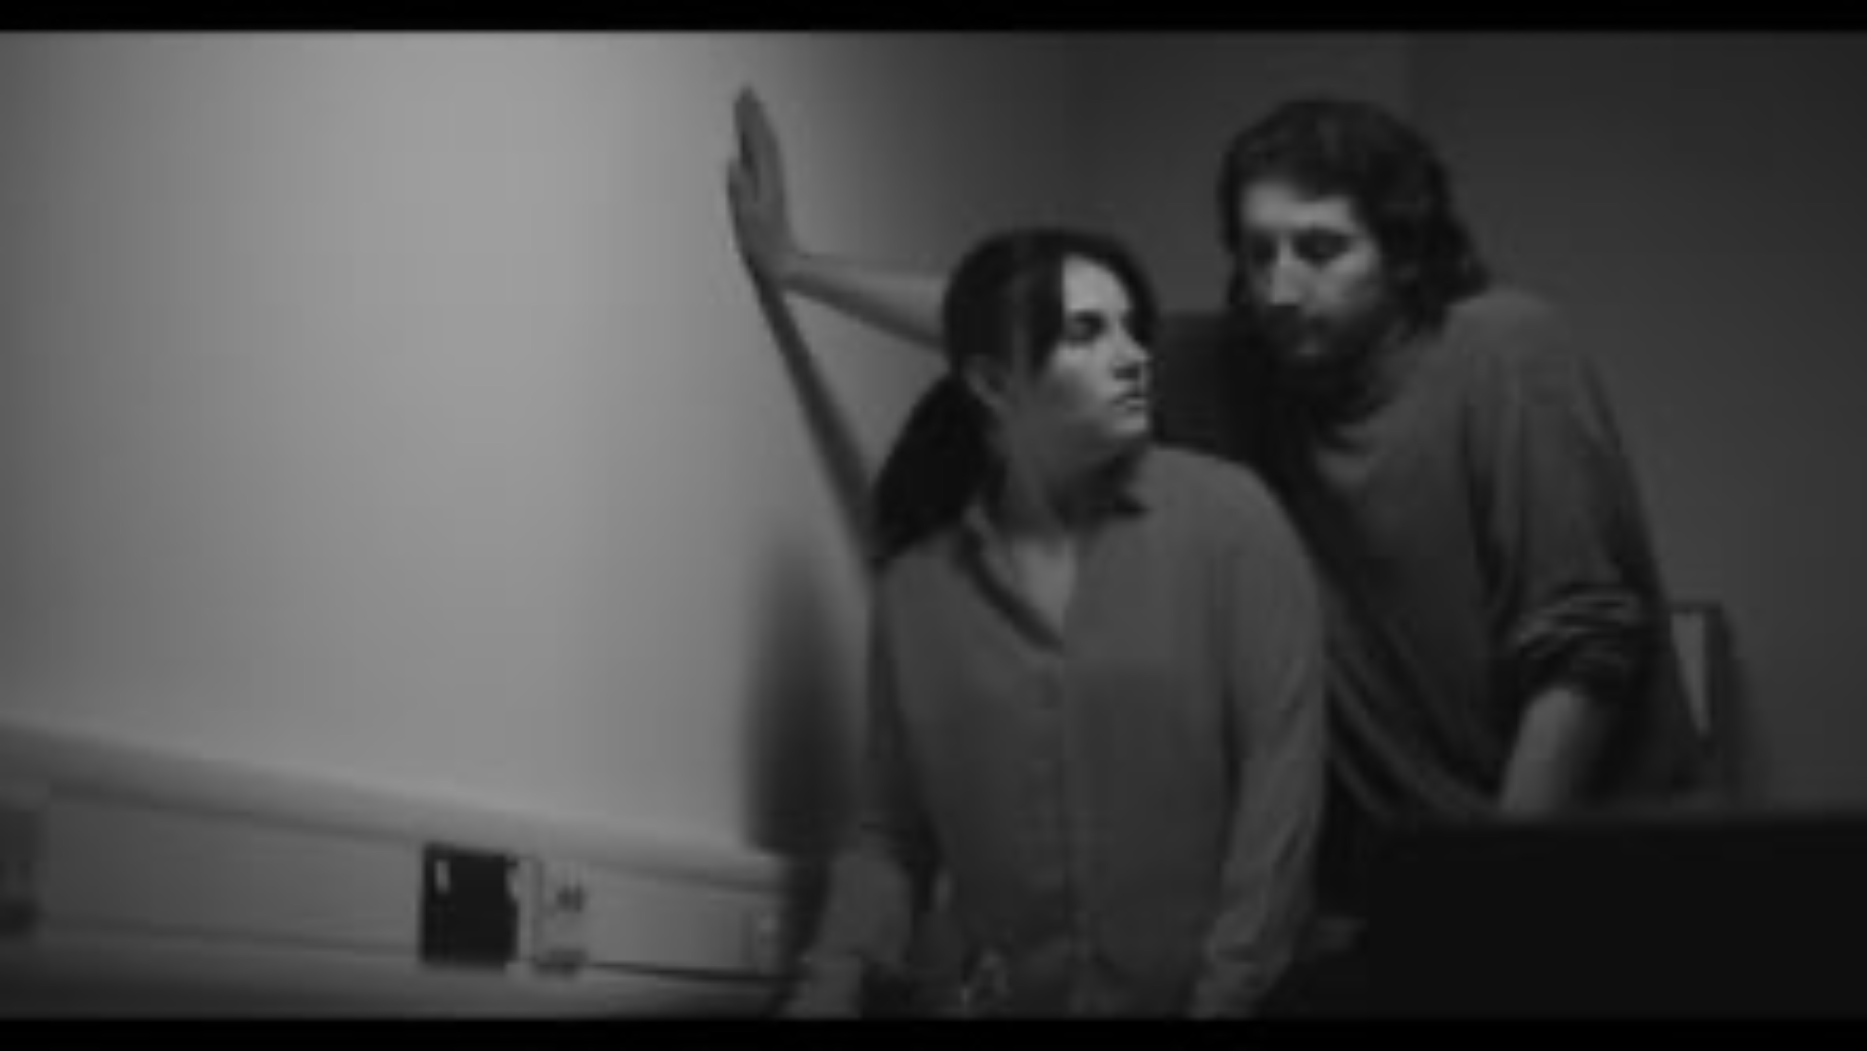
Supporting members making accusations

Slide 19
Activity C: What would you have done differently
What would you do differently if you were the rep?

Slide 20
Supporting members making accusations (complainant)
would they like a female rep and manager to deal with the case
the steps available to them and getting their agreement before reporting the incident to management.
advise the complainant to ask the alleged harasser to stop and explain that the conduct is unwelcome.
always ensure strict confidentiality
make sure the process is clear, if appropriate discuss time limits
offer to represent and or support the member at any stage
they can access emotional support such as counselling

Slide 21
Meeting member –recap
private space - not a glass fronted meeting room
take notes
Takes as long as takes
Be supportive
In person vs online?
Have they got someone with them (if at home, not office)
If member wants a rep the same gender, sexual orientation as them or someone outside their area of work, we will seek to accommodate this
What outcome is the member seeking?

Slide 22



Trauma
Physical
Mental
Professional

Slide 23
Parity of representation
Prospect’s policy is where two or more members are involved in a case, they will be given separate and equal representation where there is a potential for the members to be in conflict
Parity - representative should be broadly of the same level of experience (seniority may not always be best)
Separate - no communication about the case between the representatives
Ensure that members are aware of this when a case is raised involving them - proactive action is required

Slide 24
Too minor to report?
Is it worth raising minor infractions?
Would you record other minor breaches?
Do you have a responsibility as a bystander?

Slide 25
Supporting members who are respondents
Support is not condoning their actions
Member should reflect on their behaviour
Mitigate or defend?
Where our advice is repeatedly ignored, we can withdraw support.
Ask for help if you are unsure or uncomfortable

Slide 26
Activity D: Supporting a respondent
In your small groups discuss what advice you would give the member. There is the Personal case pro-forma and the strengths and weaknesses that were used on the rep’s part 2 course to help you go through the information
You have 20 mins for this exercise.
Then report back to the main group.

Slide 27
Supporting the respondent
meeting the respondent early on to listen to their side of the story, taking detailed notes.
providing a reassuring presence, but with no guarantees about the outcome
explaining the timescale, how the relevant procedures work,
encouraging the member to be honest throughout.
encouraging the member to stay calm
emphasising the importance of treating the matter confidentially and with sensitivity.
encouraging the member to make a careful note of their own account,

Slide 28
Securing the best outcome
This could be written warnings and training but could be worse
Ultimately it is our goal to secure the best outcome for the member of those available
Resign?
Settlement agreement?
Non-disclosure clauses?

Slide 29
Criminal behaviour?
In some cases, there will also be a criminal investigation.
We cannot represent members in that process, and they should engage a lawyer.
Lawyer cannot represent them internally.
Need a joined-up approach.
Differing standards of proof.

Slide 30
Criminal behaviour? continued
Criminal process may be long
May never conclude
Can lead to significant delays
Criminal conviction may affect employment
Criminal proceeding will be public and may get media attention.

Slide 31
When are employers liable
Employers are liable for acts of harassment:
committed by one worker against another of their workers
committed by one of their workers against a job applicant or former worker
committed by an agent acting on their behalf against one of their workers, and
where a failure to deal with harassment of one of their workers by a third party, or by another worker outside of employment, amounts to direct or indirect discrimination (or breach of other legal obligations)

Slide 32
Vicarious liability
Baldwin v Cleves School and others.
Where a respondent has acted in a discriminatory manner, they could have a personal liability in addition to any liability the employer holds.
Employer is unlikely to provide representation as their defence will likely be to blame that staff member.
Prospect provide may provide representation of last resort but will depend on the facts of the case

Slide 33
Aftermath
Should the outcome be confidential?
Can the parties work together?
Redeployment? If so, then who?
Does the member have confidence in the employer after process?
Retributive action?

Slide 34
The bigger issue
Casework while necessary will not solve this problem.
A spike in casework is a symptom that we might be addressing this.
The solution is culture change.
Cultivating a respectful workplace is the single most valuable protection against sexual harassment or other unwanted behaviours. (LRD)

Slide 35
Improving culture and policies in your workplace
An employer will be liable for harassment or victimisation committed by its workers unless they can show that they took all reasonable steps to prevent such behaviour. This could then be a big bargaining chip when it comes to negotiating change.

Slide 36
Changes to Legislation
Employers now have a duty to anticipate when sexual harassment may occur and take reasonable steps to prevent it.
If sexual harassment has taken place, an employer should take action to stop it from happening again.

Slide 37
Activity E: what is in your policy
In groups look at the list in the workbook of recommendations for a sexual harassment policy in the workbook
What would do you feel you need to add to your employer’s existing policies?
As part of the discussion, consider if zero tolerance approach really would work. What is the effect on the individual.
Each group to report back

Slide 38
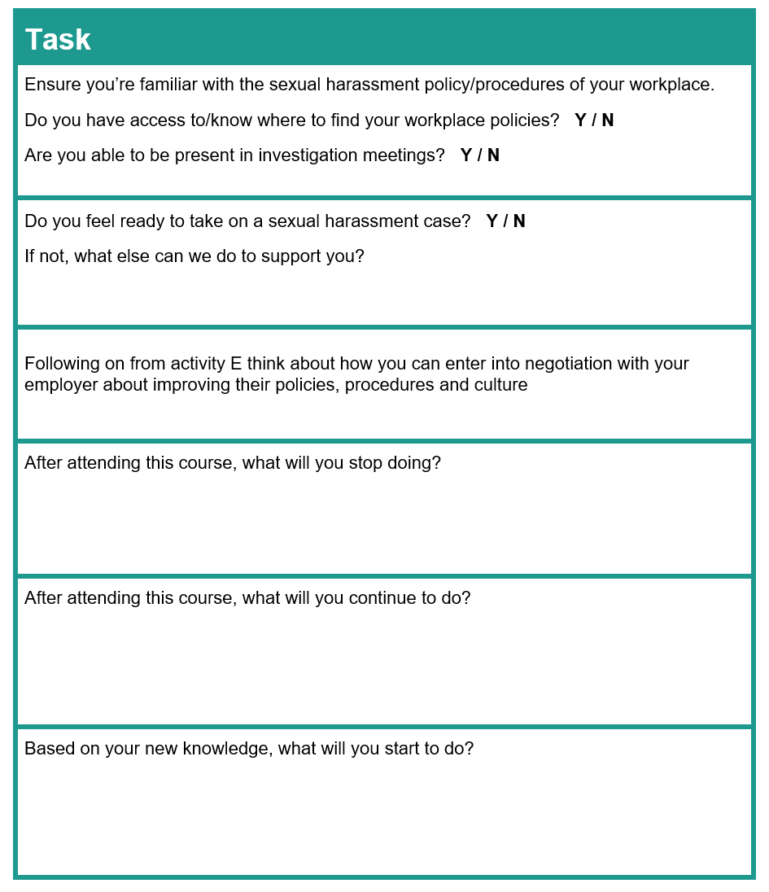
Putting what you learnt into practice

Slide 39
Any questions and feedback forms.

