Slide 1
Making the most of recognition
Collective bargaining is a precious asset
The relationship needs managing
Do your homework
Foghorn message
Skills: Needs identification and needs creation
Organisational needs and personal needs
Notes:
9. 40 – 9.50
Recap in part
Go through page 41 & 42 of the workbook drawing out the bullet points on the slide.
Key points are that both employers and members need to see that Prospect is needed and makes things happen.

Slide 2
Making the most of recognition
Collective bargaining is a precious asset
The relationship needs managing
Do your homework
Foghorn message
Skills: Needs identification and needs creation
Organisational needs and personal needs
Notes:
Go through page 46 & 47 of the workbook drawing out the bullet points on the slide.
Key points are that both employers and members need to see that Prospect is needed and makes things happen.

Slide 3
Session 6:
Negotiations in practice

Slide 4
Activity G: The X Y game
Win as much as you can
For six successive rounds, you and your team will choose either an X or a Y. Each round’s profit or loss depends on the pattern of choices made by your team and the other teams.
Notes:
Win as much as you can!
Split the group into three or four teams (three is more manageable!)
Give each player a copy of the handout and each team two colour-matched cards: one X and one Y
Give them a few minutes to read the brief and to discuss their approach with other team members.
Make sure everyone understands what they’re doing. You will need to send the teams’ representatives outside for the bonus round conferences.
Run each round discretely: “everyone ready?” or “3, 2, 1…” “Play” and mark up the results. Remind everyone when you get to rounds three and six that they are worth more and the teams can consult each other via a representative.
On tutor notes is suggested set up on flip chart
Feedback
This exercise is principally an ice-breaker or a bit of light relief in the middle of a long course. But it does have some useful lessons. Get the group to discuss what they took out of it. Prompt if the following key words and concepts do not come out…
What was the objective?
What does ‘win as much as you can’ mean? Win for whom? Your team, or the group as a whole?
Which objective was most likely to yield a reasonable result for your team?
Competition v cooperation
Aggressive competition can leave everyone worse off
‘Win-win’ game, versus zero-sum game
What would be the best strategy to maximise the amount of money of the group as a whole? (Answer – everyone play’s Y all the time: yields £13 each, and £39 in total. The most any one team can win is £26, and this would be at the expense of the others both losing £13.)
Trust
Within teams as well as between teams?!
Once trust has been lost – it is difficult to get back and it can lead to a spiral of destruction
Destructive acts can be self-destructive!
Note: anything over £20 in total for the group is pretty good going.

Slide 5
Activity H: Negotiations at Stationery State
In your pre-meeting you should read through the information on Stationery State, plus the additional material for your team
Notes:
This role-play exercise and the planning process that participants will undertake in order to carry it out will help them to:
Understand what an effective negotiating plan looks like and how to put it into practice
Evaluate negotiating positions
Demonstrate a range of negotiating skills and roles
Delivery
Participants should be pointed page 37 & 38. This is a scenario based upon a workplace equal opportunities issue. You will need to give them 10 minutes to read through the scenario. Also ask them to read page 38 Stationery State Equal ops policy.
Allocate each participant to either the management or trade union side [Management page 39 & Union page 41] using your knowledge of their experience and personal style to do this. You should try and work on the basis of having 2 sets of negotiation role plays going on.
Their task is:
To agree their objectives for these negotiations, based on the negotiation scenario
To allocate each person within the team an agreed role in the negotiations
Give each group should use the Negotiation planning sheet on page 43 which they can use to capture their understanding of the situation, what they want to achieve, what they believe the other side’s position to be, and what arguments they will use to progress their case.
They have 30 minutes to prepare for the negotiations. Check on their progress while they are in their pre-meetings. Try to make sure that they have correctly interpreted the information in the scenario – sometimes there is a misunderstanding, or people make extra things up! – but don’t try to shape their bargaining agenda. If you think it looks a bit problematic, you can tell them that in feedback if it causes difficulties, or even if they get lucky and it doesn’t.
NB the briefing in their packs on page 51 does remind them about the possibility of informally meeting the other side to solicit more information, clarify the situation, sound out positions etc – point this out to them if it looks as though they are losing the plot.

Slide 6
Activity H: The meeting
You have 30 mins for your meeting. This includes adjournments. The tutor will adjourn halfway through to reflect how it is going.
Notes:
The negotiation meeting
As each ‘union’ group to use the Negotiation Planning & Observation sheet on page 44. They will need this to help reflect on the meeting.
The meeting will be a maximum of 30 minutes in total, including any adjournments. This information is included in their packs.
Intervene in the meeting periodically, to get them to reflect on what they think has been going on. Suitable junctures for intervention could be:
If one side has clearly misunderstood the other and is ploughing on regardless
If it looks as though the negotiating lead is departing from the plan and others are not asking for an adjournment
If there is no progress ie they are just talking/shouting across the table
A display of inappropriate behaviour eg talking across each other/the other side, dismissive body language etc
You will need to use your judgement about whether to tell them what you think is going wrong and ‘re-set’ them to a more positive point in the meeting; or whether to just suggest they adjourn and re-group (or a combination of these – you could stage an adjournment and talk separately with one or both of the sides).
When there is 5 minutes to go – tell them that time is nearly up and they have 5 minutes to wrap up the meeting and agree a way forward (if this is possible).

Slide 7
Activity H: The Feedback
How did you get on?
Notes:
Once the meeting is over
Lead a discussion about how it went. Tutors should give feedback and observations first, including about the interventions – ensure everyone has understood why interventions were necessary and what their purpose was.
Then – did the teams feel that they met their objectives? On reflection, did they feel their objectives were realistic? Did the negotiation meeting make them aware of factors they didn’t previously know about? Did they think they got to a reasonable agreed position?
Reinforce that negotiations happen for a purpose, not as rituals – if they don’t use the opportunity to negotiate effectively and reach an agreed position they are not representing members well.

Slide 8
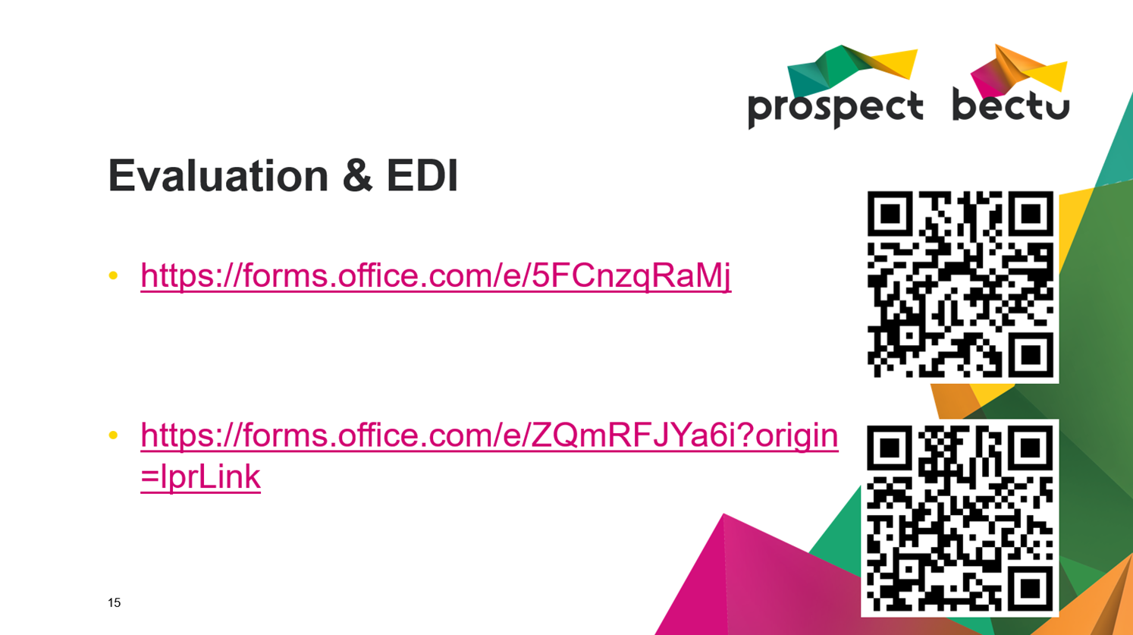

Slide 9
Any questions?
Notes:
Take any questions and advertise about the other short courses
How to have an effective branch
How to have an effective union meeting
How to give an effective speech (public Speaking)
How to write an effective motion?? Idea for the future

