Slide 1
Prospect’s 7th Annual Report on the Gender Pension Gap
Sue Ferns
Senior Deputy General Secretary
Notes:
Speakers:
Sue Ferns, Senior Deputy General Secretary
Ignacia Pinto, Senior Research and Policy Officer, Women’s Budget Group
Neil Walsh, Pension Officer, Prospect

Slide 2
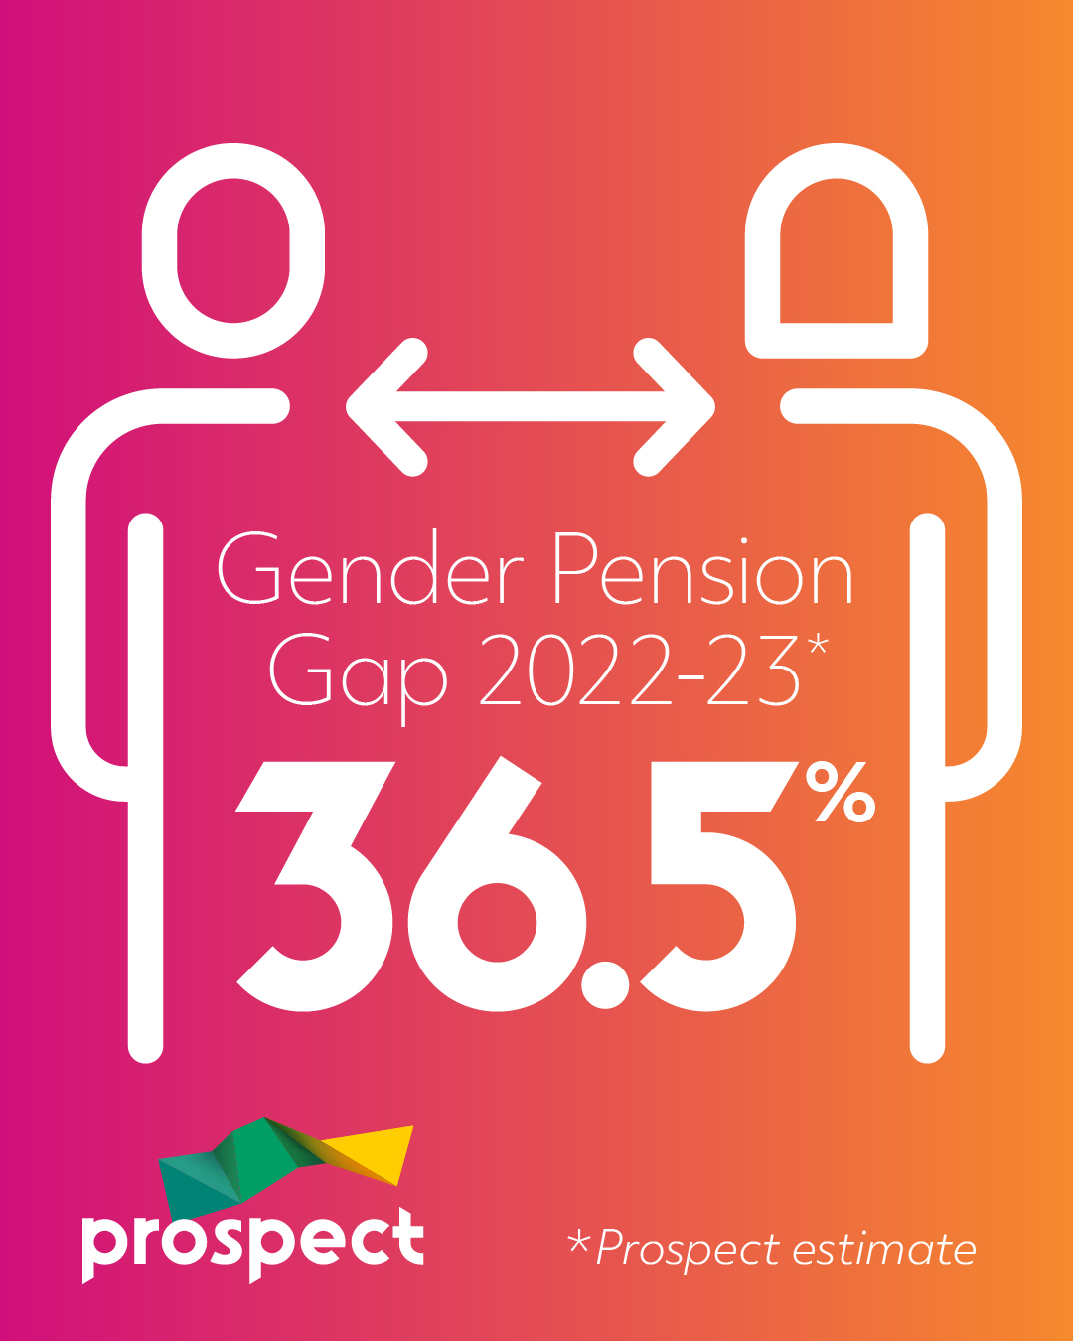
The bad news:
Notes:
This is an event to launch Prospect’s 7th annual report on the gender pension gap.
The focus of each report has been our latest estimate of the size of the gender pension gap in the UK.
In this report we publish an estimate for the size of the gender pension gap in 2022-23 (the latest year data is available for).
As you can see from the graphic on the screen this is 36.5%.
If this seems very high, it’s because it is – we’re reporting that the average retired woman has more than a third less income to live on than the average retired man.
Just pause for a second to think about what that means in terms of living standards, in terms of the risk of pensioner poverty, in terms even of the inevitable consequences for mental and physical well-being.
So, this is not a dry subject of mainly academic interest – this is a fundamentally important issue affecting the quality of life of many millions of women throughout decades of retirement.
But: just to get a bit academic for a second, people may be wondering what definition we are using and what the data source for our estimate was.
Our estimate is derived from an analysis of the datasets of responses to the Family Resources Survey (FRS). This is a continuous household survey that collects information on a representative sample of private households in the United Kingdom. FRS data are designated by the UK Statistics Authority as National Statistics (though, of course, this does not mean our estimate is a National Statistic!). We previously noted some issues with responses to the FRS related to Covid-19, but these seem to have largely been resolved for 2022-23 data.
We have defined the gender pension gap as: “The percentage difference in average gross pension income for women receiving the state pension, compared to the average gross pension income for men receiving state pension.”
Some may argue that other definitions would be more appropriate, and our previous reports went into detail on the pro’s and con’s of different approaches, but what we can say without any doubt is that this is a huge problem on any measure you choose.

Slide 3
The bad news in context:
It represents an average retired women having £7,600 less pension income than an average retired man.
This is equivalent to an average retired women only starting to receive her pension income on 13 May, if it was paid at the same rate as for an average retired man.
It is over twice the size of the gender pay gap (which ONS reported1 was 14.2% in 2023).
Notes:
In case a gap of 36.5% does not sound bad enough – we have tried to represent that in a few different ways to bring the impact home.
A gender pension gap of 36.5% means that an average retired woman was living on £7,600 less a year, which is about £150 per week! Think of what women cannot afford to buy because of this shortfall!
Another way of putting this is saying that it means an average retired woman only starts to draw her pension on 13 May (if it was drawn at the same rate as for an average retired man).
(Another way of looking at that, is to say that the average retired women stops receiving her pension in the middle of August, which is an approach the TUC takes in its work on “Equal Pensions Day” to highlight this problem.)
Crucially, the gender pension gap is over twice the size of the gender pay gap – there are *rightly* many measures in place to tackle the gender pay gap (and these will indirectly also help with the gender pension gap) but there is nowhere near the same profile for the gender pension gap.
It shouldn’t be a huge surprise that the gender pension gap is so much bigger than the gender pay gap:
• Pension income in retirement is related to pay during a career, so the gender pay gap feeds directly through to the gender pension gap.
• On top of this, women are much more likely to have gaps in workplace pension scheme service due to caring responsibilities.
• Historically women have also received less state pension than men.

Slide 4
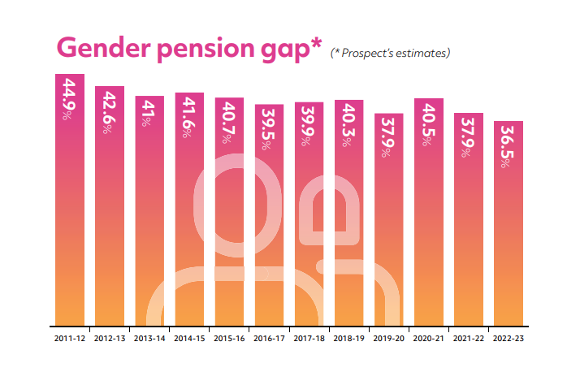
The good news:
Notes:
It is nice to be able to report some good news on this issue.
While 36.5% is an unacceptably high measure of gender inequality in retirement incomes – it is actually the lowest level we have ever reported.
It has reduced from 44.9% in 2011-12 (the first year we ever reported on).
This is a significant improvement that has benefited millions of women.
It is almost certain that the gender pension gap is lower now than it has ever been before.
You can see a clear downward trend in the data represented on this slide (the trend is not continuous, but we know that sampling problems related to Covid-19 probably caused the main kink in 2020-21’s estimate).

Slide 5
The good news in context:
We should *expect* our measure of the gender pension gap to be falling:
The gender pay gap has been falling
Female participation in the workforce has been rising
Female membership of workplace pension schemes has grown (particularly part-timers)
Gender inequality in state pension income has been addressed over time (by credits for carers and the new state pension)
Notes:
Now to qualify that good news.
Consider how the gender pension gap *should* change over time.
Most of the retired population who are represented in our estimate one year are also represented the next year. Of course, there will be sampling variation and other factors affecting the estimates between years, but the net effect of these is expected to be zero. Similarly, it is reasonable enough to assume that there is no huge different to the rate of increase for men and women’s pension income.
Consequently, the gender pension gap changes every year, mainly because of the change in the composition of the retired population.
In crude terms, we lose the men and women who died over the year from the sample population and gain the men and women who retired each year.
The men and women who retired in the latest year will, by our definition, be 66. They started work in the early 80s and experienced all the developments that we know happened in the workplace and pension landscape since then.
The men and women who died in the latest year might be, say, 86 on average. They started work in the early 60s. That was a very different time. It was before the Equal Pay Act 1970 and the gender pay gap was much higher. It was before part-time workers won equal rights to workplace pension scheme membership in 1976. It was before the first credits in the state pension for carers were introduced in 1978.
Basically – the gender pension gap is falling now, in large part because of these landmark changes that improved the situation for women over the last 55 years (many towards the start of that window!).
This is good – but we cannot simply watch these effects feed through and conclude that our work is done. Because the gender pay gap could be closed and pension scheme participation rates could be equal, and there would still be an unacceptably large gender pension gap because of the impact of caring responsibilities on workplace pensions.
We need to tackle this, or the gender pension gap will still be far higher than the gender pay gap by the end of the century!
It is great that the gender pension gap is at an historic low – but it would be terrible if we let that relax our efforts in this area at all.

Slide 6
The policies that Prospect is calling for
A commitment to publishing a regular series of official estimates of the size of the gender pension gap, on a timely basis after the data becomes available.
An official target for reducing the size of the gender pension gap over time. (Taking into account the baseline reduction even if no action was taken.)
A formal plan setting out the specific policies to be implemented in order to achieve the official target for reducing the size of the gender pension gap.
Introduction of an additional state pension credit of about £3 per week for every year spent out of paid employment due to looking after young children.
Introduction of an additional state pension credit of about £3 per week for every year spent out of paid employment due to other caring responsibilities.
Notes:
In past years we have produced a long list of changes that would benefit women’s retirement incomes.
In this report we are focussing on the main measures that we think would have the most impact.
The 5 policies on this slide, they could be split into 2 groups.
The first 3 are about reporting on the size of the gender pension gap.
This may seem just presentational and hence unimportant.
But Prospect believes it is the key to further progress. It is surely only the lack of awareness of the size of this problem that allows it to persist at these unacceptable levels.
And this was the reason we published our first report on this all those years ago: because there was no other independent estimate of the size of the problem that we wanted to talk about.
It’s also something we’ve already had some success with – our original aim of getting the government to publish an official estimate of the size of the gender pension gap was achieved in June 2023.
In fact, that was in response to a select committee recommendation that itself was something we had suggested to the committee in both written and oral evidence.
But we need that publication to become a regular series rather a one-off. The government has indicated that will be the case and we look forward to commenting on their estimates in future reports of ours.
The last 2 policies are the main ones that will have a practical impact on women’s retirement outcomes.
They are about recognising caring responsibilities in the pension system.
It’s important to understand that current credits for parents of young children and carers only protect state pension entitlement. But in the UK the state is playing less and less of a role in providing retirement income. Workplace pensions are increasingly important and there is simply no allowance for caring responsibilities in workplace pensions.
Our proposed policies would go some way to addressing that problem.
Many people accept the need for recognising caring responsibilities in the pension system but might propose an alternative way of doing that. We think our approach might be the most effective way of achieving this aim, but we would support any way of doing it.
The government is about to launch the second stage of its pension review – it really needs to consider the impact of caring responsibilities and the gender pension gap overall in its terms of reference.
This is what Prospect is calling for the government to do – we also need to work with employers and members to tackle this problem and there will be more on that later.

