Slide 1
Effective communications for union reps
Notes:
Tutor to ensure you have joined online meeting slightly earlier than the start time;
The PowerPoint is not used at the beginning of the session.
You may need to help people with technical issues such as sound Invite people, as they arrive online, to skim through introductory section of workbook (History of Prospect/ Trade Union Terminology) and check they received it ok
Run through the zoom basics – microphone – mute etc, video – off if necessary, reactions when showing the power point, chat box for anything private or sharing, change name function, raise hand function. Polls
Add if zooms/TEAMS crashes or issues with connectivity, tutor will join asap – please ask delegates to work on the activity, look at next activity.

Slide 2
Learning Outcomes
What makes a good communicator?
Variety of union communication roles and their purpose?
Exploring communications tools available and channels available and how to use them
Health check and planning next steps
Notes:
Pronoun to be mentioned and refer, if necessary, page 10 about letting people speak
Go through Learning outcomes on page 4
Interactive course and reps are encouraged to discuss, raise items and participate in the sessions whether it be online or classroom.

Slide 3
Session 1
Activity A
Introductions
Notes:
10.15 – 10.25 Page 12 in workbook
On the online version it is easier for everyone to introduce themselves in under 60 seconds. For classroom - you can do the activity in pairs and ask each pair to introduce their partner.
Tutor should go first (keep very brief in the hope everyone else will too!)
Introductions should be quick, giving most of the time to a bit of social interaction
Name, company, work role.
Why is the communications role important to you?
What forms of communications are currently used?
What would you like to get from the course?
Write down answers to what they want to get from the course. This can be referred to during the day but also covered by next steps, further courses perhaps. The most important point is that these are the outcomes of the delegates and to recap over them at the end of the 3 sessions to ensure they’ve been met wherever possible.
Finish session by summing up traditional image portrayed by media of trade union reps, based on their experience of attending reps 1, they’ll understand the key area of building membership and activity and engagement is by good communication. In this session we explore the tools which may assist the communication rep.

Slide 4
Session 2
Activity B
Health Check
Notes:
10.20 – 10.35
Page 13 in workbook
Prework – the health check questions given before the course.
Introduce the concept of the health check. To improve we need to know our strengths and weaknesses.
This is a basic tool to access on a scale of 1-10 how effective are the communications currently. If a rep answers 10 (the best), we need to ask why they think this and what they are doing and what has been achieved/happened to make them score 10.
Equally if a rep answers 1 or 2, we need to ask why they feel that is – it could be do with lack of resource, apathy etc.
Are you reaching the right people?
What might success in your branch look like?
The key point is that comms reps shouldn’t feel like the whole task falls to them – membership of a union is a two-way thing. We’re simply identifying some approaches we they may not have through of previously or perhaps didn’t know how to go about starting.
Some branches/reps may already be using a health check as a guide, but this is to explore how to get the most out of the exercise and ensure reps have something to take back to branch with them.
ACTION Complete the action plan and communication branch strategy

Slide 5
Session 3
How Prospect communications work
Why does it matter what branch you are in?
What communications happen when a new members joins Prospect/Bectu?
Structure & support for branches
Notes:
10.45am
Learning outcome; Knowledge of union structure. A union is democratic, and its’ structure should reflect that and make that possible. Any member gets to have a say on their workplace no matter how big their employer is.
Go over the questions on the slides and give each rep time to respond to what they know – it’s important this isn’t seen as a test but more an opportunity to address anything not clarified during their time as a rep and really home in on their understanding.
It is important the branch reps know the following:
What do they receive?
How does the branch know we have a new member?
What do the branch need to know from members?
As part of the communication role for the branch we need to know:
How can you get this information?
What will be your ‘foghorn message’ to member to get them to engage?
How can members contribute?
Members can manage their communications preference
Recapping a bit from reps 1 and ensuring that each comms rep knows who they are communicating to – both members and the branch officers and the union.

Slide 6
A branch
President/Chair
Branch
Secretary
Committee
Notes:
The Representative committee is to aid every member's voice.
Outcome to be achieved:
Outcome to be achieved; recap how their branch is set up (section/subsection)
The diagram shows a branch at one location but with 3 different departments
According to rules branch must have a chair, secretary. (click 1 and 2)
A branch is made up of different offices, roles and sometimes many locations. This can cause difficulties with ensuring you are communicating out to all members and allowing all member an opportunity to have their say/voice.
It also has a committee made up of elected positions. A good proportion of these roles must have direct contact with members as far as reasonably practicable. Branch Sec, Branch Chair, Membership & recruitment sec, comms rep. (click 3)
Branch meeting where an issue can be raised and discussed, and a democratic decision can be voted on. Much of the vote is the course of action a representative(s) takes up
with management on behalf of the members.
It is sometimes difficult to attract members to branch meetings, apathy rules in most cases. Decisions still need to be made on the day-to-day business of the branch and to facilitate this, the branch of members elect a committee.
It’s important that all areas, grades, department and shifts all have representation on the committee and are communicated to before meetings happen to ensure the elected ‘rep’ has a true reflected voice of the area they represent.

Slide 7

What comms are important to a new member?
Who/What is communicating to your new member?
Notes:
One of the main roles of the rep is guiding new members into the right branch
What do new members receive? Email from Prospect, possibly from M&R sec welcome email, link to website
What do existing members receive? Changing preference and updating details.
Highlight why comms to a new member is important – inclusive, informed, awareness – how to build on this to develop member engagement.
Try to remember what it feels like to be a member – what communications are useful, what is too much communication and what things were you frustrated about never receiving information about.
It's important to put ourselves in our members’ shoes as this will promote a real understanding of how we can effectively communicate with members. However, it isn’t all down to the branch – a member must be engaged in the union as well, it’s important to highlight this when they are looking to join as members get the most from their membership when they use it.
If you have permission, you should be able to find out who is in your branch through the Knowledge hub.

Slide 8
Good Communications are two way
What do you need to know from members?
How can you get this information?
What will be your ‘foghorn message’ to the member to get them to engage?
How can members contribute?
Notes:
What do you need to know?
Where they work to be relevant for their workplace
Who they work for so pay and conditions can be improved
What their role is, so working conditions can be compared with others
How are you going to get that information?
What will be your foghorn message?
What campaigns are currently running
Next meetings
How can they contribute?
What is their role as a member?
The comms role should be seen to encourage and engage with newer members to ensure they are aware of their role.
Go over diagrams in the workbook (if needed) and cover off what comms reps will have access to and can organise. (more on the job spec & tools later)

Slide 9
Session 4
Types of Communication Rep
Branch officer roles – Secretary/convenor/president
Vice Chair/Assistant Secretary
Membership and recruitment secretary
Communication rep
Comms administrator
Notes:
This section should be seen as a bit of clarification of what each role does – we’ve gone over the types of roles who communicate with members, now its drawing out a bit more about the job specs and what is expected of these roles.
Confirming there are several rep/non rep roles which can assist with the comms work and then how the comms rep role differs to those other officers and the permissions they have.
Through Prospect you can access the Knowledge Hub and the Movement communication tool.
A comms rep role can send a bulk mail and can update the Knowledge Hub (just doesn’t have access to membership lists) This would be the decision of the Branch committee. It’s advised the comms rep and the M&R sec work closely together for these purposes.
Refer to the workbook pages 20-22

Slide 10
Activity C part 1
What do effective communications look like?
Let’s look at digital tools and channels of communication.
Notes:
Use Whiteboard & post its or Flipchart
Outcome to be achieved: what do effective comms look like in your branch – be honest! (following on from health check)
List on page 23 to help but consider all the ways you could communicate with your members – reiterate, don’t worry if currently only use 1-2 ways, this is why we’re providing this training to ensure you’re aware of other ways you could communicate.

Slide 11
Activity C part 2
Use the whiteboard to add a form of communication you currently use and add where it would sit
Notes:
Second whiteboard with lines to make quarters with headings,
Frequent, Useful, Not frequent, Not useful, as per page 24
Using the list the reps have created, ask them to consider putting themselves in the shoes of the member and be honest about how effective this means of communication is working?
E.g, do members often complain they don’t know what’s going on?
Are there boundaries in terms of what comms is accessible?
Does the employer/workplace help with resource/areas you can communication (intranet/noticeboards etc)
It’s important that reps reflect on the pros and cons of the communications they currently use and look at least 1 new way they could use in the future.

Slide 12
Things to remember
Reps code of practice
GDPR
Notes:
See workbook/tutor notes for guidance – vital to go over this information but shouldn’t be seen as scare tactics to stop reps from operating in a useful and eligible way.
Go through slides and answer any queries – remember most queries can be raised with official or DPCO (Tracey)

Slide 13
Code of Practice
In representing Prospect, representatives must:
Only speak or act on behalf of Prospect when authorised to do so and clarify the capacity in which you are speaking.
Always be mindful of their responsibility to maintain and develop Prospect’s ethos and reputation.
Declare any interests that may conflict with their role in Prospect, for example in a professional or political capacity.
Respect confidentiality and ensure GDPR compliance in dealing with any documents, material, or devices containing confidential information.
Not bring Prospect into disrepute, including through the use of email, social and mainstream media and other internet sites.

Slide 14
GDPR – 7 principles
Always use the bulk mail function or ‘bcc’ members in group emails.
Ensuring if you’re using a workplace computer, understand who controls this information.
Seek permission from manager/company to request facilities to do your union role in a safe way.
If sending list of union members’ details, always password protect the document
If you think you may have a data breach, contact the data protection officer
Whatever media platforms you use as a branch ensure the union is aware and obtain the necessary permissions if required.
Social media accounts should inform Comms and be followed by Comms.
Notes:
1. Always use the bulk mail function or ‘bcc’ members in group emails. Don’t assume just because two members sit together, that they each know the other is a member of the union.
2. Ensuring if you’re using a workplace computer, understand who controls this information. The company will be the data controller for the computer system but will be the processor of union information.
3. Seek permission from manager/company to request facilities in order to do your union role in a safe way. Can you have a lockable room, secure email, filing cabinet, notice boards etc.
4. If sending list of union members’ details, always password protect the document – remember this hold secure information. Send the password protected email attachment and then send the password in a separate email.
5. If you think you may have a data breach, contact the data protection officer at Prospect at datacompliance@prospect.org.uk as soon as possible, so they can help and minimise the impact. We have 72 hours to assess and report the breach to the ICO.
6. Whatever media platforms you use as a branch ensure the union is aware and obtain the necessary permissions if required. On-line media may involve personal data being transferred overseas. Inform Prospect’s DPCO on datacompliance@prospect.org.uk
7. Social media accounts should inform Comms and be followed by Comms.

Slide 15
GDPR Individual rights & direct marketing.
Further guidance in the resource area
See guidance on direct marketing and PECR 2003
Notes:
Remember most queries can be raised with official or DPCO (Tracey)
Remind rep about direct marketing & PECR 2003_ privacy and electronic communications regulations 2003 (works side by side with GDPR 2018)
Regulation sets out more specific privacy rules on the following areas.
Direct marketing calls, email, texts and faxes.
Cookies and similar technologies that track info about people accessing a website or other electronic services.
Keeping communications services secure
Customer privacy as regards traffic and location data, itemised billing, line identification and directory listings.
There is a separate document on PECR 2003 in the course resources

Slide 16
Activity D
What would you do if……
Your tutor(s) will divide you into groups and give you one of the scenarios.
Consider what your approach may be as the Communication Rep.
Notes:
Tutor to set up breakout rooms and divide the scenarios, you don’t have to do all of them.
Dependant on time and confidence of the group, you could do this as one big group.
Brief responses
5 mins for the reps
Your branch secretary has asked you to upload the latest pay information on the Knowledge Hub, but you know many members do not access this information. What can you suggest?
Your branch is looking to run a recruitment campaign. What steps might you suggest keeping members informed and engaged, and how would you share a positive result?
A member comes to you as they feel their privacy is being invaded due to another member sharing a photo of them at work without their consent. What would you do?
A new rep approaches you as they think they may have breached GDPR with some information they have shared. What would you advise?
You’ve supported a member with a personal case resulting in a successful change in current policy, who would you tell?

Slide 17
Break

Slide 18
Session 5
Common forms of union communication.
Email (Movement email tool)
Newsletters (Branch Knowledge Hub pages)
Member meetings
Video meetings & webinars (teams/Zoom) Branded templates
Branch networking (WhatsApp, etc)
Through FTO/comms
Surveys
Thru Text/SendMode
Notes:
Go through the list the three main areas:
Email
Meetings
Networking (social media)
And other resources accessed through FTO/comms
Sign up to the Prospect website so the rep can access their Branch knowledge hub
Focus on
Ambition page
Induction
Social media/best practice
Survey & newsletters.

Slide 19
Knowledge Hub
Web pages, online resources and membership lists for your branch.
Chairs, Vice Chairs, Secretaries, Assistant Secretaries and Communications Representatives can update web pages and resources
Chairs, Vice Chairs, Secretaries, Assistant Secretaries, Membership and Recruitment Secretaries and Organising Representatives can see membership lists.
Movement, a new communication tool (bulk mailer), is now available.
How to use the Prospect Knowledge Hub | Prospect
https://prospect.org.uk/how-to-use-the-the_union-knowledge-hub/
Notes:
Most GDPR compliant way of contact reps via bulk mail, with updated minutes, newsletters etc….
https://prospect.org.uk/how-to-use-the-the_union-knowledge-hub/
Go over the functionality. (Communications role access rights for this area of work)
Please note the Secretary/assist, Chair/vice, membership and recruitment secretary all have automatic access to the membership lists, new joiner and leavers.

Slide 20
Movement
Movement is the new tool to safely contact your members. Video link included and extra content on the course resource page
https://prospect.org.uk/course-resources/
https://bectu.org.uk/movement-email-guide-for-reps/
Notes:
Movement is GDPR safe email system that allows you set up regular to groups to email, such as those members interested in equality issues.
The resources have a link to a training video and guide.

Slide 21
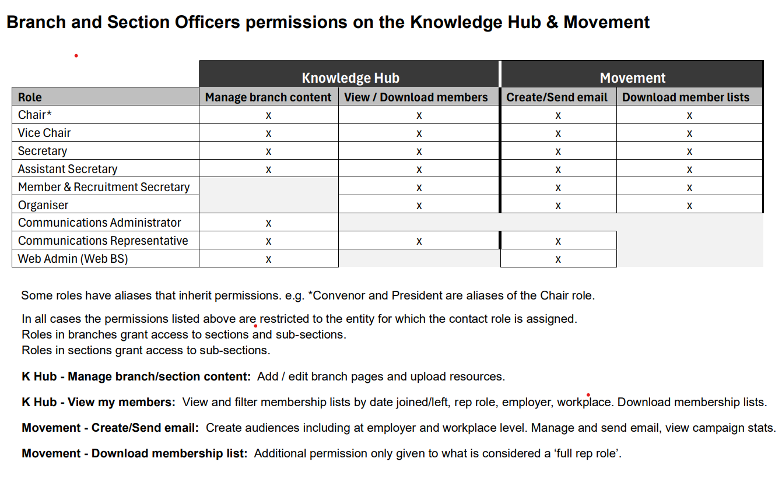

Slide 22
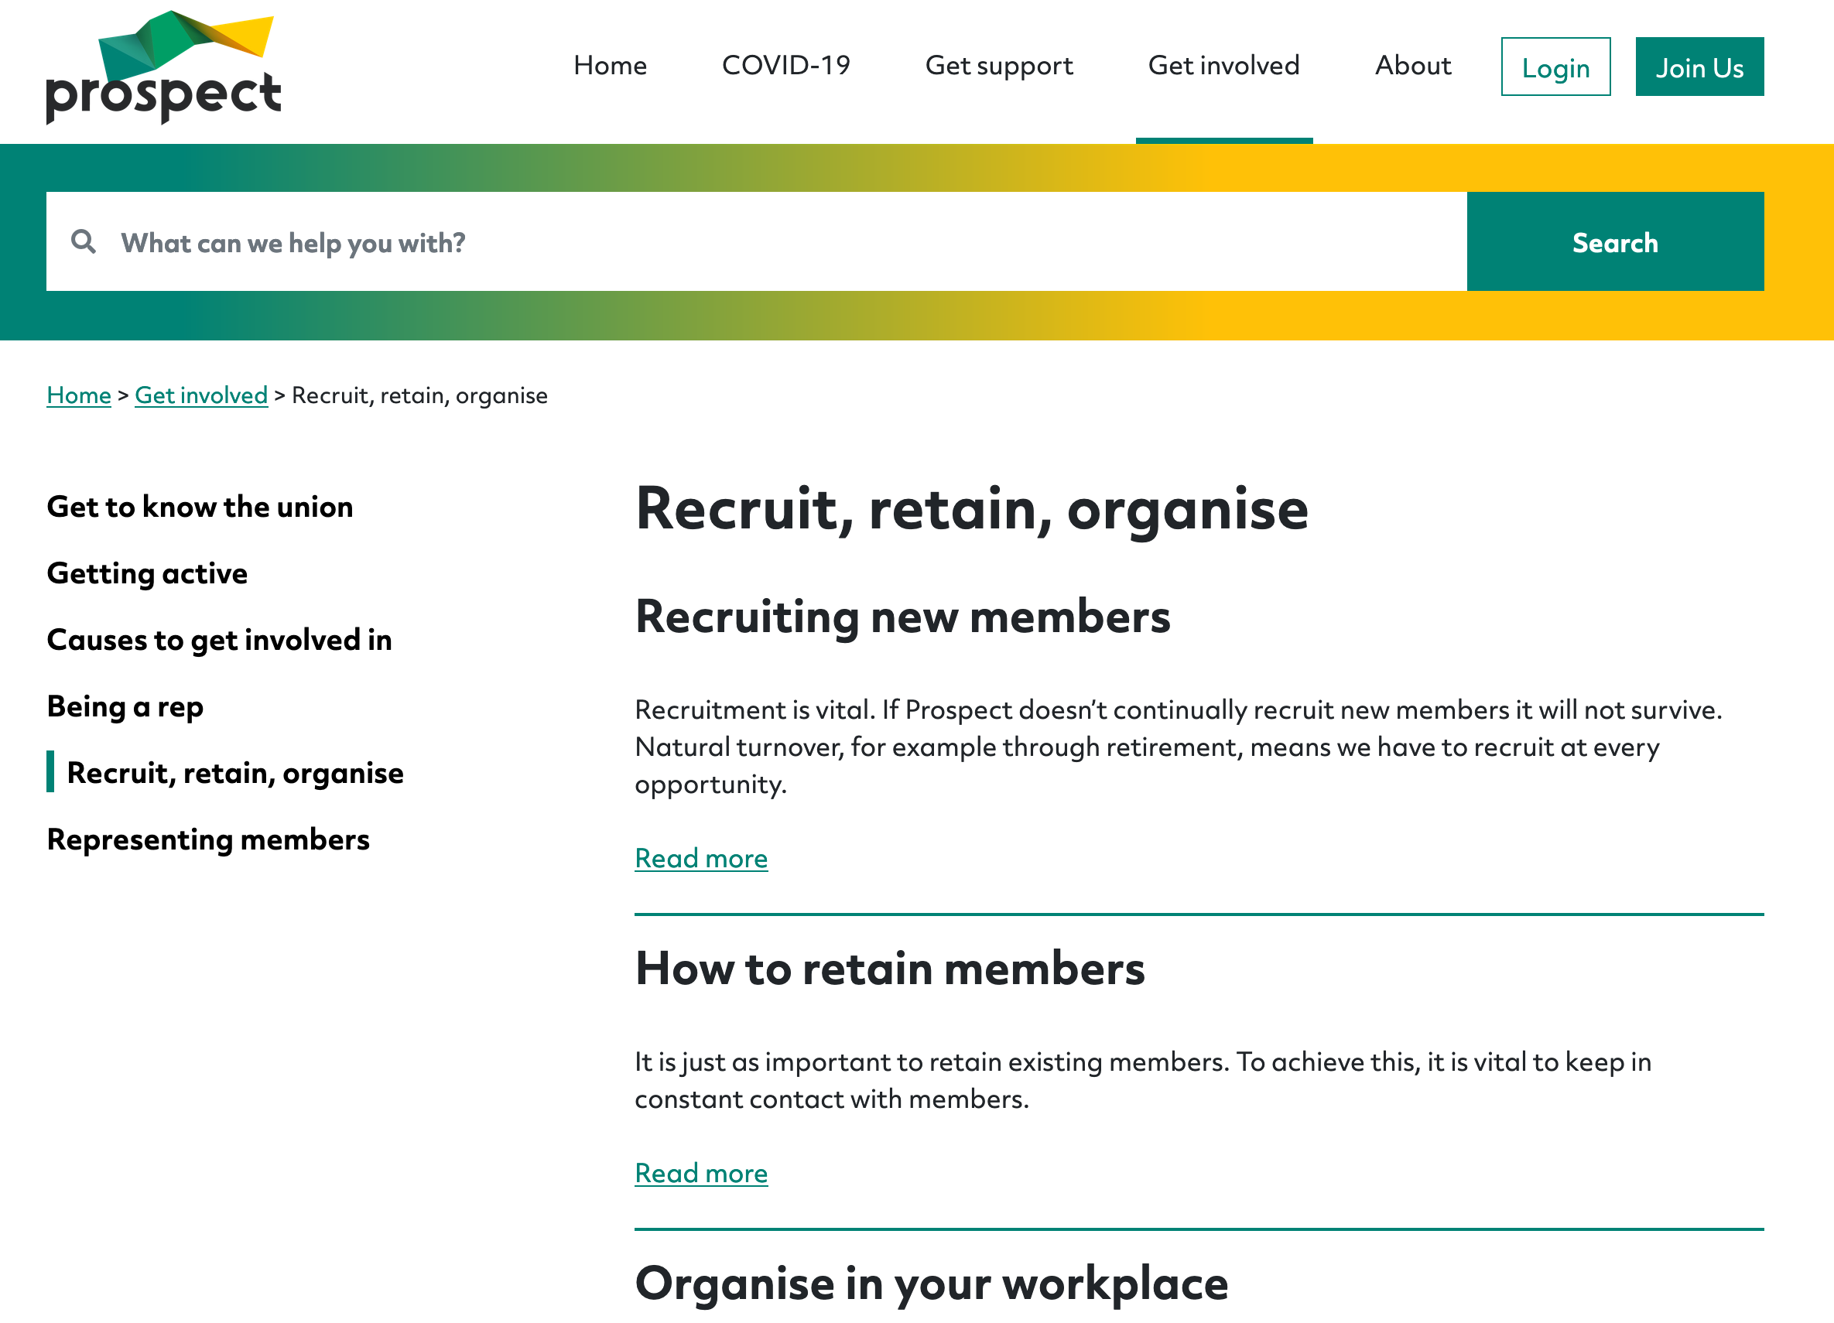
Prospect/Bectu Websites: public site
Shop window
Clear design
Profiling multi-sector work
Information on Networks
Ambition page:
prospect.org.uk/about/ambition/
Notes:
Talk through ambition page

Slide 23
Your Websites:
Shop window (non-members access?
They should have:
Clear design
Linked to Prospect/Bectu
Could use Ambition Page templates
Notes:
They reach the right audience at the right time
Can be understood by everyone.
Get people to take action
Accessible
User focused
The main piece of information here is to show and share the ambition page and resources reps have access to. (10 mins)
Mention Megaphone (TUC overview so outreach to all union members)

Slide 24
Union Inductions
Get permission from employer
Aimed at new starters (no assumptions)
Short and snappy (20 mins absolute max)
Use your checklist
Who is who / where can you find them?
How to join (special offers if applicable)
Overview of main benefits/local wins.
Notes:
Union induction – checklist – see the checklist on the course resources (5 mins)
Mention 3 months free and Member recruit member.

Slide 25
Recap
Pros/Cons of your own website/Social media?
Consider GDPR….
What to do after an induction?
'Shadow tech’ Is this software safe to use?
Notes:
Recap on what is important when formulating comms.

Slide 26
Social Media: best practice
Don’t say anything on social which you wouldn’t say in a workplace!
Sense check it if you’re not sure
Do be human, sardonic, fun and responsibly reactive. Social media never works if it’s too staid. Mix your scheduled posts in with some reactive ones too so you’re ‘on the story.’

Slide 27
4 steps
Step One – consistency
Step Two - engagement
Step Three – tone of voice
Step Four – go where your audience is….
Notes:
Reminder of four steps of Social media use.

Slide 28
Accessibility
Use a readable font size – at least 12pt
Use plain language – clear, concise and precise
Use good colour contrasts
Make your hyperlinks descriptive
Describe images and use transcripts for videos

Slide 29
Social Media
Reaching new audiences and potential members through regular posting
Scheduling posts
Promote engagement - reposting/reactive sharing tree
Different tone for different platforms
Go where your audience is

Slide 30
Surveys and getting your voice heard
Use surveys to get branch opinion
Survey potential members to find out issues you can organise around.
No longer than 10 mins to complete, 2-week roll-out.
Key is feeding back to participants

Slide 31
Creating newsletters
Digital newsletters allow you to be flexible – one big ticket item, or several small updates
A good newsletter has a human-interest story and a call to action
Use Movement for essential comms
Strong subject line, scheduling, when is it landing?

Slide 32
Activity E
Story writing
Look over this passage and in pairs/small groups, create the following;
A social media post
A headline
A blog
Notes:
Some of the basic principles in terms of putting together an interesting news story – how to separate the unnecessary detail to create something to captivate your members.
Divide the group into 3x3’s then give 15 mins for this activity.
Read through the passage on page 42 and formulate the following:
A media post,
A headline
A blog
5-8 mins for the activity
3-5mins to feedback (take 1 example from each group)

Slide 33
Recap
Communications and the rep role
Representing the union
Keep all communications professional
Use the templates and resources on the Prospect/Bectu website
Listen to your members
Notes:
Recap on the comms role & expectation (remind about no legislation for comms reps – what would fall into duty/activity
Run over the fact that comms reps don’t have legislative rights – so we should be creative to use them as our way of keeping members informed

Slide 34
Union influence & the comms rep role.
Recap on why ingredients are all required to make a successful union.
Virtuous Circle.
Notes:
Page 42
Explain the benefits of each ingredient.
• Membership density, It is very important that reps realise, without enough members the management will not take the union seriously and could look to de-recognise the union.
• Engaged members, it is very unlikely that any issues will get resolved if the member are not involved or care Virtuous circle
• Visible Profile, the management will conveniently forget to consult if they never see a union presence. Why would a non-member join something they never see or hear about
• Dialogue, the need to have good lines of communication to members and management is necessary to make things happen
• Representative membership, If members don’t feel they have a voice, their membership will be their first cost saving when they look at it
Representatives - with input, forgotten workforce, seeing no value to TU, nothing will get done, low membership, no activity
• In case it hasn’t been covered, ask how these ingredients sustain each other.
What’s the role of the rep in all this?
The virtuous circle & communication

Slide 35
Next steps
What is your branch up to?
Health Check – follow up;
How well do you think your branch communications are working?
Are you reaching the right people?
What does success look like?
Notes:
Ensure everyone has a clear focus on their action plan when going back into the workplace/ready for organiser follow up.
What will they stop, continue or start to do
What does success look like in your branch, Communication agenda? What’s to improve?

Slide 36
Plan of action
Ideas to produce a communication branch plan!
Notes:
Run through the plan and recap on everything we focussed on so reps know how to complete.
Talk about what happens now.
Page 43

Slide 37
Any questions?

