Slide 1
A rep’s rights
Session 5
Notes:
Outcomes to be achieved:
To add confidence to reps when embarking on the role, most new reps want to know what they and can’t do. This next section clarifies the legal rights of a rep and in accordance with the TULR©A ACT; based on the ACAS guidance for time off for representatives – also known as facility time the categories and how they are divided.
Feedback on homework;
Looking at Activity K; what is the response from reps on their scales of 1-10. If reps state 10 for their answers, why do they feel it warrants a 10? What are they doing?

Slide 2
Your legal rights and responsibilities
Your legal rights come under the Trade Union and Labour Relations (Consolidation) Act 1992.
Under section 199 of the Trade Union and Labour Relations (Consolidation) Act 1992 the Advisory, Conciliation and Arbitration Service (Acas) has a duty to provide practical guidance on the time off to be permitted by an employer
ACAS Code of Practice 3
Notes:
Outcome to be achieved: learn where these laws come from.
it may be that if you H&S reps you need to mention the brown book
The link is in your book to download the code of practice 3
The rights of a rep are split broadly to into two categories; duties and activities.

Slide 3
Duties
Employees who are union representatives of an independent trade union recognised by their employer are to be permitted reasonable paid time off during working hours to carry out certain trade union duties.
Examples are: pay negotiations, consultation on restructuring, or representing an individual member in a grievance. These tasks also include time to prepare for these duties and to do other things "concerned with" them (eg briefing and consulting members before and after meetings with management, or branch committee meetings to discuss such issues).
Notes:
Outcome to be achieved:
The rights of a rep are split broadly to into two categories; duties and activities.
What is a duty? As listed on slide……. Anything that benefits the employer/ reps need to inform/consult or negotiate on
Reasonable paid time off by employer in recognised workplace.

Slide 4
Activities
Union reps are entitled to reasonable time off during working hours to carry out certain trade union activities, which are seen as different from duties.
In essence, the law recognises that unions need the participation of their members to operate effectively.
Activities might include: attending meetings to discuss internal union business, organising union elections.
Notes:
Outcome to be achieved:
Reps are entitled to reasonable time off to carry out certain trade union duties. The law recognises that unions need the participation of their members and so activities are to allow reps time for this. E.G recruitment. This time although entitled is more often unpaid.
It is important that reps understand that the ACAS guidance is the minimum expected but reps need to check their own agreement as the facility time may be better.

Slide 5
Responsibilities
A Union rep has to inform the employer when they wish paid time off to undertake trade union duties or activities.
The procedure would normally found in the facilities agreement or in the recognition agreement.
This should provide clear guidelines on how a rep applies for time off.
Time for training can be declined as there is no cover, but a reasonable request can’t keep being denied.
Notes:
Outcome to be achieved:
A rep should always try to build good relationship with their manager to show they are professional in their role, this includes keeping the employer informed if they need facility time.

Slide 6

Activity F : What are your rights?
Working together in a big group, for the following examples, come up with what are the reps rights and what they can check to confirm this?
What other options are there?
Notes:
Outcome to be achieved:
Using the information on the previous slides, look at the word doc with the headings and decide as a group which examples would fit under which headings. Examples on page 28 of workbook.
There is another template form for activity F in the training resources – this has all the answers added already (but with two red herrings), if short for time I would encourage tutor to use this version. It’s had very good feedback from Reps.

Slide 7
Activity G: What would you do if?
As a big group look at the situations and decide what can be done.
Notes:
Do this activity as big group face to face
Outcome to be achieved:
Much of your role initially will be signposting or finding out information. However, there are instances where you can assist whilst you build up your knowledge and understanding. Here are some scenarios (page 29/30 in workbook) as a group discuss what you might do as a rep……….
Remind reps they are not trained to deal with personal cases but can advise and signpost queries.

Slide 8
Ingredients of union influence
Session 6
Notes:
Outcomes to be achieved:

Slide 9
Ingredients
Membership density
Engaged members
Visible Profile
Constructive Dialogue
Representative membership
Representatives
Equality & Diversity
Notes:
Outcome to be achieved: learn what different roles there are in the branch
Density – proportion of members to help campaign./add their voice
Engaged members – keeping information relevant and specific, timely and useful.
Visible profile – is the union visible in the workplace, if you started a job tomorrow, would you know how to join the union?
Constructive dialogue – do you listen to members? Do you have opportunities to discuss issues? Is it worthwhile conversation?
Representative membership – Does every member in your branch have a say – or a rep to speak on their behalf. If you have a large percentage of under 35’s – do you/have you elected a young members rep? To ensure the proportion of the memberships’ voice is heard.
Representatives – Key role in the communications between the employer and the members and the union and it’s members. Supporting/advisory roles.
Equality and Diversity. – Encourage reps that this should be paramount in their thinking in line with union values. A key benefit to demonstrate to members – improving conditions for all.

Slide 10
The virtuous circle
Growing Membership
Members set and support union’s negotiating priorities
Negotiations deliver results
Encourages others to join
Notes:
Outcome to be achieved: learn how you need all the ingredients to make a strong branch
When the virtuous circle is working effectively members can see the benefit of being part of the union and they take that message with them – whatever company they work for in the future.
Effective local organisation – meaning reps like you – stands at the heart of Prospect’s ability to keep the virtuous circle going. Local union reps…
are the union’s eyes and ears, picking up issues that matter to members and can be resolved by negotiation.
are the union’s voice in the workplace, getting members involved in new campaigns and keeping them informed about on-going negotiations.
give the union a positive profile – visible on notice boards, identified with important issues.
grow the union by talking about joining to colleagues who are not yet in Prospect
keep members in touch with the wider union, eg by organising meetings and events with visiting speakers from beyond the branch.
A really important task for everyone involved in Prospect’s activities is to feed members’ views, queries, concerns and ideas back to Prospect – keeping the union in touch with members.

Slide 11
Building a stronger union
Session 7
Notes:
Outcomes to be achieved:

Slide 12
Activity L: Chart your work area
The tutor will provide a scenario for you (in workbooks) Activity L
Devise a strategy to organise the members of each department and effectively feedback to management.
Consider the following points.
How can the branch co-ordinate dialogue between the various departments?
How can the branch use this consultation for recruitment?
What message do the branch want to communicate to the management?
Notes:
As the tutor we would suggest dividing the group to have 1 or 2 reps to look over each department and pick out the key findings.
NOTE; The second proposal is the same amount of hours for staff but over a 10 day rolling rota rather than a 5 day rolling rota.
We want reps to identify the following.
find out where members are and the strength in the workplace, areas which could be improved in terms of membership.
What can they do to engage members further?
Highlight the two different proposed changes and would this change their approach to management. We would suggest using a working party as two proposals affect different groups – who would be on the working party (ideally one from each department – won’t always necessarily need to be the rep)
How would their members feel about the first proposal?
How many members are affected negatively by the second proposal for operations – two reps in the department but differing views – would this provide a balanced view. (What do we think of Martha’s viewpoint as the rep? Perhaps working on her own agenda of trying to increase pay rather than thinking of the work/life balance)
What if there is a well-being policy within the workplace?
Can anyone be identified as a potential rep/advocate for the union?
Things to remember when recruiting/then mapping the workplace… Pitfalls to doing this; membership list is only updated on the information members have given to us e.g. if a member has left they won’t necessarily let Prospect/Bectu know and so they may still show on the membership list.
The list is private and confidential/any notes you make about members/non- members need to be kept very securely. Not every member wants to be known and you’ll have to show some discretion in your work as a rep (hence the ebranch and the list of members most GDPR compliant way of contact members.
Always be wary of GDPR, if members have expressed a wish no to be contacted, we have to honour that as part of the consent on the application forms.
(use points on p38 to help)

Slide 13
Task
Find out the name of the branch chair and engage in conversation about recognition/ facilities agreements and what they can negotiate, be informed and consult on. Find out the name of the branch secretary. Find out the names of the committee members, and when they meet.
Find out the name of your organiser. Find out the name of your negotiations officer.
Sign up to the Prospect or Bectu website and view your branch’s electronic communications.
Reflecting on activity D and activity K, how could you improve how your branch is organised? Does your branch have a development plan?
After attending this course, what will you stop doing?
After attending this course, what will you continue to do?
Based on your new knowledge, what three practical things will you do? 1. 2. 3.
Notes:
Go over the action plan and ensure reps are clear on the task. To complete, where possible before the follow up with the organiser.

Slide 14
What next?
Reps part 2 (Case Handler)runs over 3 mornings Tuesday – Thursday in one week, running 3-4 times monthly.
Negotiation Skills – runs over 3 mornings, Tuesday – Thursday, in one week, running 3-4 times a year online (as demand requires
Health and Safety (running once a month over 4 sessions)
Public Speaking (running 3 session prior to conference)
Further details;
https://prospect.org.uk/training-for-reps/ or contact your Prospect Organiser.

Slide 15
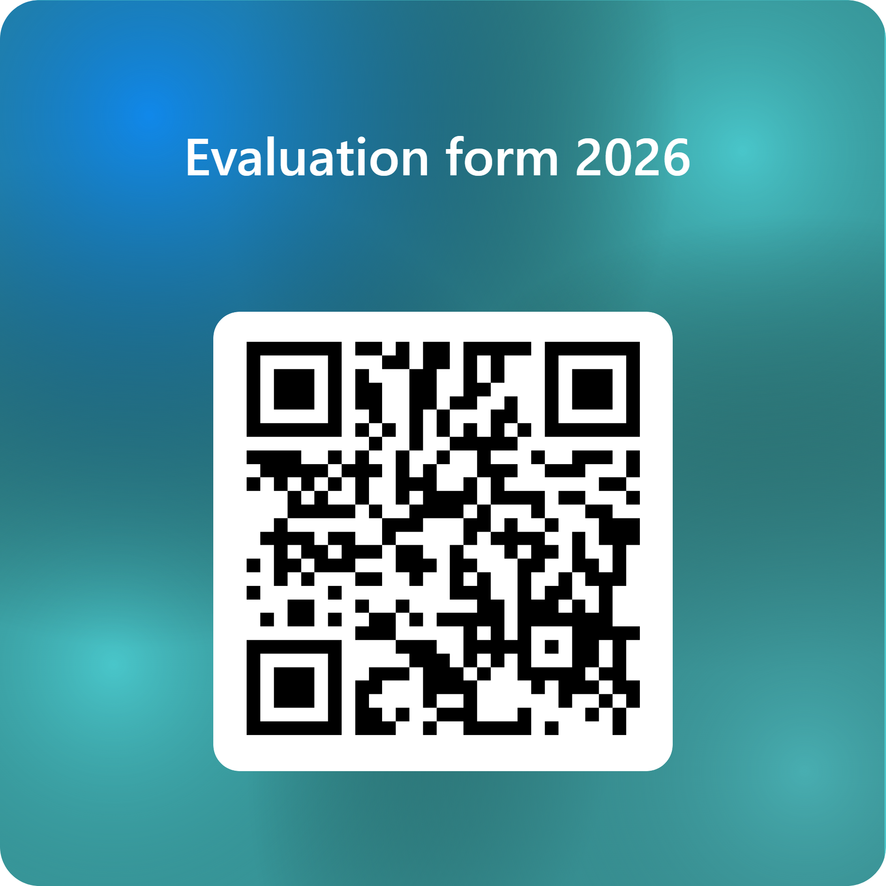
Evaluation
Evaluation form 2026 – Fill in form

Slide 16

Questions?

