Slide 1
Introduction to Equality
Notes:
Introduce name and pronouns

Slide 2
Overview of session
Structure of today’s session:
    Introduction
    Part 1: An overview of discrimination & inequality in UK workplaces
    Part 2: What the law says
    Part 3: Taking action: campaigning and organising around equality issues in your workplace
Notes:
Structure of today’s session:
Introduction (10 mins)

Slide 3
Learning outcomes
Key learning outcomes:
  Understand some of the key equality issues in UK workplaces today
  Understand key provisions in the Equality Act relating to discrimination
  Understand why trade union members have a key role in equality & ways to start getting active
Notes:
Assumes no prior knowledge
Introductory
Interactive

Slide 4
A note on language
Sensitivity to language use is critical
Think about inclusivity of language you use
Be prepared to listen and learn…
…but don’t let language be a barrier, ok to make mistakes
Notes:
Course pack includes language glossary
We are role models
Language is dynamic and is constantly changing
Being a good ally and supporter means committing to keeping up! Do you own reading and research. Be curious!
Its ok to get words wrong but its how you proceed. Apologise and keep learning!!
Even though language may change and move it is up to people how they ‘self identify’. Identity belongs to you, and you only.

Slide 5
Introductions
What is your name/pro noun (optional)?
Where you currently work?
What is your union role?
Notes:
If you have a large group ask people to introduce themselves in the chat.

Slide 6
Do not edit
How to change the design
what are your aims for today?
The Slido app must be installed on every computer you’re presenting from

Slide 7
Part 1:
Workplace issues

Slide 8
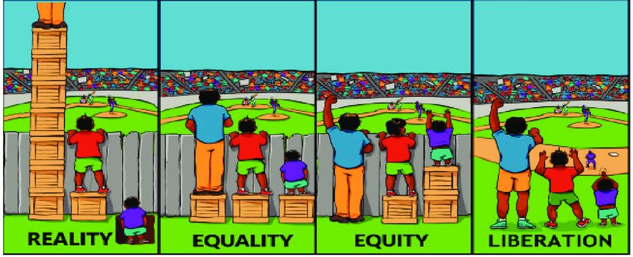
Part 1: Workplace issues
Social Model of Disability: Language | Disability Rights UK
Notes:
We all have a vital role in promoting equality: ​
• by negotiating policies and procedures that advance equality and diversity ​
• challenging examples of discrimination, harassment and bullying in the workplace and dealing with all members’ complaints effectively and promptly ​
• by acting as a role model in their treatment of others​
• and in helping to create a workplace in which everyone can participate fully ​
​
Can anyone explain what the image it telling us? ​
​
Terms that we use everyday such as equality and inclusion still carry a sense of people being outside the current system and that to make things equal or include them, we will tweak things.
Thinking about equality using an intersectional approach (more on this later), we understand that liberation cannot exclude anyone in the first instance. ​ Give the example of the social model of disability which tell us that if the workplace was accessible in the first place, barriers would not exist and we wouldn’t need ‘boxes’ to stand on. Social Model of Disability: Language | Disability Rights UK
With the Introduction of Statutory Equality Reps in October unions will have more influence within workplaces to further their equality aims to make workplaces more inclusive and start to move closer to the liberation model buy including groups of people from the start. Proud Employers | Stonewall UK

Slide 9
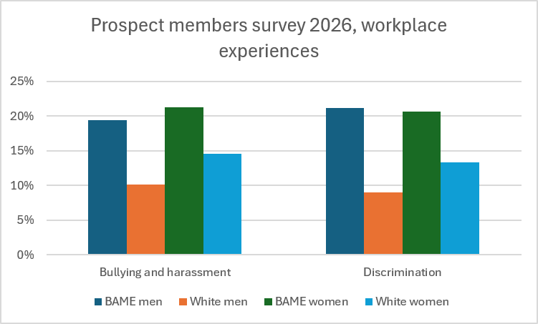
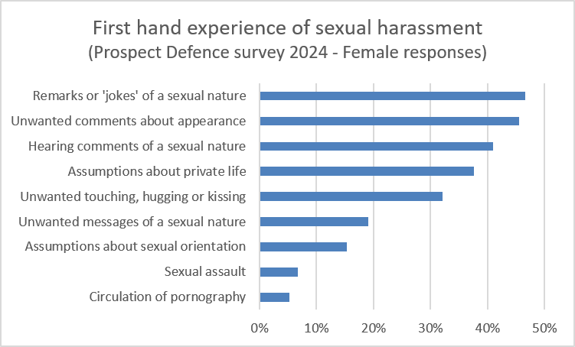
Bullying and harassment
Notes:
You ask people for there observations. From the stats it tells us that you are
Most likely to be bullied if you are a black women or a black man
You more likely to be discriminated against if you are a black man and a black woman. Make the point that discrimination takes many forms some more obvious that others. We will look at these
One form of discrimination is harassment and specifically sexual harassment. As you can see from the most recent survey carried out by prospect members incidents of a sexual nature still score very highly and have recently been described by the Office of National Statistics as ‘every day’.
9

Slide 10


Recruitment and progression
Centre for Social Investigation (2019) Are employers in Britain discriminating against ethnic minorities?
Notes:
The statistics are looking at ethnicity and sex (men/women). What do the stats tell us?
More likely to be successful at entry level if you are white compared to other non white groups.
Only 11% of engineers are women
That drops to only 8% of women are high earning engineers.
There are equality barriers such as career breaks for child birth that prevent progression
This leads to an increased percentage of women engineers being lower earners
The reason the percentage is only 16% is that there are so few female engineers to start with, it would not be possible to get a much higher percentage.

Slide 11
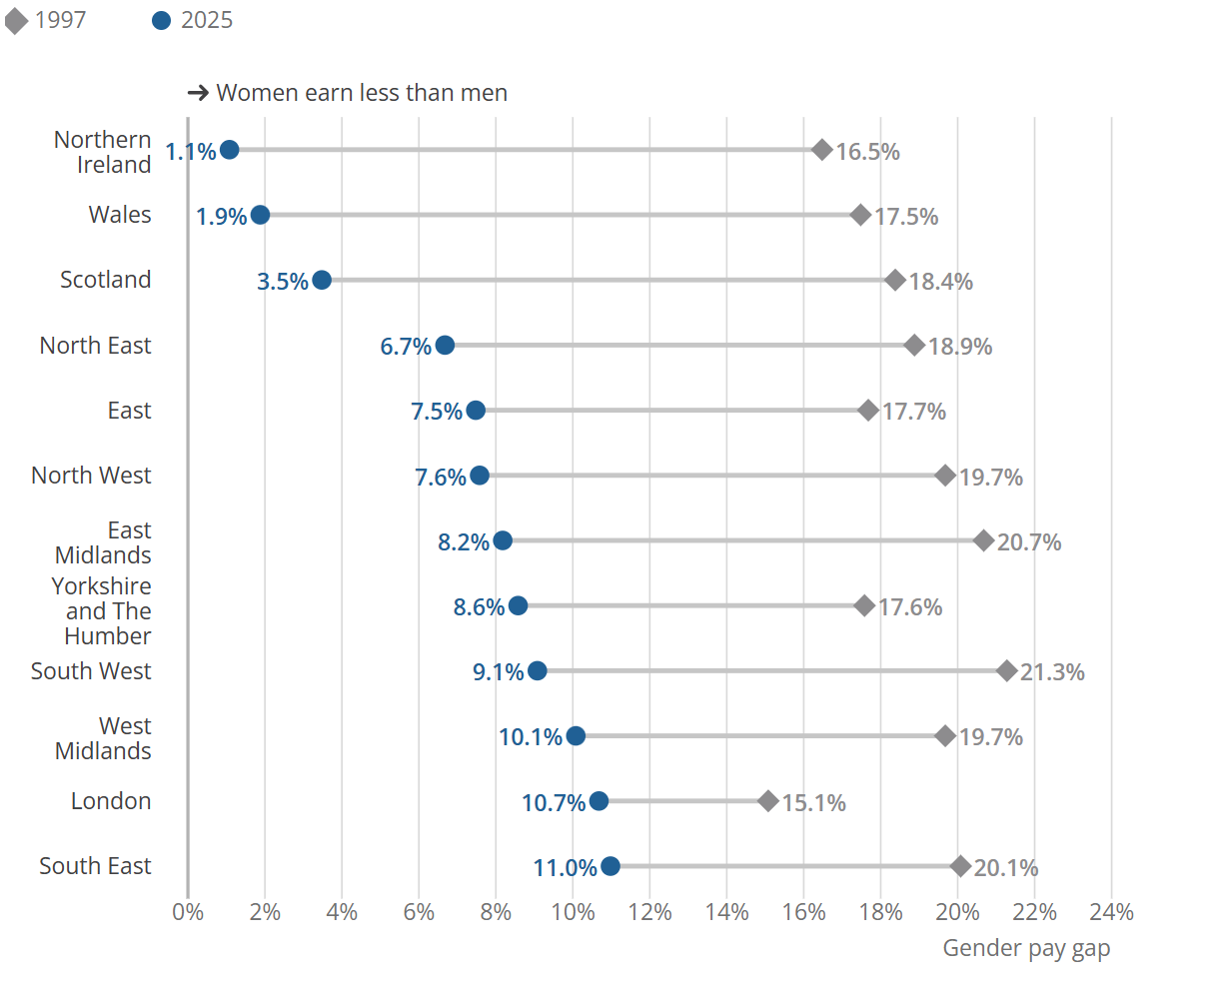
Pay
The gender pay gap is higher in all English regions than in Scotland, Wales or Northern Ireland
Notes:
Gender pay gap for median gross hourly earnings (excluding overtime) for full-time employees, by work region, UK, April 1997 and 2025
Interesting spread of results by region. Wales and Scotland have stronger duties in relation to closing the gender pays.
Why does the gap get bigger in specific regions?

Slide 12
Notes:
Government has been consulting on disability and ethnicity pay gap reporting – superficially similar to gender pay gap, BUT…
Can you sensibly aggregate a disability pay gap for workers with anxiety or depression with that for autistic workers?
How do you deal with workers with both (plus others)?
Can we sensibly expect an employer to disaggregate by ‘main impairment type? How would this look in the Employer X data?

Slide 13
Do not edit
How to change the design
What are the current equality issues at your workplace?
The Slido app must be installed on every computer you’re presenting from
Notes:
Have a break after this.

Slide 14
Part 2:
What the law says

Slide 15
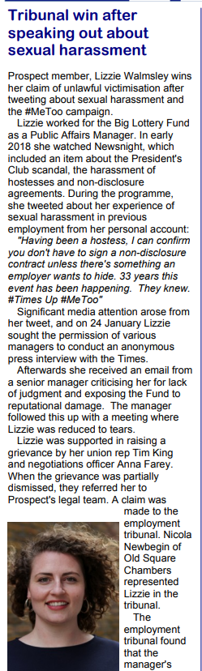
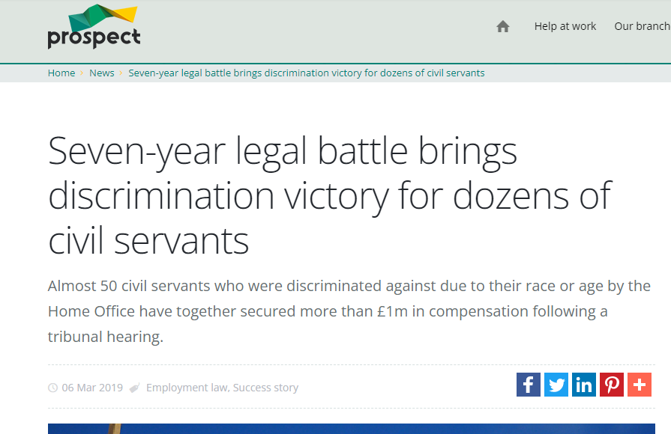
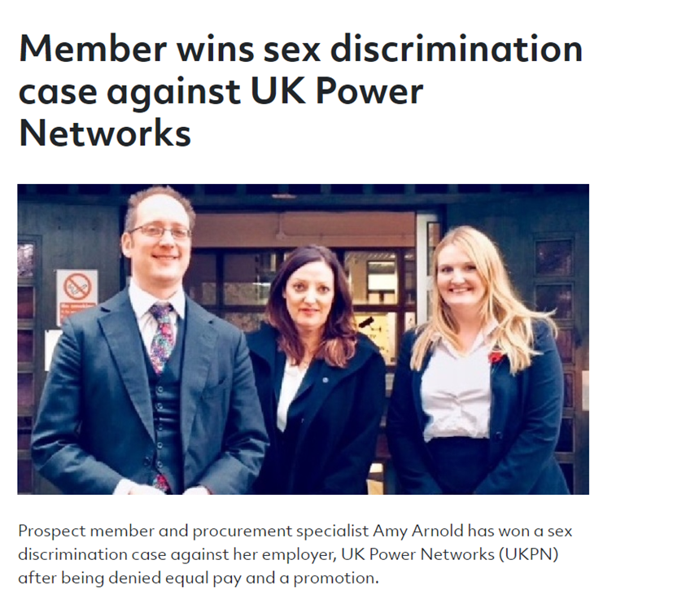
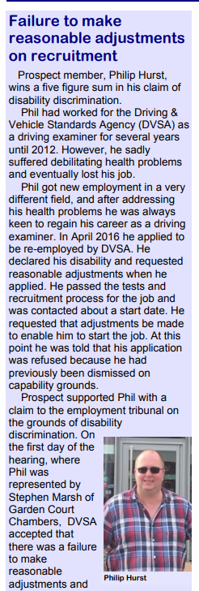
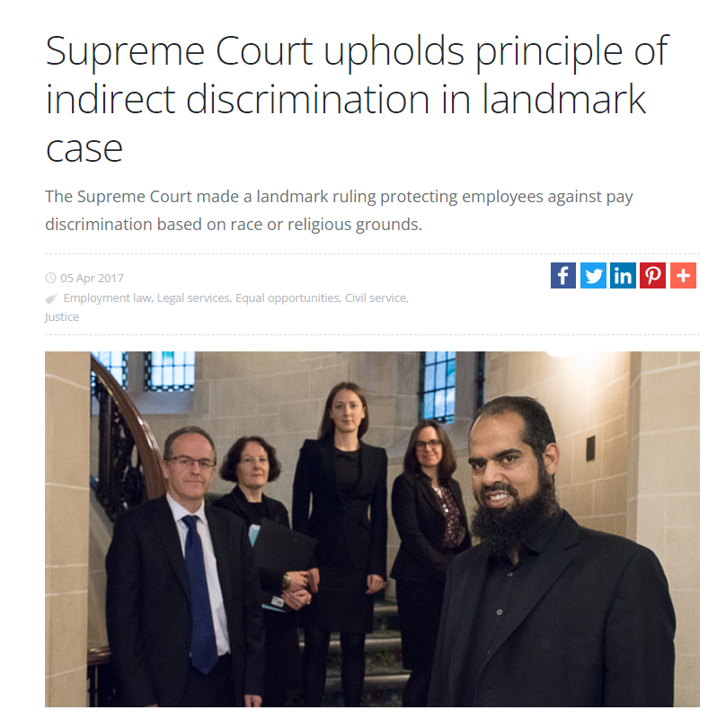
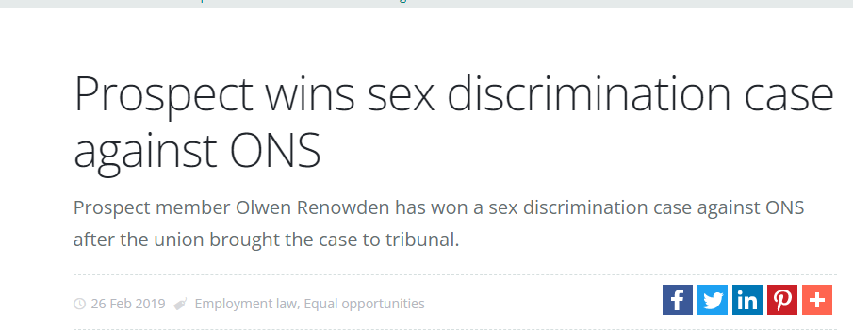
Notes:
Just give the headlines on these stories:
Lizzie Walmsley v Big Lottery Fund - In early 2018 watched Newsnight which included an item about the Presidents Club. The programme included the treatment of hostesses and the use of non-disclosure agreements where there had been allegations of sexual harassment. While the programme was on, Lizzie tweeted from her personal account: “Having been a hostess, I can confirm you don’t have to sign a non-disclosure contract unless there’s something an employer wants to hide. 33 years this event has been happening. They knew. #TimesUp #PresidentsClub #MeToo #Newsnight” There was significant media attention and on 24 January Lizzie sought the permission of various managers to conduct an anonymous press interview, which she subsequently gave to The Times. She received an email from a senior manager criticising her for lack of judgment in trusting journalists, the potential exposure of the Big Lottery Fund and breaches of Big Lottery Fund’s ethics and social media policies. This was followed up by a meeting with the same manager at which Lizzie was reduced to tears. The employment tribunal found that the manager’s conduct, the manner of the meeting and the email were unacceptable and Lizzie was therefore disadvantaged and her sense of grievance justified.
Graham Dean v Home Office - Almost 50 civil servants who were discriminated against due to their race or age by the Home Office have together secured more than £1m in compensation following a tribunal hearing. This tribunal came about after a successful case taken by Prospect in 2012. Prospect had won an employment tribunal claim against the Home Office for our member Graham Dean. The Home Office used a Core Skills Assessment (CSA) for determining promotion. Graham had failed the CSA test four times despite commendations for promotion from his managers. The evidence showed that a disproportionate number of Black, Asian and Minority Ethnic (BAME) and older workers failed the test.
The employment tribunal ruled that Graham had been subjected to unlawful indirect discrimination on grounds of his race and age. Graham was then promoted without needing to complete the CSA and the CSA was changed for the future. But the change wasn’t applied to other staff, who had previously been affected by the test. Forty seven further cases were presented by members of PCS and Prospect. PCS members, who were supported by Thompsons Solicitors, were the test cases.
Despite having already lost the tribunal for Graham Dean, the Home Office robustly resisted the new claims. And the case went all the way to the Supreme Court (under the lead name of Essop & others).
The case was joined with Prospect’s Supreme Court case for Mohammad Naeem against the Prison Service, as both cases looked at what should be the correct approach for determining indirect discrimination.
The union cases won in the Supreme Court and the Home Office case was sent back to the employment tribunal for hearing.
The three-week hearing started on 18 March, but after the first couple of days the Home Office agreed to settle all the claims without admission of liability and to pay the 47 claimants £22,000 each – totalling more than £1m.
Amy Arnold v UKPN - Procurement specialist Amy Arnold has won a sex discrimination case against her employer, UK Power Networks (UKPN) after being denied equal pay and a promotion. After starting at the company, Amy became aware that she was being paid substantially less than male graduate trainees, who were doing the same work as her. She raised a grievance and was eventually awarded an increase in pay. Shortly after this she applied for promotion. Her application was rejected despite her being well qualified and suited to the job. Prospect supported her in bringing a tribunal claim. A Norwich employment tribunal found that a man who was less qualified and less experienced was given the job that she had applied for. The judge said she had been discriminated against on grounds of sex and victimised for making a complaint about equal pay with her employer.
Olwen Renowden v ONS - After her appointment in 2016 Olwen noted quite early on that there were no female economists at Grade 6, despite a headcount of over 114 economists. In February 2017 two Grade 6 posts were advertised. Olwen was the only candidate who had been previously employed at this grade and who had strong academic and professional credentials from some of the world’s most prestigious macro-economics employers, such as the Bank of England, and the IMF, in addition to holding various senior Whitehall posts. One other female employee applied for the roles, who had an equally impressive CV and managerial experience. Olwen was rejected for both posts in April 2017 and was told that she had failed to get an interview for either role. She contacted management to request an explanation but none was forthcoming, other than in the form of a suggestion that she contact HR.
In June 2017 it was announced that the successful candidates were both male – young, inexperienced, neither had been employed at G6 level previously, neither had a specialisation in macro-economics. These candidates had less than six years’ professional experience in economics each, versus the 20+ years’ of the female candidates. Further to these appointments came the announcement that a third post had been created – again with no advertisement. The ONS claimed that the third post had been created to create opportunity for male candidates who had passed the Grade 6 promotion board, and yet no such corresponding opportunity was made available for any female candidates who had also passed the Grade 6 promotion board. Olwen raised a grievance which was not upheld. She resigned from the ONS in August 2018. The tribunal agreed that “favouritism” existed towards male staff and that those who should have addressed it, failed to do so, concluding that “the approach to gender balance…pointed towards a culture where discrimination and, in particular, sex discrimination, is not properly understood by those who are required to ensure its elimination”. It went on to add that it was “reasonable to infer that the culture of the respondent is one where advantage and favouritism to males is not recognised as potentially discriminatory”, which significantly highlights the serious cultural problems and issues that Olwen had been trying to raise throughout her employment at the ONS. The tribunal found that Olwen’s claims of direct sex discrimination succeeded and the ONS was ordered to pay compensation and interest.
Philip Hurst v DVSA -

Slide 16
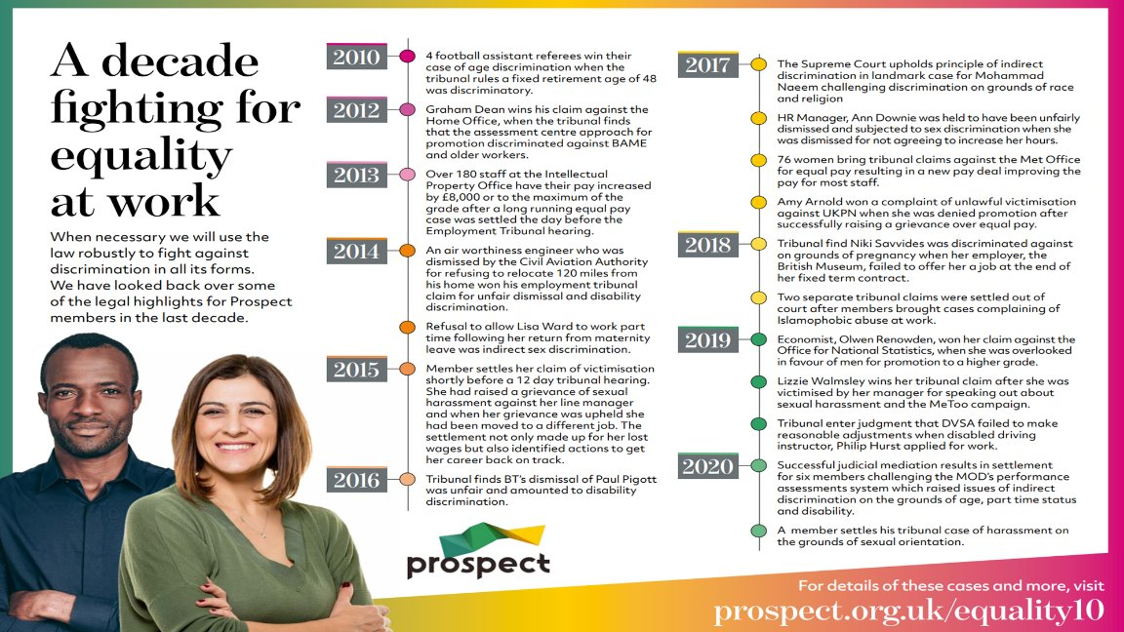
A decade fighting for equality at work | Prospect
Notes:
Pick out a selection of cases to highlight the broad application of the EA2010 e.g. applying to different groups and different types of prohibited conduct (2018 to 2020 seems to cover a number of different situations) which we will move onto in next section.

Slide 17
When might issues of equality/discrimination arise?
Offering employment
Terms on which the employment is offered
By refusing employment
In the terms and conditions
Access to promotion, training, transfer, or other benefits
Dismissal
Harassment
Subjection to any other detriment
Notes:
Please add in any current issues

Slide 18
Protected Characteristics
Discrimination Law Timeline
Age
Disability
Gender reassignment
Marriage & civil partnership
Pregnancy & Maternity
Race
Religion or belief
Sex
Sexual orientation
  Equal Pay Act 1970
  Sex Discrimination Act 1975
Race Relations Act 1976
Disability Discrimination Act 1995
Sexual Orientations Regulations 2003
Religion or Belief Regulations 2003
Age Regulations 2006
The Equality Act 2010
Notes:
The Act applies to employees BUT this has a broader definition than other legislation, with many freelancers, zero hours contract workers and other atypical workers being covered. This is an important difference – the right to claim unfair dismissal/redundancy pay only applies to employees.
In order to bring a claim under the Equality Act, the discriminatory treatment must be linked to one or more protected characteristics. Bad conduct which is not related to a protected characteristic is not covered. Further explanation below:
Age or age group is covered
Disability - physical or psychological – many disabilities are ‘unseen’ or ‘non visible’ also applies to neurodivergent identities and additional learning needs
Gender reassignment – applies to trans people. Outdated term- many groups have campaigned to have the wording changed because if a person wanted to change the sex they were born with and identify as the opposite sex (trans man or trans woman) or neither binary sex so identified as non binary, you do not have to undergo any medical process to do this in law.
Race – can also apply to nationality; country of birth etc. So you can be white for example (Irish; Scottish etc) and still be racially discriminated against.
Belief (if people ask) – subject to Grainger test: The requirements of this test are that the belief in question must:
Be reasonably held. Be a belief as opposed to an opinion. Relate to a weighty and substantial aspect of human life/behaviour.
Have a level of cogency, seriousness, cohesion, and importance. Be worthy of respect in a democratic society. It cannot be incompatible with human dignity and in conflict with the fundamental rights of others.
PCs *3 and 9 = people who identifity with either or both of these protected characteristics ordinarily identify as LGBT+

Slide 19
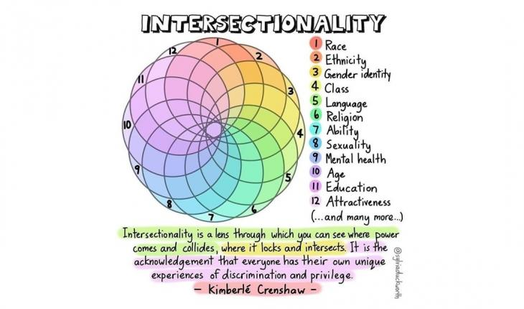
Power, pay gaps and the workplace
Notes:
In the next slide we are going to consider the EA2010 protected characteristics but before we do lets consider intersectionality. Has anyone come across Kimberley Crenshaws work before?
Performative gestures
HR policies are not enough
ethnicity, disability and LGBT+ pay gaps, securing flexible work, banning zero-hours contracts and ensuring accessible workplaces.
The danger of the single story (Chimamanda Ngozi Adichie) Chimamanda Ngozi Adichie: The Danger of a Single Story | TED (to watch in own time)
Who holds the positions of power (& privilege) in your workplaces and how does that affect how the organisation is run?

Slide 20
Prohibited Conduct
Direct discrimination
Indirect
Harassment
Victimisation
Notes:
Just go through – ask reps what each of them are. Definitions are on the following slides with examples.

Slide 21
Direct Discrimination
A person is treated less favourably because of a protected characteristic
Includes discrimination on the grounds of association or perception
The ‘but for’ test
Age discrimination only – subject to test of justification
Notes:
Go through definition
It must be established whether the protected characteristic is the cause of the treatment. There has been significant debate as to the best test to use to answer this question.​
Would that person have been treated that way but for the fact she was a woman, or Asian or disabled. ​
the fact that a claimant's race (or sex) is part of the circumstances in which the treatment complained of occurred, or of the sequence of events leading up to it, does not necessarily mean that it formed part of the ground or reason for that treatment​
In general, in the employment context, it will usually be essential to enquire why the employer acted as they did in order to establish if that treatment was on prohibited grounds. In such cases the but-for test is of no assistance in determining whether or not the treatment amounted to direct discrimination​

Slide 22
Indirect Discrimination
The employer:
Applies a provision criterion or practice to all employees,
Which puts, or would put people sharing a protected characteristic at a disadvantage compared to others,
Which is not a proportionate means of achieving a legitimate aim, and
Puts, or would put, the person at a disadvantage
Notes:
Go through definition
Example: A bus company adopts a policy that all female drivers must re-sit their theory and practical tests every five years to retain their category D licence. Such a policy would amount to direct discrimination because of sex. In contrast, another bus company adopts a policy that drivers on two particular routes must re-sit the theory test. Although this provision is apparently neutral, it turns out that the drivers on these two routes are nearly all women. This could amount to indirect sex discrimination unless the policy can be objectively justified​
​
The contracts for senior buyers at a department store have a mobility clause requiring them to travel at short notice to any part of the world. A female senior buyer with young children considers that the mobility clause puts women at a disadvantage as they are more likely to be the carers of children and so less likely to be able to travel abroad at short notice.​
​
A food manufacturer has a rule that beards are forbidden for people working on the factory floor. Unless it can be objectively justified, this rule may amount to indirect religion or belief discrimination against the Sikh and Muslim workers in the factory. If the aim of the rule is to meet food hygiene or health and safety requirements, this would be legitimate. However, the employer would need to show that the ban on beards is a proportionate means of achieving this aim. When considering whether the policy is justified, the Employment Tribunal is likely to examine closely the reasons given by the employer as to why they cannot fulfil the same food hygiene or health and safety obligations by less discriminatory means, for example by providing a beard mask or snood. ​

Slide 23
Harassment
Harassment is where a person engages in unwanted conduct related to the relevant protected characteristic which has the purpose or effect of:
  Violating that other person’s dignity, or
  Creating an intimidating, hostile, degrading humiliating or offensive environment for them
Employers are liable for unlawful behaviour unless “all reasonable steps” taken to prevent it
Notes:
Go through definition
Tribunal has to apply a subjective and objective test – considering the perception of the claimant – what effect did the unwanted conduct have but also they will consider whether it was reasonable for the conduct to have had that effect.
Employers are liable for unlawful behaviour unless “all reasonable steps” taken to prevent it e.g. proper training in place, process which they apply – evidence that they do apply it etc.
Applies to all protected characteristics except for pregnancy and maternity.

Slide 24
Victimisation
Victimisation is where a person is treated unfavourably because they have:
  Brought proceedings under the law
  Given evidence or information
  Done anything else under the Act
  Alleged that someone has infringed the Act
Notes:
Go through definition
Would cover raising a grievance – if treated unfavourably as a result. Doesn’t matter whether the grievance is upheld or not.
Protects people providing evidence in support of a colleague’s grievance e.g. if a colleague gave witness evidence in relation to a race discrimination/sexual harassment claim for example, they will have protection under the Act if they are treated unfavourably.

Slide 25
Activity – what would you argue here?
C, a police officer, made a complaint that she had been sexually assaulted by a male colleague whilst off duty. Her complaint was not upheld. Subsequently, her name was removed from a list of specialist officers.
Mr English was subjected to homophobic comments from his colleagues, apparently because he had gone to a boarding school and lived in Brighton, even though his colleagues knew he was not gay.
Mr Hussain and his colleagues were Muslim. Their employer introduced a rule that no holidays could be taken during May-July. The Muslim festival of Eid fell in June this year. Employer refused a day off work to celebrate. They took the day anyway and were disciplined.
Notes:
Put reps into groups and allocate one case study per group. 10 mins
Victimisation – unfavourable treatment – being removed from the list; protected act – raising a complaint of sexual harassment. It doesn’t matter that the claimant’s complaint was not upheld. Waters v. Commissioner of Police For The Metropolis
Harassment – doesn’t matter that Claimant is not gay – legal test for harassment is unwanted conduct related to the relevant protected characteristic…
Sometimes participants think this may be perceived discrimination but the colleagues did not think he was gay. English v Thomas Sanderson Ltd
3. Indirect discrimination – PCP is rule that no holidays are taken in May – July. This applies to everyone equally but has disproportionate impact on Muslim colleagues. BUT was it a proportionate means of achieving a legitimate aim. Legitimate aim – continue to provide full service during business period BUT not proportionate – could have let a few workers have one day off over a 3 month period. JH Walker Ltd v Hussain and others
Take a break

Slide 26
Disability Discrimination
Definition of a disabled person:
  Someone who has a physical or mental impairment
  Which has a substantial and long term adverse effect
  On the ability to carry out normal day to day activities
Notes:
Cancer, MS and HIV automatically covered – otherwise definition applies.
Long term – has lasted or is expected to last a year or more.
Normal day to day activities – includes impact on mood, ability to get dressed, prepare food, mobility, concentration, memory etc.
Legal definition not a medical one – i.e. Judge will make determination but medical evidence will be very important.
New additions to the definition are long covid and the menopause

Slide 27
Types of disability discrimination
In addition to the 4 forms of prohibited conduct:-
Failure to make reasonable adjustments
Discrimination arising from a disability
Prohibition on pre-employment health questions
Notes:
3 additional types of discrimination.
Prohibition on pre-employment health questions except:
to find out if reasonable adjustments are needed to enable a disabled job applicant to take part in any assessment
to find out whether a job applicant will be able to carry out an intrinsic part of the job
To find out whether a job applicant has a particular disability where having that disability is an occupational requirement of the job

Slide 28
Reasonable adjustments
The employer must make reasonable adjustments where a disabled person is placed at a substantial disadvantage by:
a provision, criterion or practice applied by the employer, or
a physical feature of the workplace, or
a failure to provide auxiliary aids.
Notes:
Go through definition
What is reasonable?
The tribunal will consider factors such as:
How effective the change will be in avoiding the disadvantage that would otherwise be experienced.
How practical it is for the organisation to make the adjustment.
The cost
The organisations resources and size.
Whether financial support is available to help the organisation.

Slide 29
Activity
1. A nurse took sick leave when she had an seizure at work. Occupational Health recommended that she did not work in direct clinical care or on varying shifts.
A. Altering hours of work
2. A teacher who is registered blind has asked for a classroom assistant to help her.
B. Providing support or supervision
3. An employee with impaired mobility, finds it difficult to travel at rush hour.
C. Acquiring or
modifying equipment
4. A worker with restricted manual dexterity is applying for promotion. The recruitment process includes a written test.
D. Redeployment
E. Modifying assessment procedures
5. A secretary suffers from severe RSI that means she is unable to use a keyboard.
Notes:
Run this as a whole group: reps can answer in chat or unmute
1 – redeployment
2 – providing support or supervision
3 – altering hours of work
4 – modifying assessment procedures
5 – acquiring or modifying equipment

Slide 30
Discrimination arising from a disability
It is unlawful for an employer to treat someone unfavourably because of something arising in consequence of the employee’s disability.
Which is not a proportionate means of achieving a legitimate aim.
For example - An employee is dismissed for a poor attendance record but the reason for their poor attendance is linked to their disability.
Notes:
The following group of slides have been hidden as an optional extra and time dependent. They go into disability discrimination in more detail
Equal Pay will be covered in the Equality Reps course

Slide 31
Example
Ms Houghton worked for the Land Registry
The employer had an annual bonus scheme
Bonuses were not payable to those who had a formal warning about their sickness absence during the year
Ms H had a disability & had received a warning for taking sick leave
LR did not give her a bonus.
Would she win a claim of discrimination arising from a disability?
Notes:
JF

Slide 32
Disability
Sickness absence
Warning for sickness absence
Non-payment of bonus
A disability
Something arising in consequence of
Unfavourable treatment
Notes:
JF

Slide 33
Case study answer
Discrimination arising in consequence of disability claim succeeds
https://assets.publishing.service.gov.uk/media/596cd9c340f0b60a440001cb/Land_Registry_v_Ms_E_Houghton_and_Others_UKEAT_0149_14_BA.pdf
Notes:
The Employment Tribunal found that there was an anomaly in the bonus scheme. Whereas managers had a discretion, having issued a warning for a conduct related matter, to determine that such warning would not affect entitlement to the bonus, if awarded, no such discretion existed in relation to a sick absence warning. The claimants were thus not awarded a bonus. They won their claim of disability discrimination at the ET, the ET saying that non-payment of bonus was the consequence, result, effect or outcome of each claimant's disability and the non-payment to the claimants was disproportionate to achieve the aim of acknowledging employees' contributions towards corporate achievements and specifically to encourage and reward good performance and attendance. The respondent appealed.
The EAT dismissed the appeal. The Employment Tribunal found that in each case the absences leading to the warning were disability related. That type of warning automatically disentitled the claimants to the bonus. That was plainly sufficient to amount to unfavourable treatment (non-payment of the bonus) in consequence of the disability. The Employment Tribunal were also entitled to reject the respondent's justification defence.

Slide 34
Discrimination in pay
Equal pay (EA 2010)
  Like work​
  Work rated as equivalent​
  Work of equal value​
  Covers all contractual terms
Gender Pay Gap Regulations (2017)
    Mean & median pay gap between men and women
    Also: differences in % receiving bonus pay; bonus pay gap; % of men and women in each pay quartile
  Key point: GPG is not the same as equal pay
Notes:
Read through slide
Can view gender pay gap information online – only applies to employers with 250 employees or over.
Material Factor Defence
The employer has a defence to a claim ifthe difference in pay is: –​
Due to a material factor which is not thedifference of sex.​
The factor must be significant and relevantand not tainted by sex discrimination

Slide 35

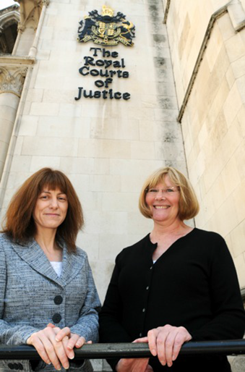

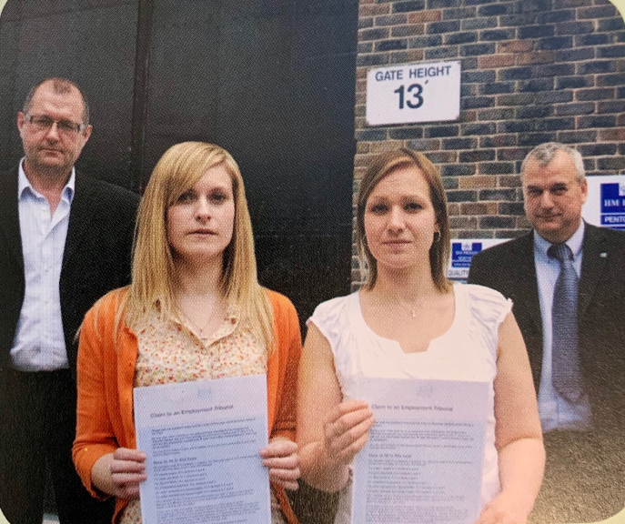
Prospect equal pay cases
Notes:
JF

Slide 36
Is there an equal pay case?
What might be causing unequal pay & what would you look for in the pay structure?
Equal pay - a union perspective
library.prospect.org.uk/download/2019/00834
Notes:
JF

Slide 37
There are many indicators to an equal pay problem. Some points to watch for:
  Opaque pay structures
  Long pay bands
  Discretionary elements of pay
  Impact of performance pay
  Historically male dominated jobs or specialisms
  Gender segregation of roles
  A lack of robust job evaluation
  Individual contracts
  Differences in average pay & by quartiles in pay bands
  Clustering by gender at one end of pay scale
  Impact on part time or a-typical workers
  Check for impact on BAME and disabled workers too
See our newsletter at : Equal pay - a union perspective library.prospect.org.uk/download/2019/00834
Notes:
JF/SH

Slide 38
Time Limits
Ensure a grievance (or appeal) is presented (but this does not extend the time limit)
Strict time limits for bringing a claim to the Employment Tribunal
Most claims 3 months from date of incident giving rise to the claim. Will increase to 6 months in October
Equal pay – 6 months from the end of the contract being complained of
All claims must be presented to ACAS for Early Conciliation before presenting to the tribunal
Notes:
SH

Slide 39
Quiz: test your understanding
Which protected characteristic is missing?
  Age; Sex; Gender reassignment; Marriage/civil partnership; Pregnancy & maternity; Race; Religion or belief; Sexual orientation
Equal pay and the gender pay gap are the same thing – true/false?
The provisions of the Equality Act apply to workers – true/false?
Employers are liable for unlawful behaviour by an employee unless they have taken “all reasonable steps” taken to prevent it – true/false?
Direct discrimination is always unlawful – true/false?
Employers must make reasonable adjustments for disabled workers unless there is a cost involved – true/false?
Notes:
You may not have time for this
1 – Disability
2 – False
3 – True
4 – True
5 – False (age discrimination can be justified)
6 - False

Slide 40
Part 3:
Taking action in your workplace

Slide 41
Public Sector Equality Duty
Applies to most public bodies plus some private and not-for-profits
General duty:
  Eliminate unlawful discrimination
  Advance equality of opportunity
  Foster good relations
Specific duties (vary by UK nation)
Notes:
Read through slide
Public Sector Equality Duty
PSED: outline of key features of the Duty; relatively weak, with limited enforcement in practice, but a potential tool for activists to use
Some successes in using PSED to challenge behaviour of public authorities (e.g. challenging council development plans)

Slide 42

EHRC recommendations on employer good practice:
Have an equality policy
Show leadership on equality issues
Assess the equalities impact of business changes
Monitor equalities outcomes
Regularly engage and consult staff on equality issues
Provide equalities training
Negotiate facilities for equality reps
Notes:
Outlines some of the Equality and Human Rights Commission (EHRC)’s recommendations for good practice by employers; not legal requirements (unless subject to Public Sector Equality Duty (PSED) but help minimise risk of breach of Equality Act
A good example of the EHRC’S work is investigating antisemitism in the Labour party
Enforcement of Equality Act is limited in practice
Workers tend to trust unions more than management
Collective action often faster, more effective
Collective action engages, builds trust
Top-down approach rarely works – need to engage everyone
Trade union members are key to addressing workplace equality issues
The Equality and Human Rights Commission (EHRC) has limited ability to enforce equalities legislation, underfunded and understaffed
Trade union members are well placed to know the issues, and devise good solutions; can leverage collective strength of union members to pressure employers to act
Legal routes to tackling issues can be very important, but can also be long, expensive, and not always lead to satisfactory outcomes
Some issues (e.g. harassment) require a cultural change that legal action alone won’t achieve

Slide 43
Discussion: your workplace
Group activity
What more could your employer do in relation to equality?
What more could the Prospect Bectu branch do to promote and embed equality?
PERFORMANCE MANAGEMENT/
APPRAISALS
PAY AND PENSIONS
WORK-LIFE BALANCE/
HEALTH & SAFETY
BULLYING & HARASSMENT
RESTRUCTURING/REDUNDANCY
Notes:
Put the reps into new groups. Ask them to nominate a chair and a speaker to report back,
Answers could include:
Employer
Consistency and clarity of policies and pay
Paying lip service; ERAs late, removal of networks=created a barrier so not involved; invisible data.
Not! Following their own policies; misuse of passports; not implementing RA
Branch
Galavanise!
More equality reps
FOI of equality data
Create working groups: Sex Har

Slide 44
Where to begin?
Engaging colleagues & raising awareness
Be a good ally – be an active bystander; increase visibility; education; listen and learn
Think about your union branch:
  Do you have equality reps/committee?
  equality a standing agenda item at branch meetings?
  Is your branch representative of the workforce?
  Are you getting a wide spectrum of views/opinions?
  equality part of your bargaining agenda?
  Easy for new members to get involved?

Slide 45
What if your employer won’t act?
  Can you increase the pressure?
    Demonstrate staff concern
    External pressure points
  Can you find allies?
  Can you act without your employer?
    Monitoring/data
    Engagement
    Training/awareness raising
    campaigning

Slide 46
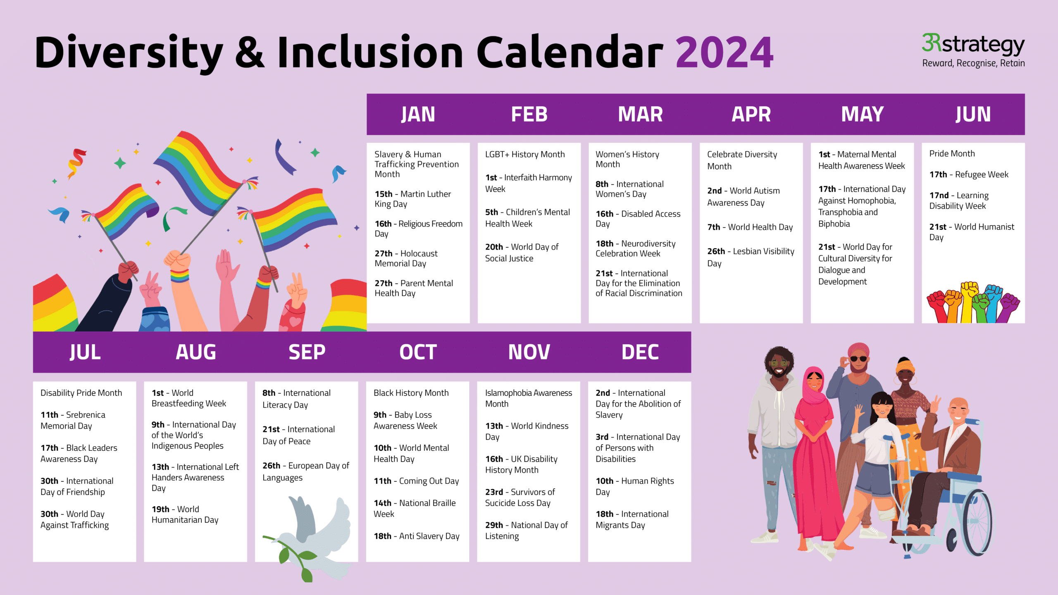
Raising Awareness and running campaigns?
Notes:
Running awareness campaigns – why we need to be aware of these issues etc.
8th march international womens day
10th October world mental health day
February LGBT history month or disability pride in July

Slide 47
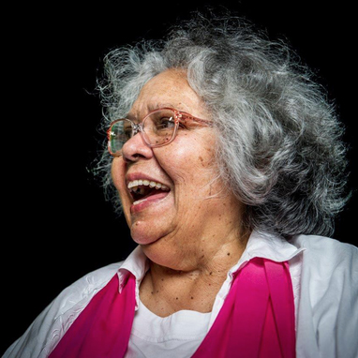
Liberation
If you have come here to help me, you are wasting your time. But if you have come because you understand your liberation is bound up with mine, then let us work together.
Lilla Watson, Academic, Artist and Activist.
A photo of Lilla Watson
Notes:
Tweaking our current system to include people is not enough.
Here we have a quote from Lilla Watson, a Murri or indigenous women from Australia. She understands.
A liberated workplace would be one in which the barriers to participation have been removed and individual adjustments are rarely if ever needed. Where stigma and discrimination are a thing of the past and diversity experience/skills embraced

Slide 48

Next steps
Feedback on this course – what one thing are you going to take away?
Other courses:
  Become an equality rep? London 9th September
  Encourage others to attend intro to equality course
  TUC and ACAS also provide free equality training
Talk to your organiser
Notes:
Evaluation form 2026 – Fill in form

